Slide 1


Slide 2


Digital Tools Course: Digital Alternative Spaces of Learning
Module 1: Introduction to New European Bauhaus (NEB) Principles and Sustainable Design
1.1 Historical context of the Bauhaus movement and the evolution to NEB.
1.2 Key NEB principles: sustainability, aesthetics, inclusivity.
1.3 Introduction to sustainable design concepts and practices.
2023-1-CY01-KA220-HED-000160668

Slide 3
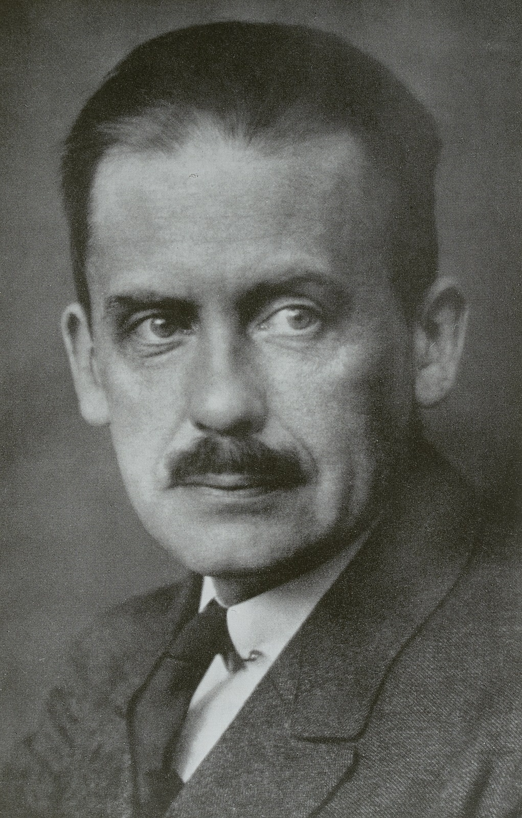
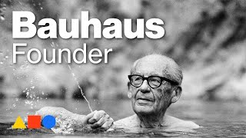
Historical Context: Bauhaus Movement
Origins: Founded by Walter Gropius in Weimar, Germany, in 1919.
Purpose: Integrating art, crafts, and industry to enhance daily life through functional design.
Influence: Focus on simplicity, functionality, and unity of form, impacting global modernist design.
Walter Gropius με Handrick, Roland (Herstellung) (Fotograf) - Deutsche Fotothek, Germany - In Copyright - Educational Use Permitted.
https://www.europeana.eu/item/188/item_7KCTZEYJYKTKAJU4K2KQP3JODQPLOG6F

Slide 4
Bauhaus Core Ideas and Legacy
Core Ideas:
Everyday objects as both beautiful and functional
Use of geometric forms, minimalism, and modern materials
Legacy:
Global spread of Bauhaus ideals after its closure in 1933
Lasting impact on architecture, product design, and art worldwide
FUN FACT: Bauhaus school believed less is more. Their minimalist designs focused on functionality and simplicity, which still influence everything from IKEA furniture to your sleek smartphone today!

Slide 5
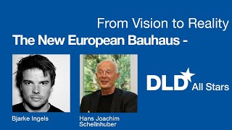
Evolution to the New European Bauhaus (NEB)
Emergence:
Launch: NEB was initiated by the European Commission in 2020.
Purpose: Respond to climate change, social inequality, and digital transformation.
Vision:
Blending sustainability, aesthetics, and inclusivity, aligning with Europe’s Green Deal
Continuity and Change:
Adapting Bauhaus’s art-industry dialogue to include ecological and social priorities

Slide 6

Key NEB Principles: Sustainability
Environmental Responsibility:
Use of eco-friendly materials, energy-efficient processes, and low-impact practices
Circular Economy:
Emphasis on reusing, recycling, and regenerating resources, moving away from “take-make-dispose” models
Photo by Noah Buscher on Unsplash

Slide 7

Key NEB Principles: Aesthetics
Beauty and Functionality:
Encouraging aesthetically pleasing yet practical designs
Cultural Diversity and Expression:
Integrating European cultural heritage, local crafts, and artistic expression into design
Photo by Leo Manjarrez on Unsplash

Slide 8
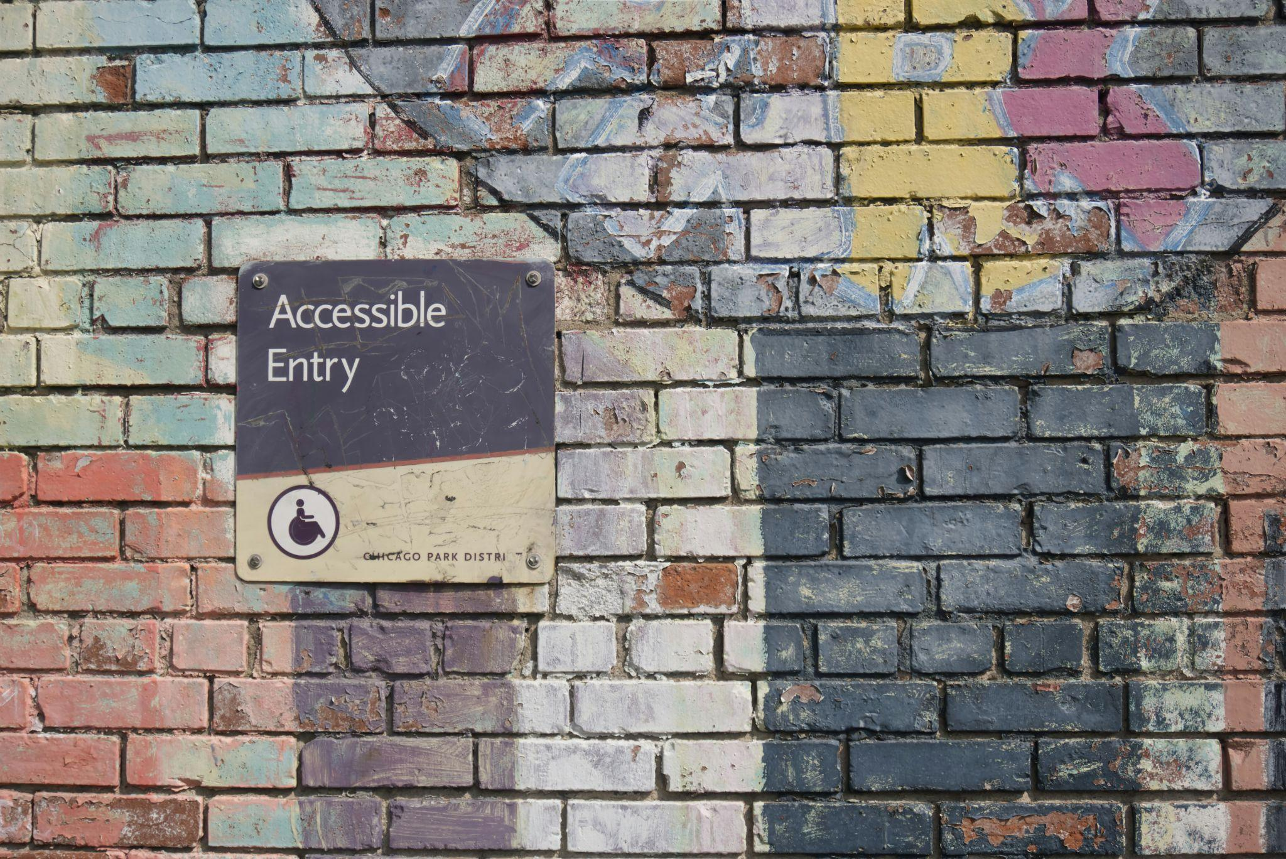
Key NEB Principles: Inclusivity
Design for All:
Creating accessible spaces and products for all ages, abilities, and backgrounds
Participatory Design:
Engaging communities in design processes to meet diverse needs and perspectives
Photo by Daniel Ali on Unsplash
Notes:
Creator: Meyer, Thomas, 2017
|
Credit: Bildnachweis siehe Beschreibung
Copyright: Thomas Meyer/OSTKREUZ

Slide 9
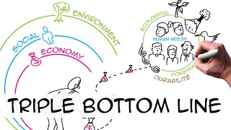
Introduction to Sustainable Design Concepts
What is Sustainable Design?
Definition: Designing with reduced environmental impact and enhanced resource efficiency.
Triple Bottom Line: Focusing on environmental, social, and economic sustainability.
Notes:
In the Style of Kairouan, 1914 - Paul Klee - WikiArt.org. (n.d.). www.wikiart.org. https://www.wikiart.org/en/paul-klee/in-the-style-of-kairouan-1914

Slide 10
Sustainable Design Practices
Material Selection:
Prioritising renewable, recyclable, and low-impact materials
Energy Efficiency:
Using passive design and renewable energy sources to reduce consumption
Waste Reduction:
Minimising waste through modular design, disassembly, and digital fabrication
Water Conservation:
Integrating efficient water usage and harvesting systems in design
Notes:
In the Style of Kairouan, 1914 - Paul Klee - WikiArt.org. (n.d.). www.wikiart.org. https://www.wikiart.org/en/paul-klee/in-the-style-of-kairouan-1914

Slide 11
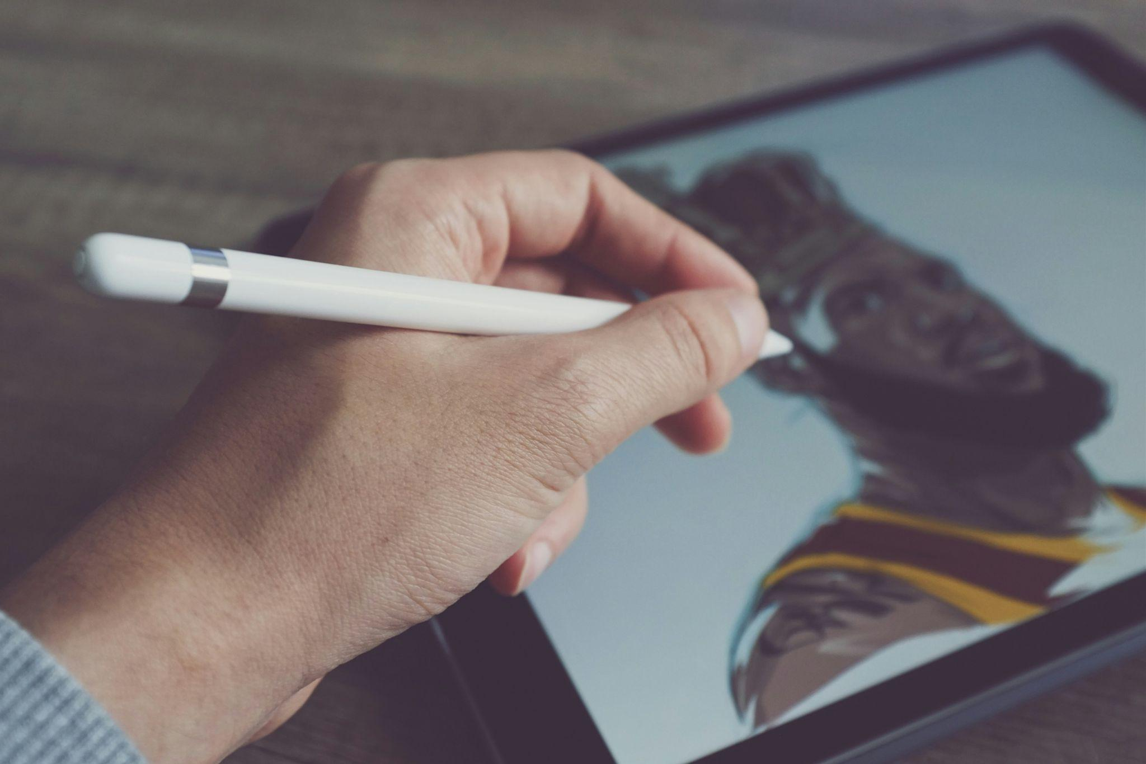
Role of Technology in Sustainable Design
Digital Tools:
Examples: Building Information Modelling (BIM), VR, 3D printing,
Enhancing design processes with optimised resource usage and reduced waste
Photo by Howard Bouchevereau on Unsplash
Notes:
Copyright: Freepik Company S.L. - www.freepik.com

Slide 12
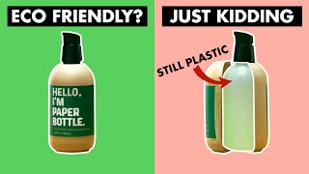
Notes:
Copyright: Freepik Company S.L. - www.freepik.com

