Slide 1
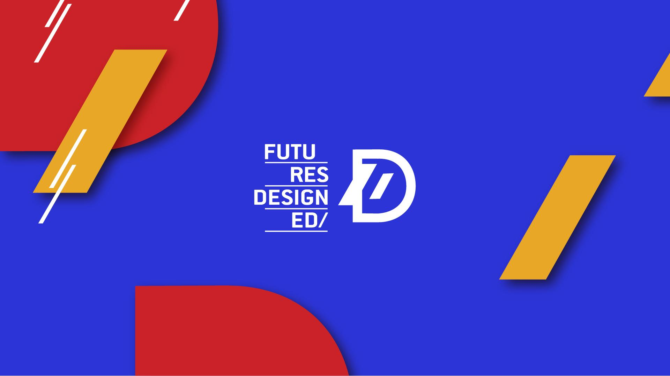

Slide 2


Digital Tools Course: Digital Alternative Spaces of Learning
Module 2: Digital Art Tools and Techniques
2.1 Overview of digital art software
2.2 Techniques for digital painting, 3D modelling, and animation.
2.3 Introduction to digital fabrication methods (3D printing, laser cutting).
2023-1-CY01-KA220-HED-000160668

Slide 3
Introduction to Digital Art Software
Importance of digital tools in modern art and design
Enabling precise, innovative forms of artistic expression
Key applications in creating sustainable, accessible designs

Slide 4
Adobe Creative Suite Overview
Overview:
Widely used professional suite including Photoshop, Illustrator, and After Effects
Key Software Features:
Photoshop: Digital painting, photo editing, compositing
Illustrator: Vector graphics, scalable designs, logo creation
After Effects: Animation, motion graphics for dynamic art
Applications in Projects:
Designing artworks and educational materials with a focus on sustainability and inclusivity

Slide 5
Procreate for iPad
Overview:
Popular digital painting app with intuitive interface and robust features
Key Features:
Extensive brush library with customisation options for unique effects
Layer system for complex compositions and easy editing
Time-lapse recording for process documentation and sharing
Application in NEB Projects:
Creating visual narratives and educational materials that highlight sustainability

Slide 6
Blender: Open-Source 3D Creation Suite
Overview:
Free, comprehensive 3D tool for modelling, animation, and rendering
Key Features:
3D Modelling: Tools for creating detailed objects and spaces
Animation: Keyframing, rigging, and simulations for lifelike movement
Rendering: High-quality production for realistic visuals
Example Projects:
3D models and animations for NEB-aligned concepts like sustainable architecture

Slide 7
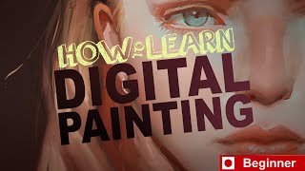
Digital Painting Techniques
Layering:
Separate elements for flexibility and detailed editing
Brush Customisation:
Adjustable brushes to create unique textures and visual effects
Blending Modes:
Various modes to create depth, lighting, and shading effects
Application Example:
Using Procreate to paint a sustainable landscape, applying layers and blending for a realistic effect

Slide 8
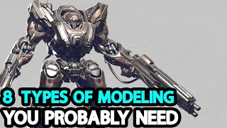
3D Modelling Techniques
Polygonal Modelling:
Building shapes from basic geometric components like vertices, edges, and faces
Sculpting:
Digital sculpting tools for organic, complex forms
Texturing:
Applying colours, patterns, and materials to create realistic surfaces
Example Project:
Modelling a sustainable furniture design with materials that reflect eco-friendly choices
Notes:
Creator: Meyer, Thomas, 2017
|
Credit: Bildnachweis siehe Beschreibung
Copyright: Thomas Meyer/OSTKREUZ

Slide 9
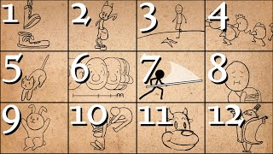
Animation Techniques
Keyframing:
Setting motion points over time for smooth transitions and effects
Rigging:
Building a movable structure or “skeleton” for animation
Simulations:
Using fluid, smoke, and cloth simulations to enhance realism
Application Example:
Animating a product’s lifecycle to illustrate the principles of sustainable design
Notes:
In the Style of Kairouan, 1914 - Paul Klee - WikiArt.org. (n.d.). www.wikiart.org. https://www.wikiart.org/en/paul-klee/in-the-style-of-kairouan-1914

Slide 10
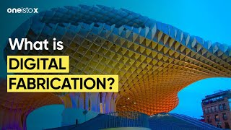
Introduction to Digital Fabrication Methods
Overview of Digital Fabrication:
Bringing digital designs into physical form through precise fabrication techniques
3D Printing:
Definition: Layer-by-layer creation of objects from digital models
Techniques: Slicing for precision, choosing eco-friendly materials
Example: Printing a model of a NEB-inspired building that demonstrates sustainability
Laser Cutting:
Definition: Using laser precision for cutting or engraving materials
Techniques: Vector cutting, engraving designs
Example: Creating a sustainable architecture model in wood or acrylic
Notes:
In the Style of Kairouan, 1914 - Paul Klee - WikiArt.org. (n.d.). www.wikiart.org. https://www.wikiart.org/en/paul-klee/in-the-style-of-kairouan-1914

