Slide 1


Slide 2


Digital Tools Course: Digital Alternative Spaces of Learning
Module 3: VR/AR for Immersive Art Experiences (Theoretical)
3.1 Fundamentals of VR/AR technology and applications in art.
3.2 Overview of virtual gallery platforms.
2023-1-CY01-KA220-HED-000160668

Slide 3
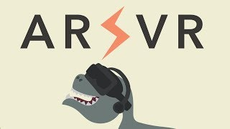
Introduction to VR and AR Technologies
Virtual Reality (VR):
Simulates a 3D environment entirely separate from the real world
Requires VR headsets (e.g., Oculus Rift, HTC Vive) for immersive experiences
Augmented Reality (AR):
Overlays digital content onto the real world
Utilises devices like smartphones, tablets, or AR glasses
Applications in Art:
Transforming artistic expression through interactive and immersive storytelling

Slide 4
Components of VR Technology
VR Headsets:
Provides stereoscopic displays that create a sense of depth
Motion Controllers and Sensors:
Track user movements to enable interaction within the VR environment
Immersive Experiences in Art:
Artists can create interactive 3D worlds, allowing viewers to explore art in new ways

Slide 5
Components of AR Technology
Device Cameras and Sensors:
Use camera input to overlay digital elements onto the physical world
AR Frameworks:
ARKit (iOS) and ARCore (Android) provide development tools for AR apps
Applications in Art:
Artists can enhance real-world environments, such as turning a physical sculpture into an animated experience

Slide 6
Applications of VR in Art
Creation of Immersive Environments:
Artists use VR to build fully interactive virtual worlds for viewers to explore
Narrative-Driven Art Installations:
VR enables storytelling through digital landscapes, guiding viewers on a personal journey
Example:
Creating a VR art exhibit that allows viewers to walk through a digital landscape inspired by the New European Bauhaus (NEB) principles

Slide 7
Applications of AR in Art
Enhancing Real-World Artworks:
Artists use AR to add digital elements to physical art pieces, creating layered experiences
Location-Based AR Installations:
AR can be used to place digital sculptures or artwork in public spaces, viewable through mobile devices
Example:
An AR app that animates a mural when viewed through a smartphone, promoting interactive engagement with street art

Slide 8
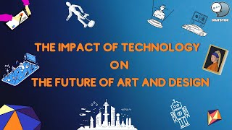
VR/AR in the Context of New European Bauhaus (NEB)
Sustainability:
Simulating sustainable environments or concepts virtually, reducing material use
Aesthetics:
Freedom to design visually rich, creative worlds that transcend physical limitations
Inclusivity:
Expanding access to art by allowing diverse audiences to experience and interact with it regardless of location

Slide 9
Virtual Gallery Platforms for VR/AR Art
Artsteps:
Customisable virtual galleries with 3D walkthroughs
Mozilla Hubs:
Social platform for creating shared virtual spaces, accessible across devices
ARTIT:
VR and AR galleries for immersive exhibition experiences, accessible via VR headsets and mobile devices

Slide 10
Advantages of Virtual Gallery Platforms
Global Access:
Visitors can access galleries worldwide, expanding the reach of art exhibits
Flexibility in Exhibition Design:
Digital galleries allow for creative layouts and interactive features not feasible in physical spaces
Example:
Hosting a NEB-inspired gallery online to showcase sustainable design concepts accessible to a global audience

