Slide 1


Slide 2


Digital Tools Course: Digital Alternative Spaces of Learning
Module 4: VR/AR Development for Immersive Art Experiences (Practical Tools)
4.1 Software tools for VR/AR development
4.2 Principles of accessible design in virtual spaces
2023-1-CY01-KA220-HED-000160668

Slide 3
Introduction to VR/AR Software and Tools for Art Development
The importance of software in creating immersive VR/AR experiences
How these tools enable dynamic storytelling and interactive art environments

Slide 4
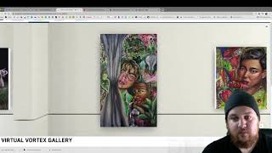
VR Development Tool: Kunstmatrix
Overview:
Kunstmatrix: A platform for creating 3D virtual exhibitions
Key Features:
Allows for customisable gallery layouts, 3D object integration, and multimedia support
Options for adding artwork details, descriptions, and artist information

Slide 5
AR Development Tool: Google AR
Overview:
Google AR: Tools and frameworks for creating augmented reality experiences accessible on mobile devices
Key Features:
Environment detection, light estimation, and motion tracking
Supports interactive elements that respond to the physical environment
Application Example:
Developing an AR app that overlays digital art onto real-world locations, such as adding interactive elements to a public mural

Slide 6
Benefits of VR/AR in Art Development
Immersive Storytelling:
Engages viewers by allowing them to explore and interact within a digital environment
Enhanced Accessibility:
Broadens access to art for individuals who may not be able to visit physical exhibitions
Scalable Art Experiences:
Enables artists to reach a global audience and offer unique, personalised experiences

Slide 7
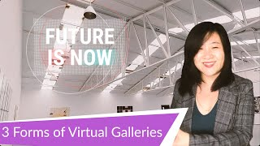
Introduction to Virtual Gallery Platforms
Importance of virtual galleries in expanding access to art
How digital platforms allow for unique, interactive, and inclusive exhibits

Slide 8
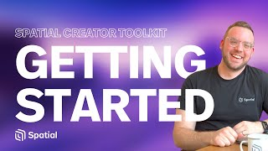
Platform Example: Spatial.io
Overview:
Spatial.io provides virtual environments where users can create, share, and explore immersive galleries
Key Features:
Supports 3D models, audio integration, and real-time interaction
Accessible through VR headsets, desktops, and mobile devices

Slide 9
Platform Example: Artland
Overview:
Artland allows artists and galleries to create virtual tours of art exhibitions, viewable on both desktop and mobile
Key Features:
High-resolution imaging for detailed artwork display, 3D gallery spaces, and interactive features
Flexible design options for customising exhibition layouts and visitor interactions

Slide 10
Principles of Accessible Design in Virtual Spaces
Importance of Accessibility:
Ensures virtual spaces are inclusive and accessible to all, aligning with NEB’s inclusivity principle
Key Accessibility Principles:
Perceivability: Clear text, image alt tags, and audio descriptions for visually impaired users
Operability: Keyboard navigation and interactive elements designed for ease of use
Understandability: Clear instructions and simple navigation
Robustness: Compatibility across various devices and screen readers

Slide 11
Practical Tips for Accessible Virtual Gallery Design
Visual Accessibility:
High contrast text, readable fonts, and alt-text for images
Audio Accessibility:
Captions for videos and transcripts for audio content
User-Friendly Navigation:
Consistent layout, intuitive controls, and compatibility with assistive technologies
Testing Tools:
Tools like WAVE and Axe to check accessibility compliance before launch

