Slide 1


Slide 2




Inclusive and Accessible design. Friendly public spaces.
Module 3: Policy and EU-Level intervention
3.1. Policy and EU-Level intervention
3.2. Holistic approach to inclusivity
2023-1-CY01-KA220-HED-000160668

Slide 3
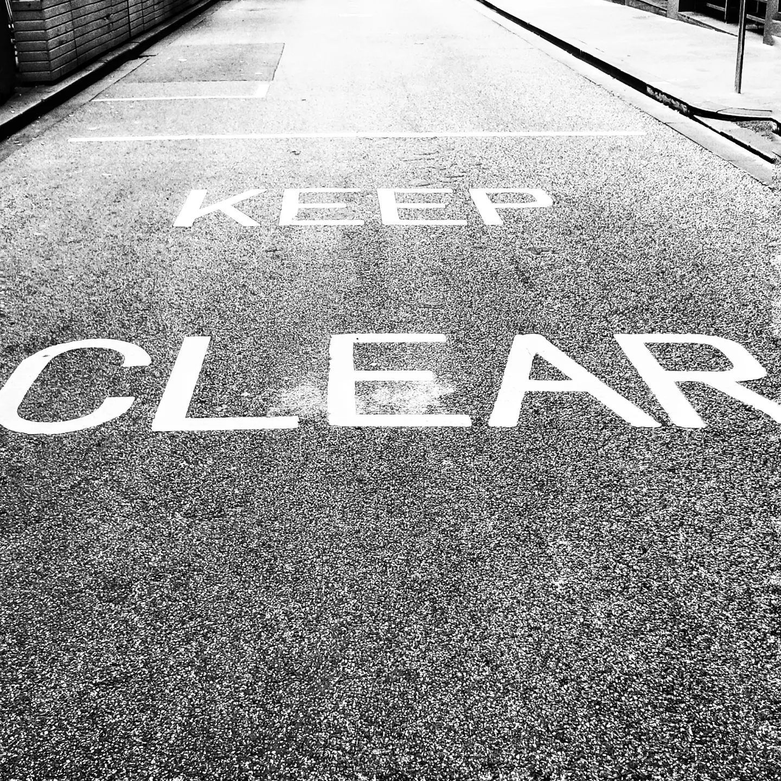
3.1. Policy and EU-Level intervention
The European Accessibility Act (EAA) and other EU policies promote accessibility and universal design to enable people with disabilities to fully participate in society, aiming to create a cohesive regulatory framework across member states.
The “Union of Equality: Strategy for the Rights of Persons with Disabilities 2021-2030” builds on previous efforts, emphasizing inclusion in employment, education, digital accessibility, and democratic participation.
While the European Disability Strategy raised awareness and improved accessibility standards, it faced challenges in implementation, monitoring, and adequately addressing all disability types, particularly invisible and intellectual disabilities.
Notes:
Creator: Meyer, Thomas, 2017
|
Credit: Bildnachweis siehe Beschreibung
Copyright: Thomas Meyer/OSTKREUZ

Slide 4

3.2. Holistic approach to inclusivity
A holistic approach in design goes beyond physical and cognitive needs, considering individuals’ lifestyles, values, and emotional needs for truly universal accessibility.
Notes:
In the Style of Kairouan, 1914 - Paul Klee - WikiArt.org. (n.d.). www.wikiart.org. https://www.wikiart.org/en/paul-klee/in-the-style-of-kairouan-1914

Slide 5
3. Activities | Readings
European Parliament. The European Accessibility Act.
European Commission. Communication from the Commission to the European Parliament, the Council, the European Economic and Social Committee and the Committee of the Regions. European Disability Strategy 2010-2020: A Renewed Commitment to a Barrier-Free Europe.
European Commission. Communication from the Commission to the European Parliament, the Council, the European Economic and Social Committee and the Committee of the Regions. Union of Equality: Strategy for the Rights of Persons with Disabilities 2021-2030
3. Activities | Visuals
What is the European Accessibility Act? - https://www.youtube.com/watch?v=eD6O8AlEpZg
Why Businesses Can't Ignore the European Accessibility Act - https://www.youtube.com/watch?v=7-7Rw4WhwJs
Elements and goals of the European Disability Strategy - https://www.youtube.com/watch?v=VHJ-9BGcKbA

