Slide 1


Slide 2




Inclusive and Accessible design. Friendly public spaces.
Module 5: Designing Inclusive and Friendly Cities
5.1. Inclusive and accessible cities. Cities that are listening.
5.2. Characteristics of friendly cities
5.3. Types of accessible and “designish” city
5.4. Accessible infrastructure and easy navigation for all users
5.5. Creating walkable and bike-friendly streetscapes. Case studies.
2023-1-CY01-KA220-HED-000160668

Slide 3
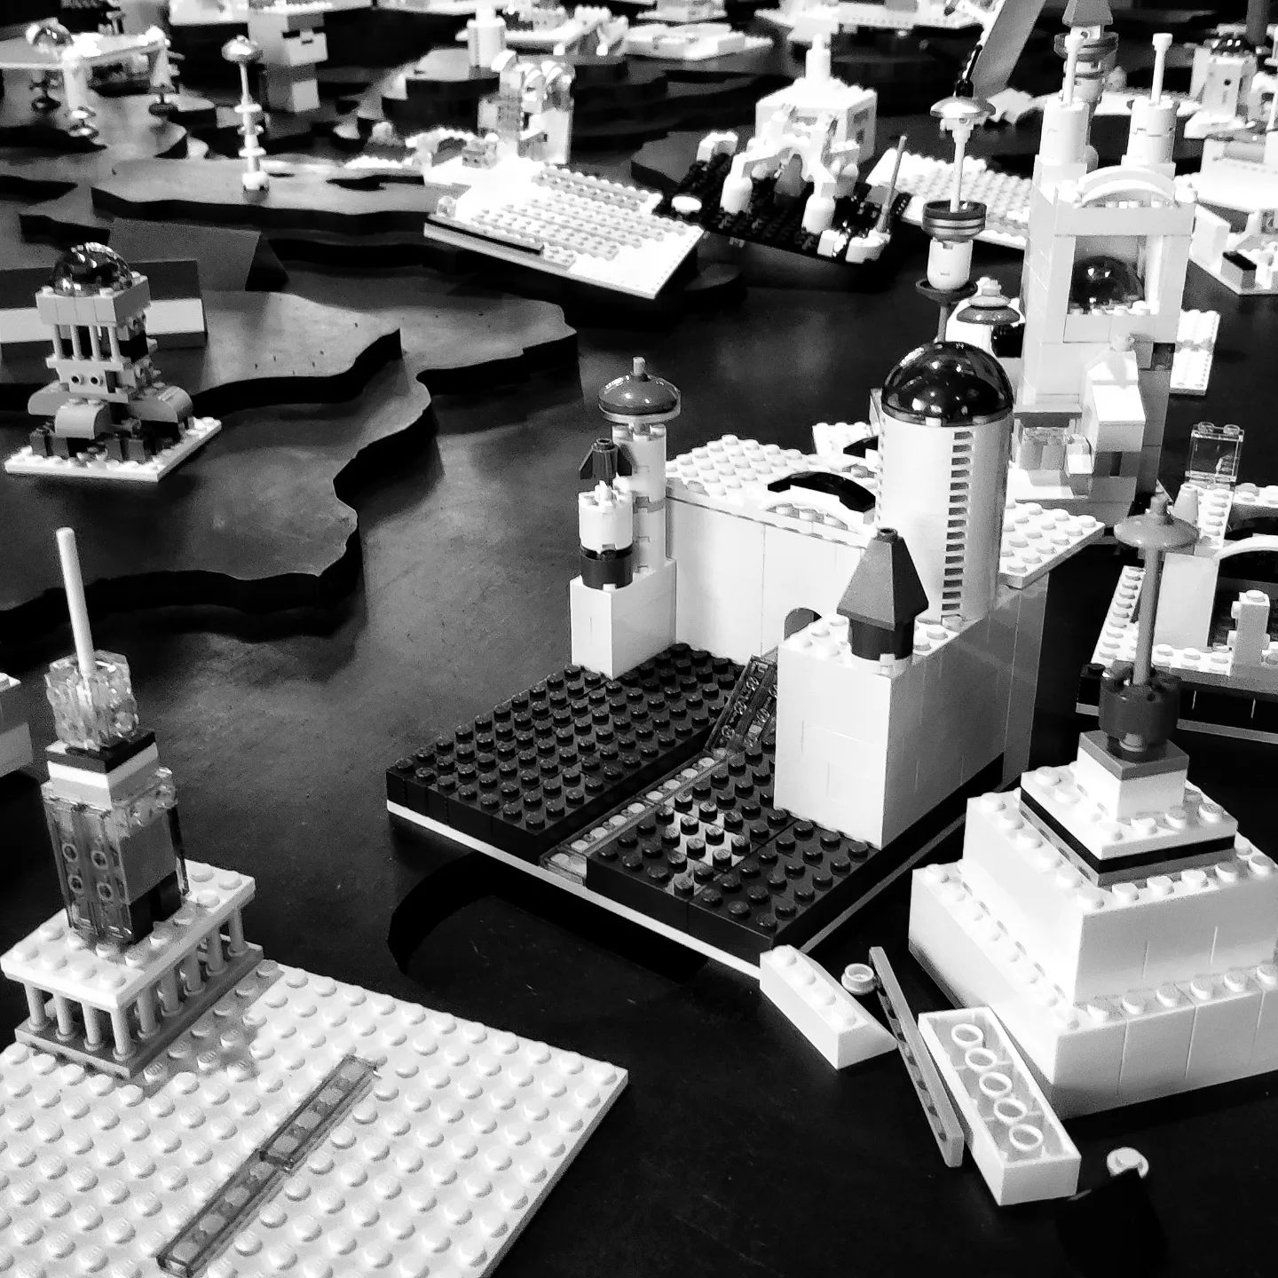
5.1. Inclusive and accessible cities
Creating inclusive and accessible cities requires a focus on universal design, involving marginalized groups in planning, and removing barriers in physical, digital and social environments to ensure equal participation for all.
Local governments play a critical role in fostering inclusive urban development by adopting international standards, collaborating with stakeholders and using data to monitor the effectiveness of inclusive policies.
Notes:
In the Style of Kairouan, 1914 - Paul Klee - WikiArt.org. (n.d.). www.wikiart.org. https://www.wikiart.org/en/paul-klee/in-the-style-of-kairouan-1914

Slide 4
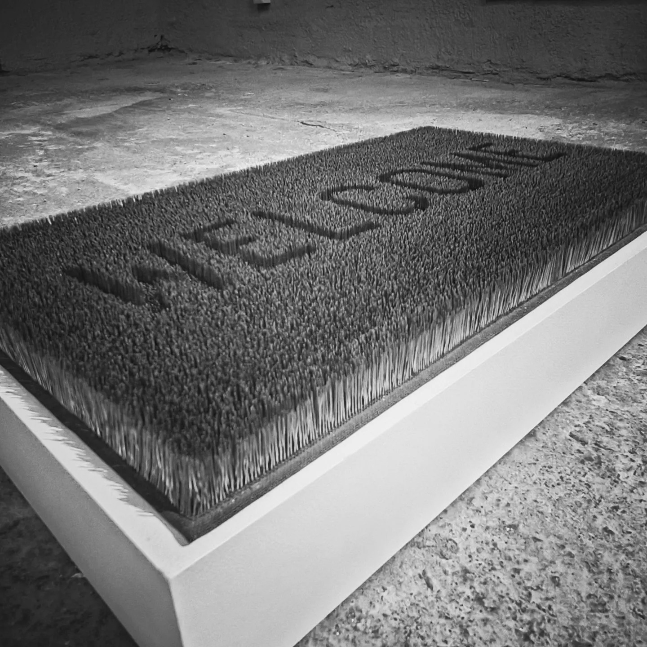
5.2. Characteristics of friendly cities
Friendly cities prioritize accessibility, inclusivity and community engagement, ensuring that all residents, regardless of abilities or background, can fully participate in urban life.
Sustainability is a key feature of friendly cities, with a focus on green infrastructure, sustainable transportation, waste reduction and climate resilience to create a livable environment for future generations.
Community involvement is integral, with friendly cities fostering civic participation and social inclusion through collaborative urban planning and programs that promote diversity and well-being for all residents.
Notes:
In the Style of Kairouan, 1914 - Paul Klee - WikiArt.org. (n.d.). www.wikiart.org. https://www.wikiart.org/en/paul-klee/in-the-style-of-kairouan-1914

Slide 5
5.3. Types of accessible and “designish” city
15-Minute City: essential services within 15-minute walk/bike.
Smart City: uses tech for efficient, sustainable urban management.
Inclusive City: equal access to opportunities for all residents.
Sponge City: water management through absorption and reuse.
Biophilic City: integrates nature to enhance well-being.
Circular City: focus on waste reduction and resource reuse.
Citta slow: promotes slower pace, local economy, cultural heritage.
Walkable City: prioritizes pedestrian-friendly infrastructure and mobility.
Sustainable City: focuses on green energy, low environmental impact.
Child-Friendly City: safe, accessible environments for children.
Age-Friendly City: urban spaces designed for older adults' needs.
Design City: emphasizes innovative, human-centered urban design.
Notes:
In the Style of Kairouan, 1914 - Paul Klee - WikiArt.org. (n.d.). www.wikiart.org. https://www.wikiart.org/en/paul-klee/in-the-style-of-kairouan-1914

Slide 6
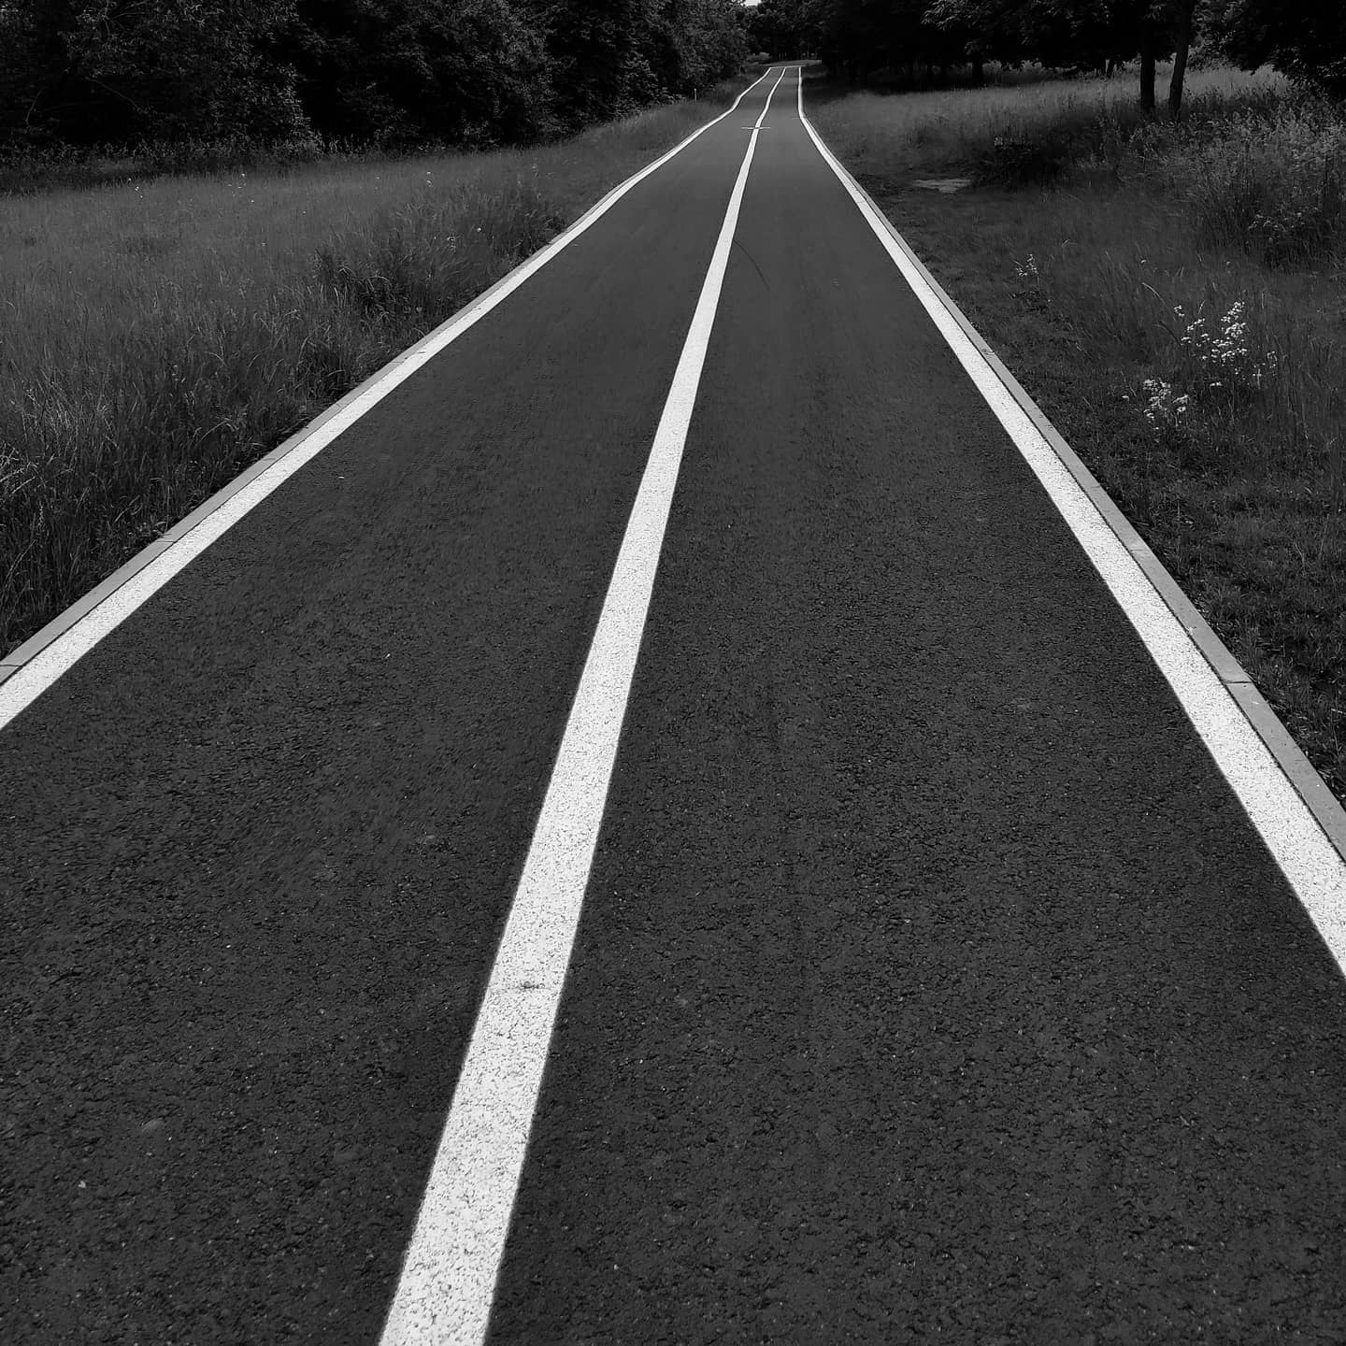
5.4. Accessible infrastructure for all users
Inclusive urban design is essential for accessibility. Accessible public transport, spaces, and services help reduce social exclusion and enable everyone to fully participate in city life.
Prioritizing accessibility benefits cities both socially and economically. Inclusive design supports a diverse, aging population and attracts more people, promoting equality and resilience.
Smart city technology and unified accessibility standards improve urban spaces. Real-time adaptations make cities safer and more intuitive, supporting the independence and dignity of all residents.
Notes:
In the Style of Kairouan, 1914 - Paul Klee - WikiArt.org. (n.d.). www.wikiart.org. https://www.wikiart.org/en/paul-klee/in-the-style-of-kairouan-1914

Slide 7
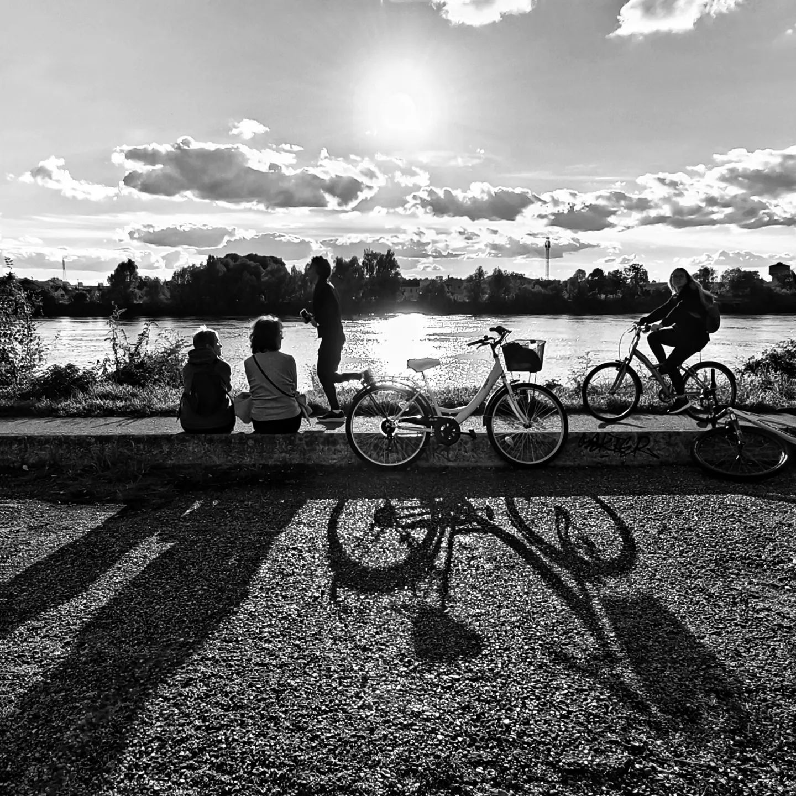
5.5. Creating walkable and bike-friendly streetscapes
Bicycle and pedestrian master plans create safer, more accessible cities by prioritizing walking and cycling. These plans enhance mobility, reduce congestion, and improve public health while supporting sustainability and economic growth.
Standalone plans provide a focused, structured approach to active transportation, ensuring non-motorized modes are given equal importance and better integrated into urban infrastructure.
By involving the community and aligning with broader urban planning goals, these plans foster public support, secure funding, and make cities more livable and inclusive for all residents.
Notes:
In the Style of Kairouan, 1914 - Paul Klee - WikiArt.org. (n.d.). www.wikiart.org. https://www.wikiart.org/en/paul-klee/in-the-style-of-kairouan-1914

Slide 8
5. Activities | Readings
UCLG. Inclusive and Accessible Cities.
United Nations. 2030 Agenda for Sustainable Development.
Convention on the Rights of Persons with Disabilities (CRPD).
New Urban Agenda.
U.S. Department of Housing and Urban Development. Creating Walkable & Bikeable Communities.
Creating walkable + bikeable communities. A user guide to developing pedestrian and bicycle master plans.
United Nations. New Urban Agenda.
United Nations. Convention on the Rights of Persons with Disabilities.

Slide 9
5. Activities | Readings
United Nations, Department of Economic and Social Affairs, Sustainable Development. Transforming our world: the 2030 Agenda for Sustainable Development.
The WHO Age-friendly Cities Framework. Global age-friendly cities: a guide.
UK Government. A Guide for Inclusive, Accessible,Safe and Resilient Urban Development.
UCLG. Building Cities for All: Inclusive and Accessible Cities and Territories.
Julienne Hanson. The Inclusive City: delivering a more accessible urban environment through inclusive design.
UCLG. Inclusive and Accessible Cities.
City of Toronto. Toronto accessibility design guidelines.
Case studies: Walkable and bikeable cities. Lessons from Seoul and Singapore.

Slide 10
5. Activities | Visuals
How Dubai has become one of the most accessible cities in the world - https://www.youtube.com/watch?v=XjRHMO8RGUo
How to design streets for everyone - https://www.youtube.com/watch?v=8mh-GTlvf0w
Designing for Accessibility: Inclusive Landscape Architecture - https://www.youtube.com/watch?v=Gen_8hrFWb8
Open Sidewalk #3: The Accessible City - https://www.youtube.com/watch?v=tf4vBIpku2g
Making Shared Spaces Accessible for Everyone - https://www.youtube.com/watch?v=GsTahycQjRU
Why the Netherlands is INSANELY well designed: Dutch vs. American Day - https://www.youtube.com/watch?v=Ux8PahDH9bg
The Fascinating Human-Scale Urbanism of Dutch Suburbia - https://www.youtube.com/watch?v=nImFJ7KKjAo
Age-friendly cities benefit everyone - https://www.youtube.com/watch?v=sppjdYCM8yg

Slide 11
5. Activities | Visuals
How to Design Bicycle-friendly Cities - by The Life-Sized City - https://www.youtube.com/watch?v=RJGIhu02ATg&t=151s
Barcelona’s Car-Free Superblocks Explained - https://www.youtube.com/watch?v=9kmIUjHL0zs
The Life-Sized City – Copenhagen – https://www.youtube.com/watch?v=ZfeSjqUfQwE
The Life-Sized City – Tokyo - https://www.youtube.com/watch?v=cuonmSoZmFw
Livable Densities Through Traditional Urbanism - https://www.youtube.com/watch?v=huauSWIGnrg
How Amsterdam Became a Bicycle Paradise - https://www.youtube.com/watch?v=DKbRL6Opifg

