Slide 1


Slide 2




Inclusive and Accessible design. Friendly public spaces.
Module 6: Participation in public space designing
6.1. Participation in public space designing
6.2. The role of community organizations and NGOs
6.3. Technological and social innovation in stakeholder engagement
6.4. Participation methods in designing of city accessible public spaces
2023-1-CY01-KA220-HED-000160668

Slide 3
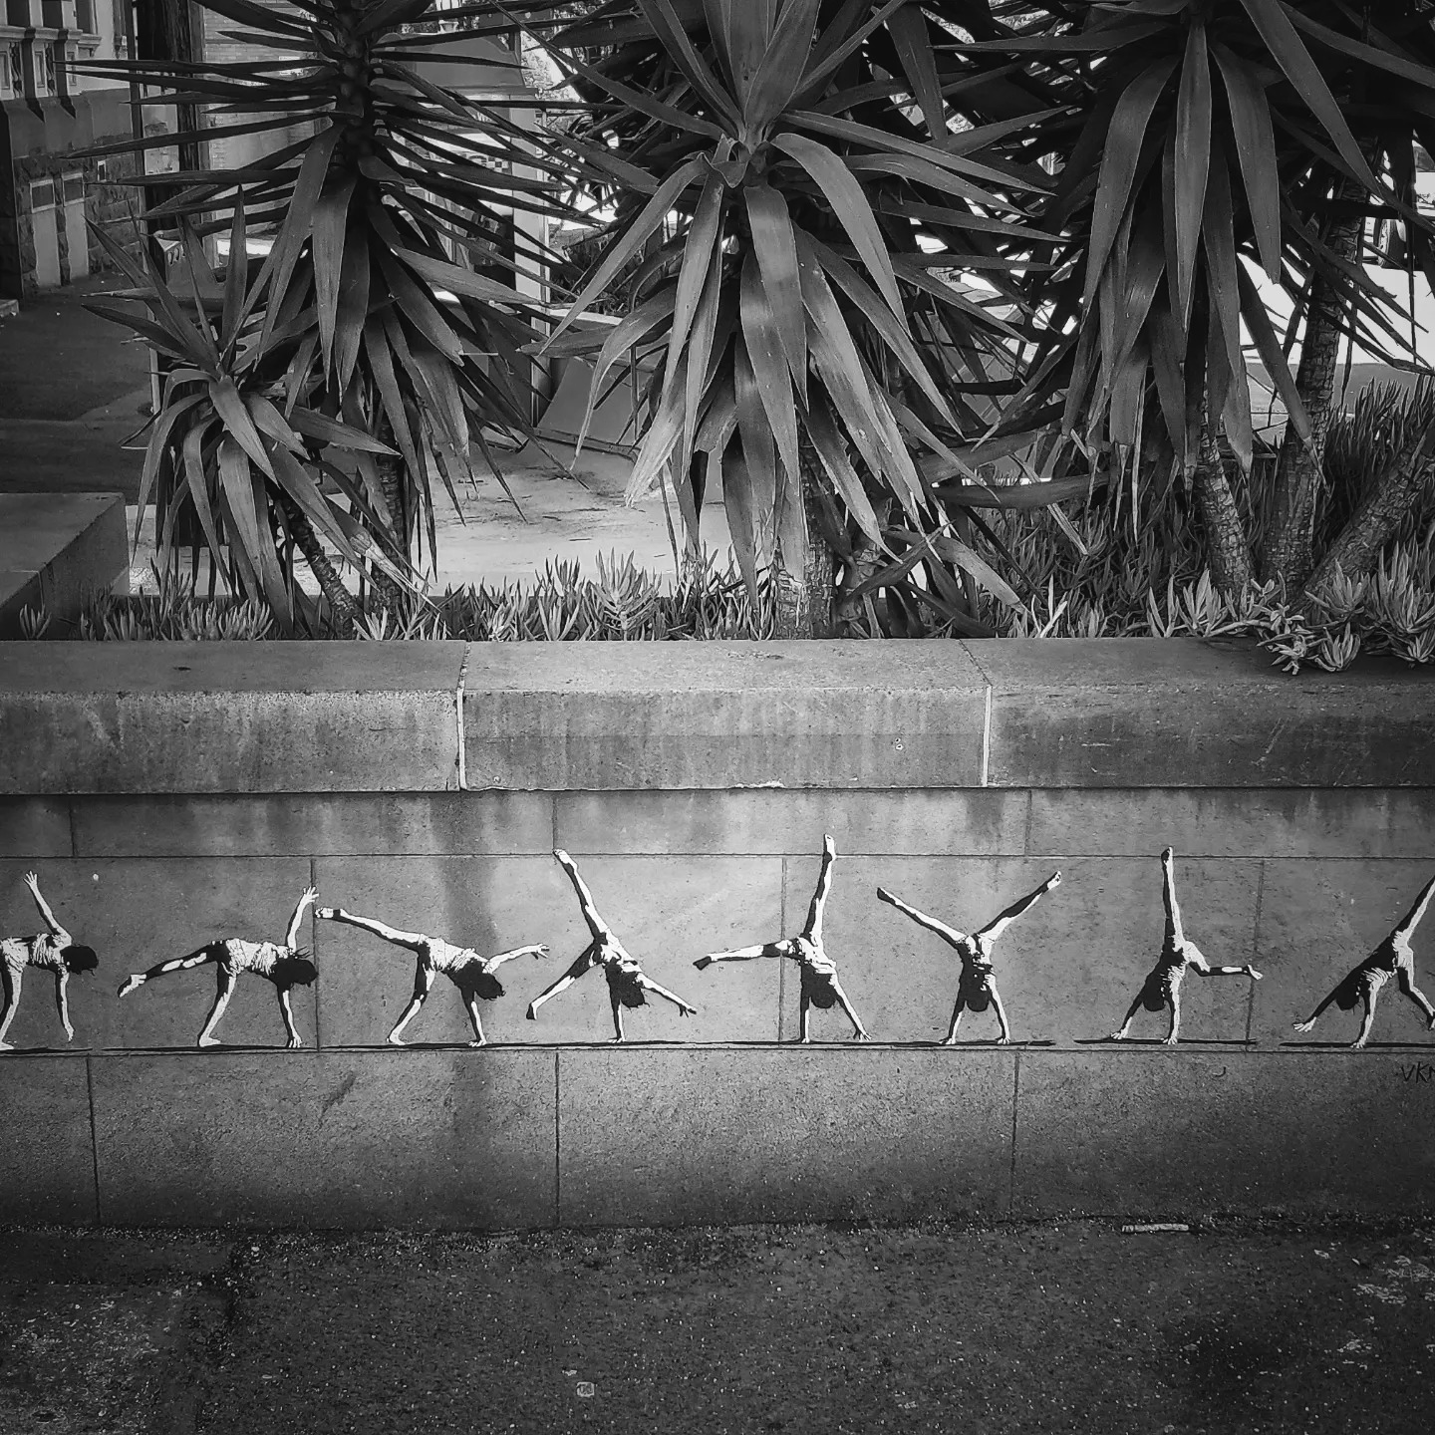
6.1. Participation in public space designing
Bicycle and pedestrian master plans create safer, more accessible cities by prioritizing walking and cycling. These plans enhance mobility, reduce congestion, and improve public health while supporting sustainability and economic growth.
Standalone plans provide a focused, structured approach to active transportation, ensuring non-motorized modes are given equal importance and better integrated into urban infrastructure.
By involving the community and aligning with broader urban planning goals, these plans foster public support, secure funding, and make cities more livable and inclusive for all residents.
Notes:
In the Style of Kairouan, 1914 - Paul Klee - WikiArt.org. (n.d.). www.wikiart.org. https://www.wikiart.org/en/paul-klee/in-the-style-of-kairouan-1914

Slide 4

6.2. The role of community organizations and NGOs
Community-based organisations and NGOs are key to enabling public participation and promoting inclusive public spaces, especially for marginalised groups.
Inclusive public spaces promote social cohesion by ensuring accessibility and interaction between different social groups.
Genuine social inclusion in the design of public spaces requires the removal of both physical and social barriers that prevent marginalised groups from participating in decision-making.
Notes:
In the Style of Kairouan, 1914 - Paul Klee - WikiArt.org. (n.d.). www.wikiart.org. https://www.wikiart.org/en/paul-klee/in-the-style-of-kairouan-1914

Slide 5
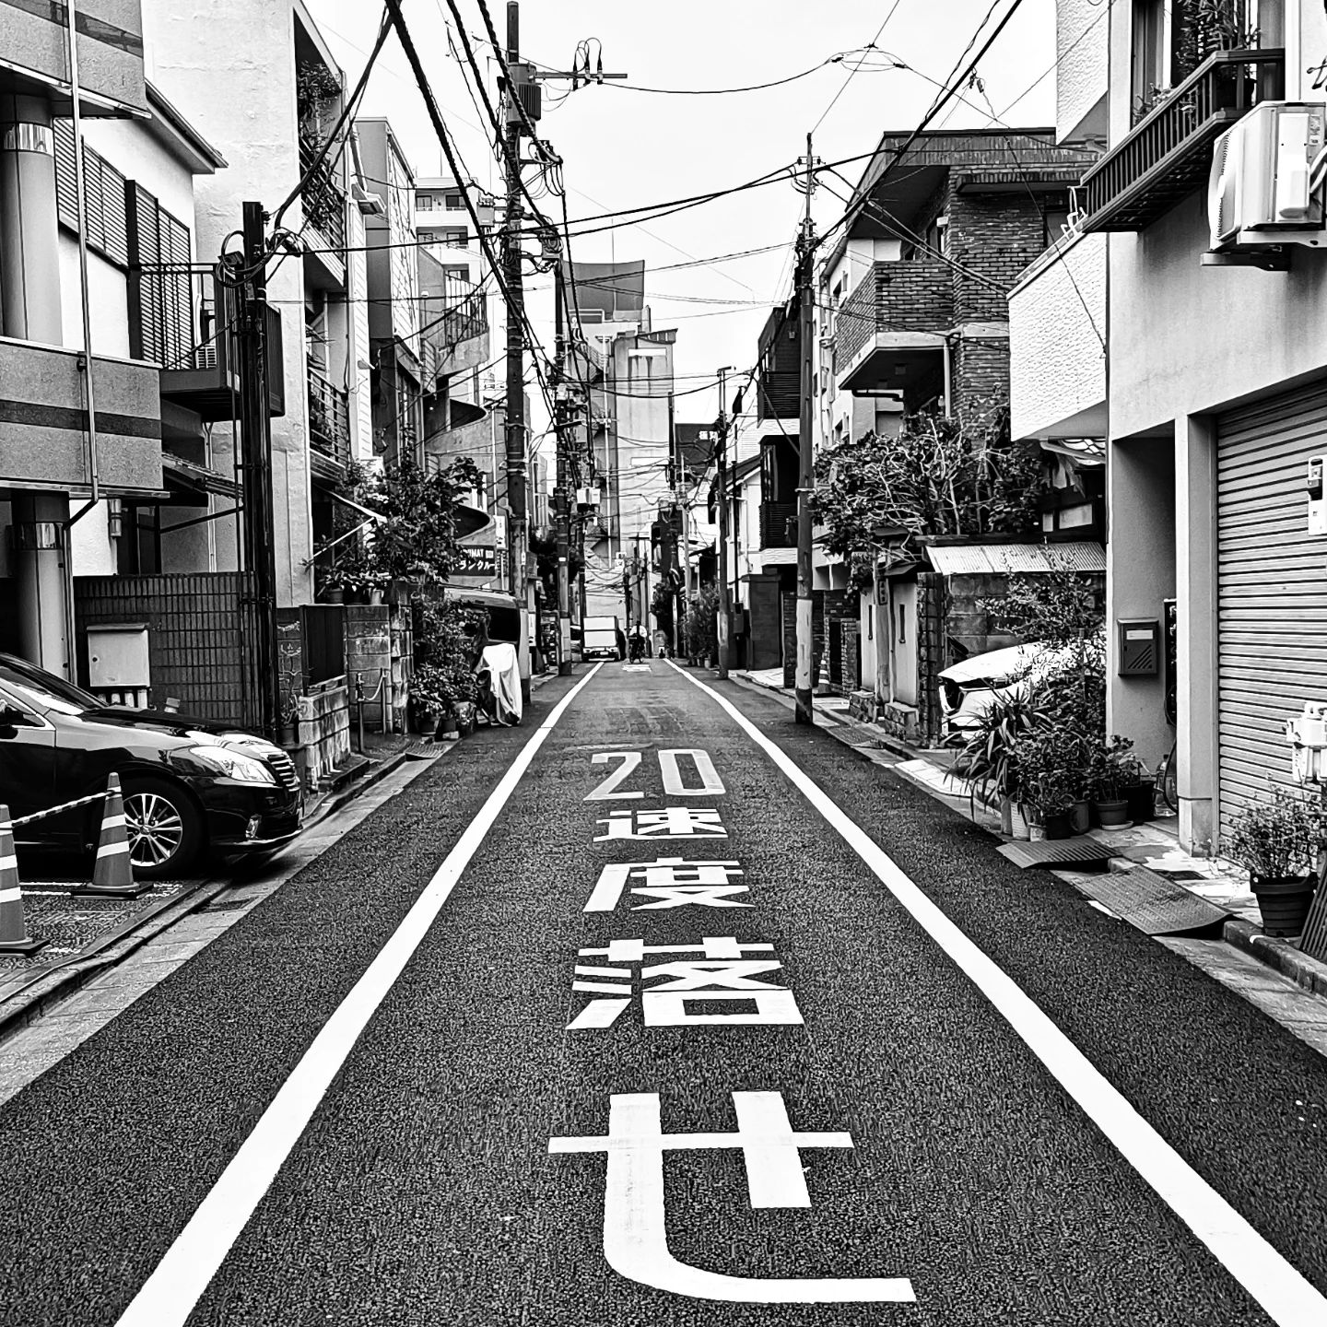
6.3. Technological and social innovation in stakeholder engagement
Technology-driven methods, like mobile apps and social media, are expanding public engagement in urban planning, making it easier for citizens to provide input anytime and from anywhere.
Interactive tools, such as InstaBooths, facilitate real-time feedback, enhancing co-creation and allowing more inclusive participation in the design of public spaces.
Notes:
In the Style of Kairouan, 1914 - Paul Klee - WikiArt.org. (n.d.). www.wikiart.org. https://www.wikiart.org/en/paul-klee/in-the-style-of-kairouan-1914

Slide 6
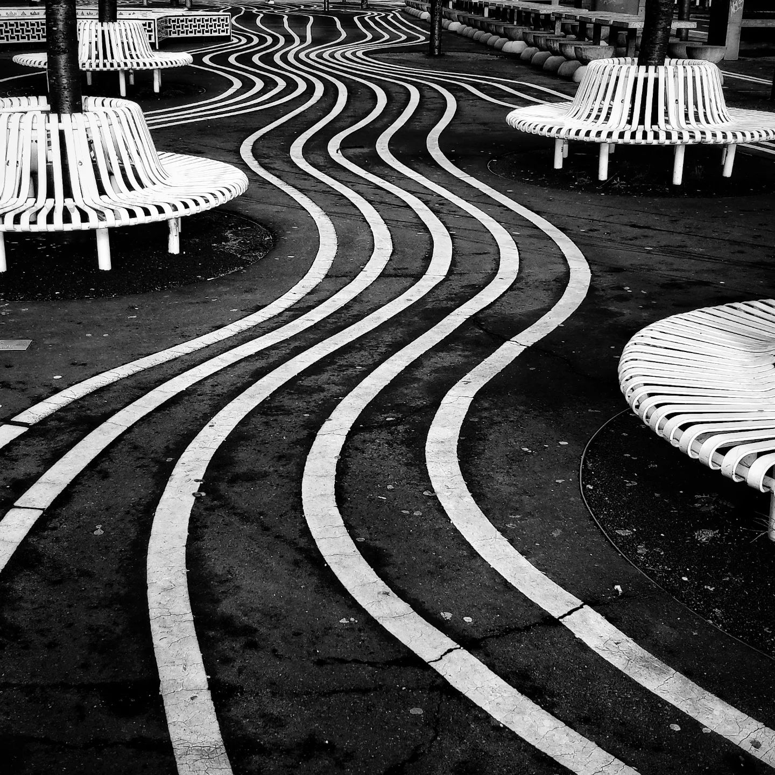
6.4. Participation methods in designing of city accessible public spaces
Participatory design ensures public spaces meet diverse
community needs by engaging residents in planning,
fostering a sense of ownership, and making spaces more
inclusive and culturally relevant.
Successful projects, like Kaunas2022 and Copenhagen‘s
Superkilen, illustrate how co-creation integrates local identity
and enriches spaces, leading to more active use and pride
among residents.
User-centered design and workshops, as seen in Zurich, help
align designs with local preferences, though challenges like
technical jargon require clear communication for effective
participation.
Notes:
In the Style of Kairouan, 1914 - Paul Klee - WikiArt.org. (n.d.). www.wikiart.org. https://www.wikiart.org/en/paul-klee/in-the-style-of-kairouan-1914

Slide 7
6. Activities | Readings
Kaunas – European Capital of Culture 2022. COMMUNITY programme methodology.
Tamara Kocan. Participative processes as tools for designing public spaces.
Evans Kimani Njungea, Buket Asilsoy. A Study about Public Participation in the Universal Design of Public Spaces.
Salma Belmoussa. Constructing accessibility in Dutch Public Spaces.
Karin Peters, Dahae Lee. Ensuring inclusive and accessible public spaces in an austerity context.
Andrew Lacey. Designing an essential guide for public buildings for Accessibility.
Adam Rallo, Eric Forest, James Kuo, Randal Boutilier, Edmund Li. A Practical Handbook on Accessible Graphic Design.

Slide 8
6. Activities | Visuals
Participatory design processes: Improving public participation in public space - https://www.youtube.com/watch?v=jsK2kISMDDE
What is Tactical Urbanism ? - https://www.youtube.com/watch?v=HiQ0xoHp-fM
Participatory Planning: Improving Your Community Engagement Efforts - https://www.youtube.com/watch?v=QpkKNopm2So
Augmented Urbans – Technologies for urban participation and resilience - https://www.youtube.com/watch?v=2uCs_VghgEQ
Participatory Planning & Community Engagement: Towards More Socially Inclusive Cities - https://www.youtube.com/watch?v=-OKvA_S_7VA
Conversation with AI: a vision for London's future public space - https://www.youtube.com/watch?v=2xFEOq7glJc
Learn all about the URBACT Method! - https://www.youtube.com/watch?v=poeMVmO9K-A

