Slide 1


Slide 2

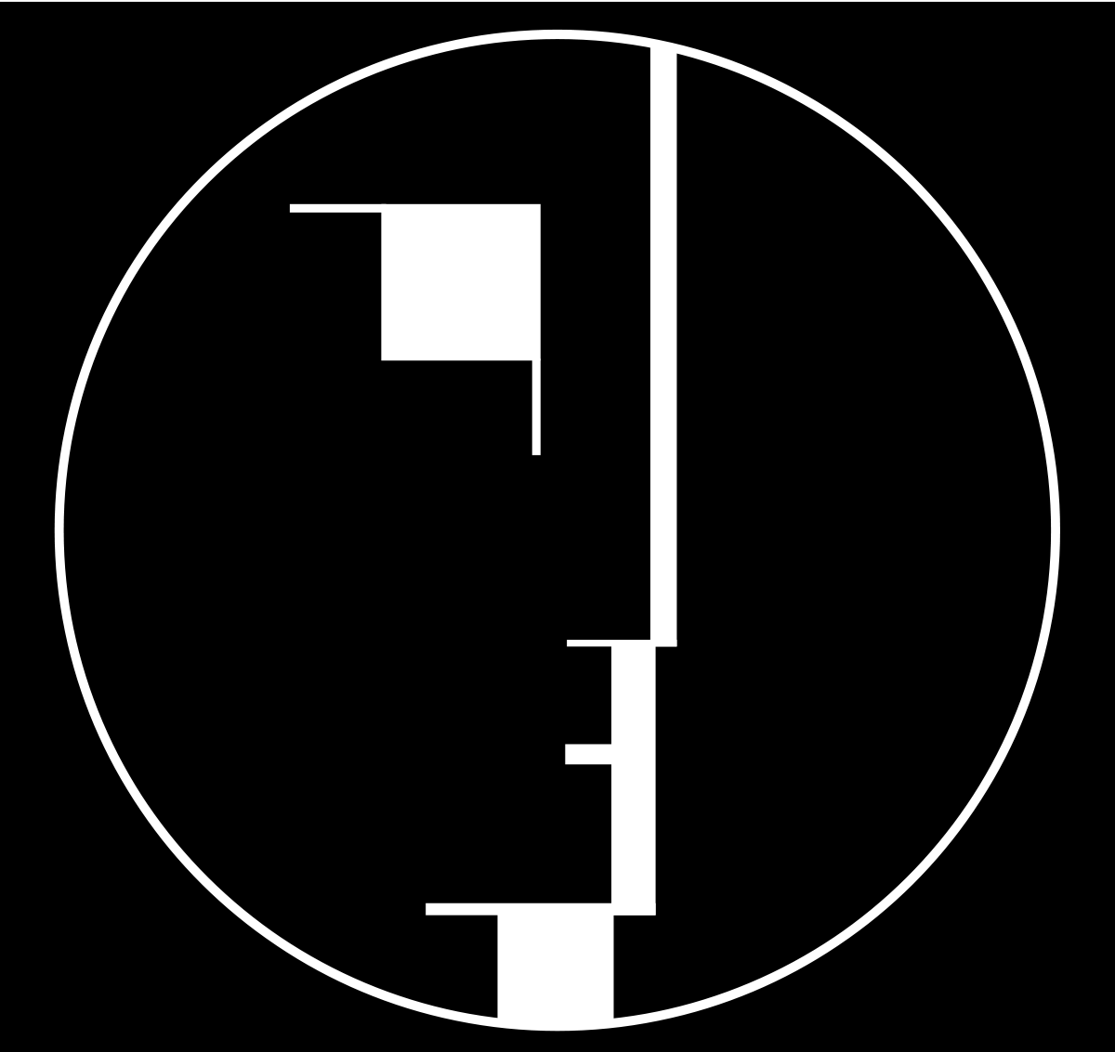

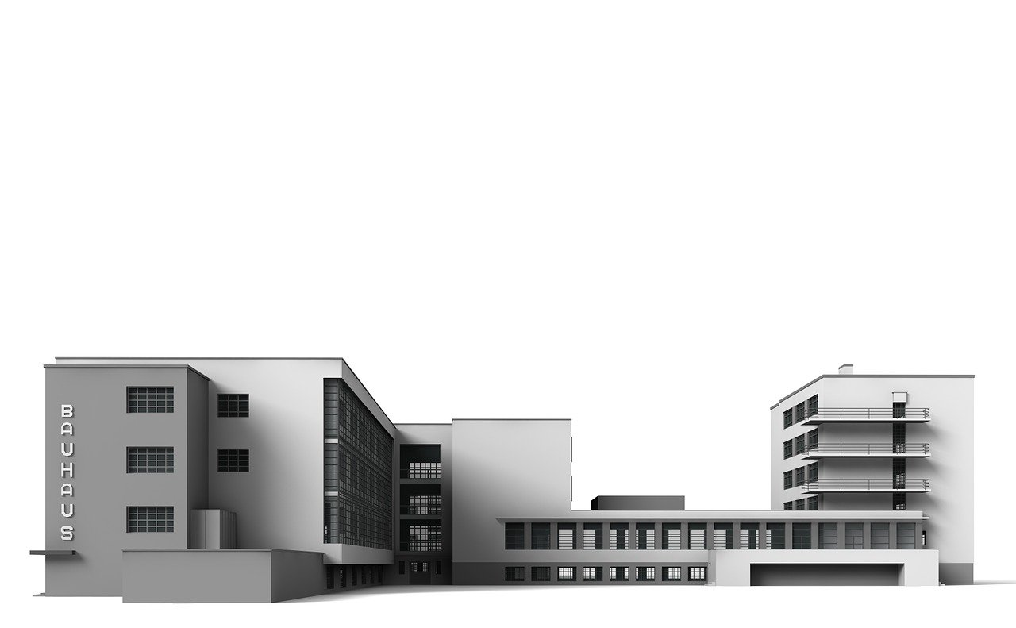

Introductory Course - New European Bauhaus and Principles of Sustainability in Design
Module 1: History and Principles of the Bauhaus Movement
1.1 Overview of the Bauhaus movement origins and historical context.
1.2 Core principles of Bauhaus design & tools.
2023-1-CY01-KA220-HED-000160668

Slide 3
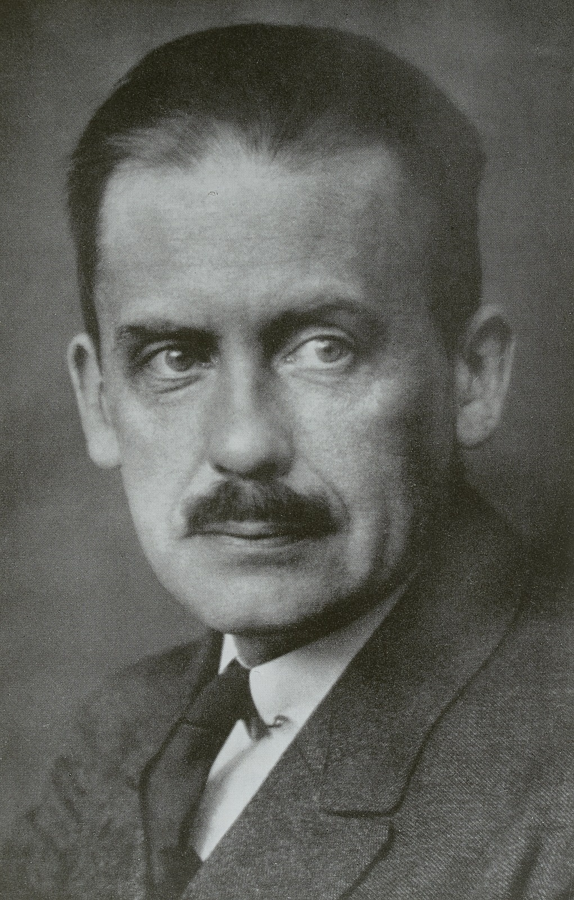

Introduction to the Bauhaus Movement
Founded in 1919 by Walter Gropius.
Aimed to unify art, craft, and technology.
Influential in architecture, design, and modernism.
Walter Gropius με Handrick, Roland (Herstellung) (Fotograf) - Deutsche Fotothek, Germany - In Copyright - Educational Use Permitted.
https://www.europeana.eu/item/188/item_7KCTZEYJYKTKAJU4K2KQP3JODQPLOG6F

Slide 4
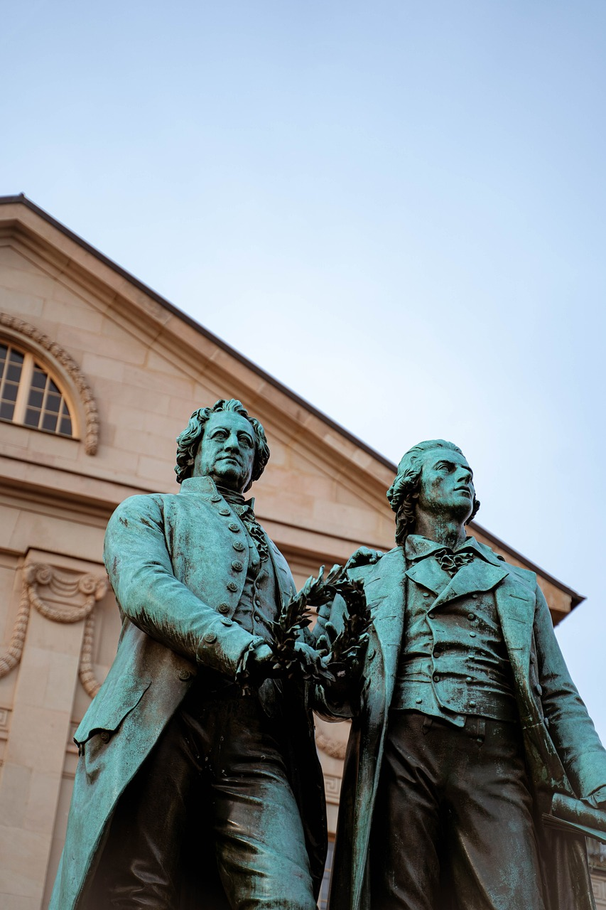
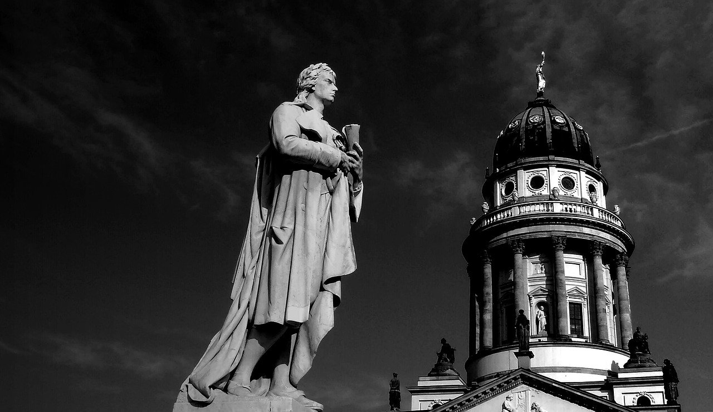

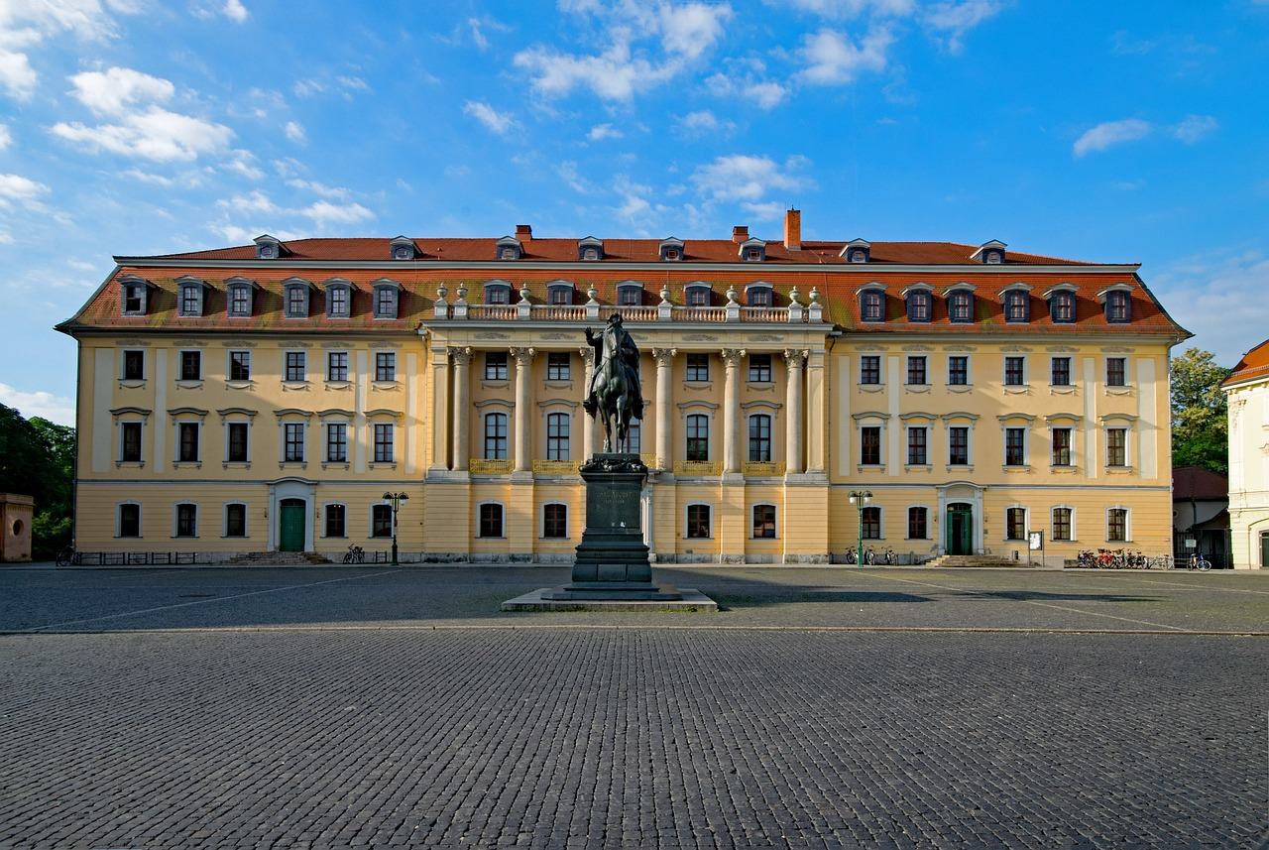
Historical Context
Post-WWI Germany: Weimar Republic (1919-1933).
Economic struggles and political instability.
Rise of avant-garde movements.

Slide 5
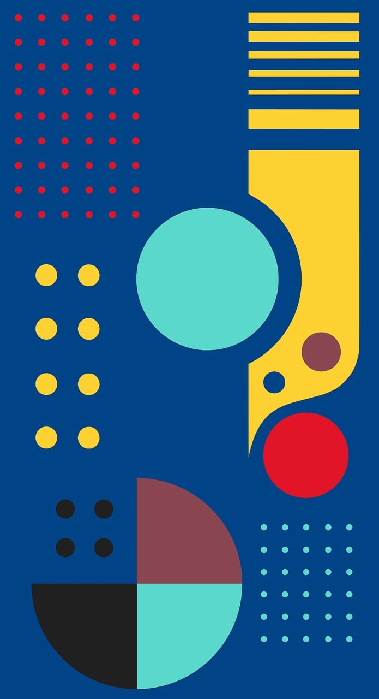
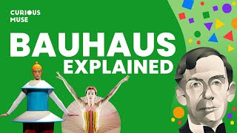
Bauhaus Founding Philosophy
"Art and Technology: A New Unity."
Emphasis on functional, mass-produced art.
Integration of all artistic disciplines under one roof.

Slide 6
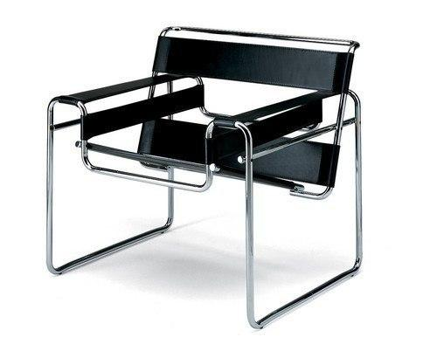
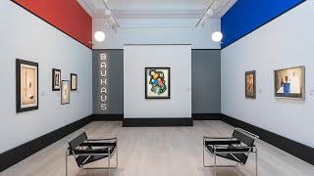
Shift Toward Industrial Production
Initially focused on handcraft.
Moved toward industrial and mass production by mid-1920s.
Designed everyday objects for the masses.
The Wassily Chair, designed by Marcel Breuer in 1925–1926

Slide 7
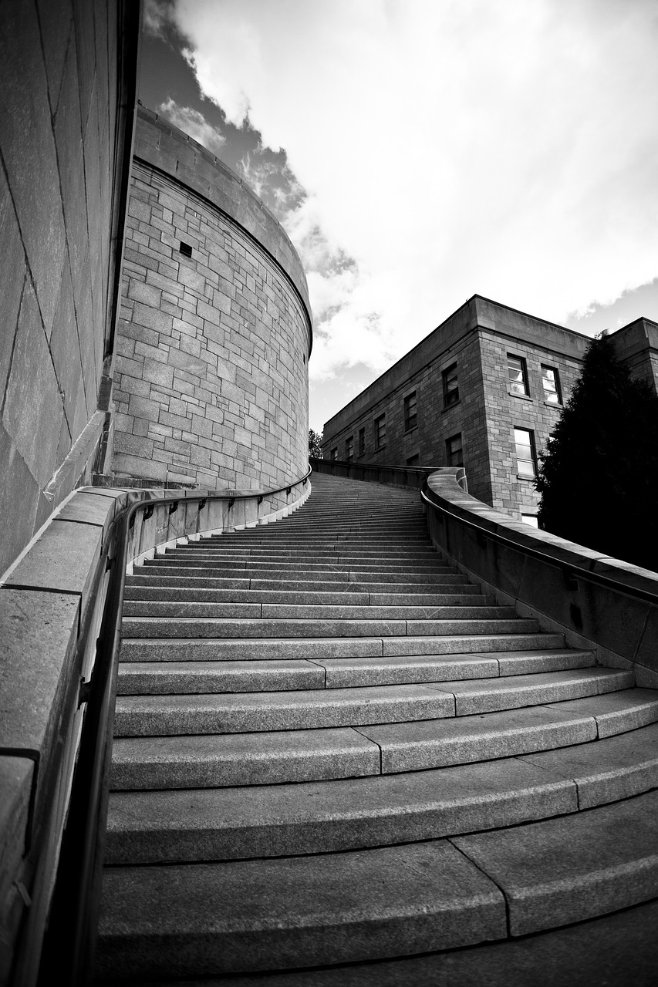

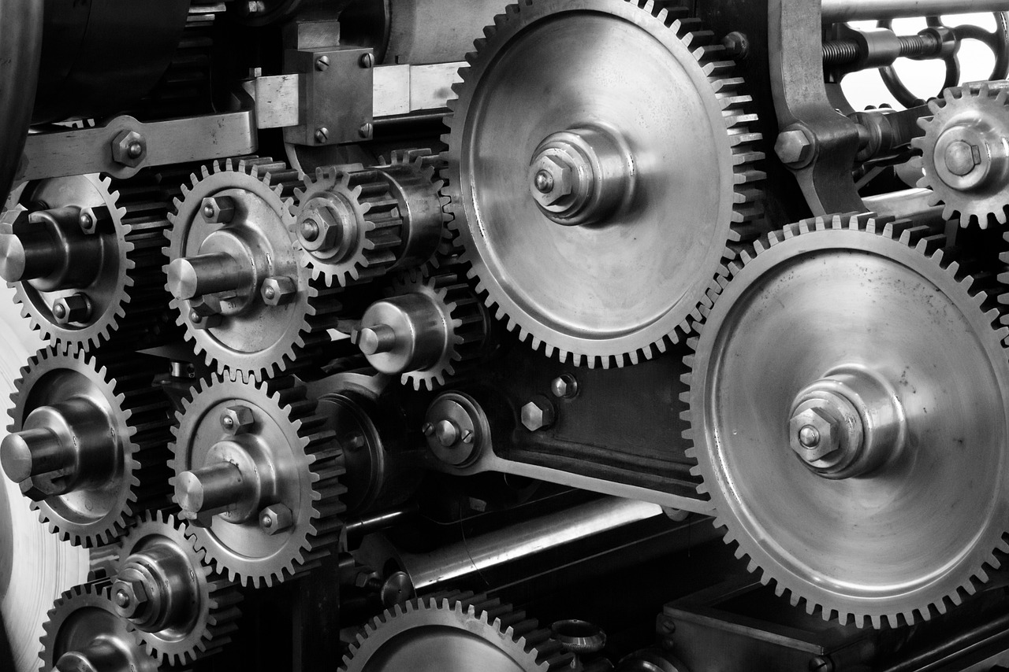
Bauhaus in Weimar (1919-1925)
Focus on individual craftsmanship and experimental arts.
Tensions over the role of technology and handcraft.
Early students: fine arts background.

Slide 8
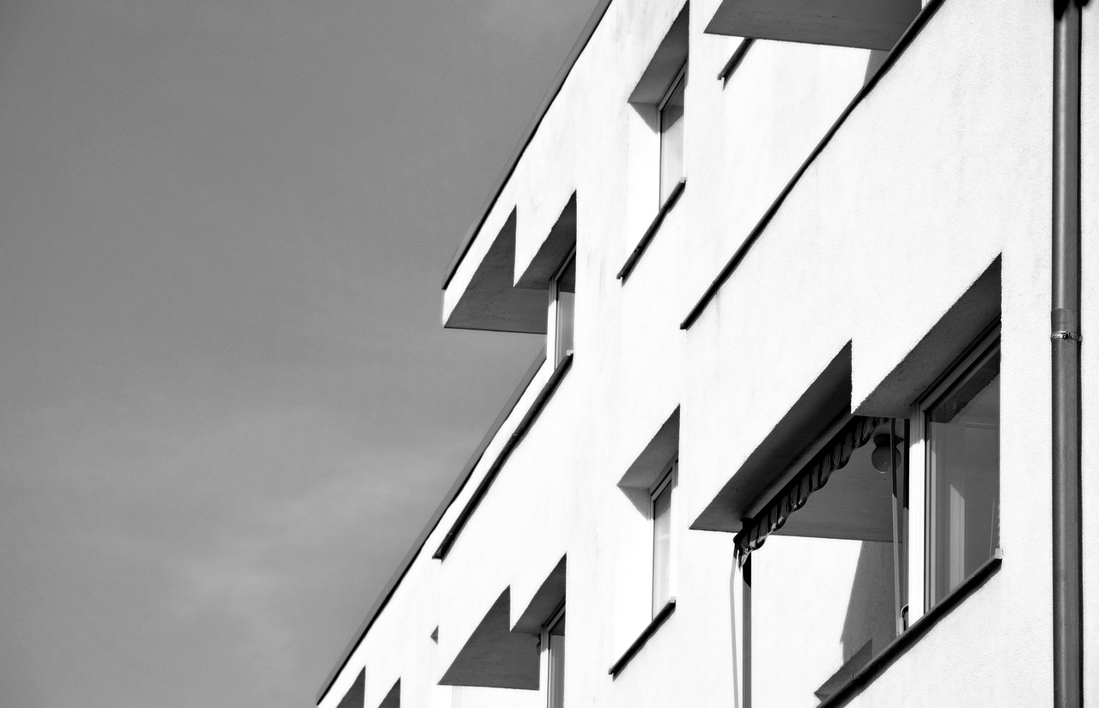
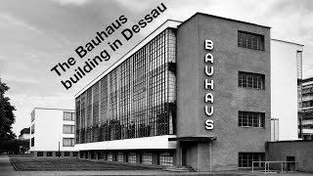
Bauhaus in Dessau (1925-1932)
Moved to Dessau in 1925 due to political pressure.
Industrial orientation: design for mass production.
Iconic Bauhaus building by Gropius.
Notes:
Creator: Meyer, Thomas, 2017
|
Credit: Bildnachweis siehe Beschreibung
Copyright: Thomas Meyer/OSTKREUZ

Slide 9
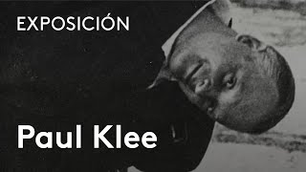
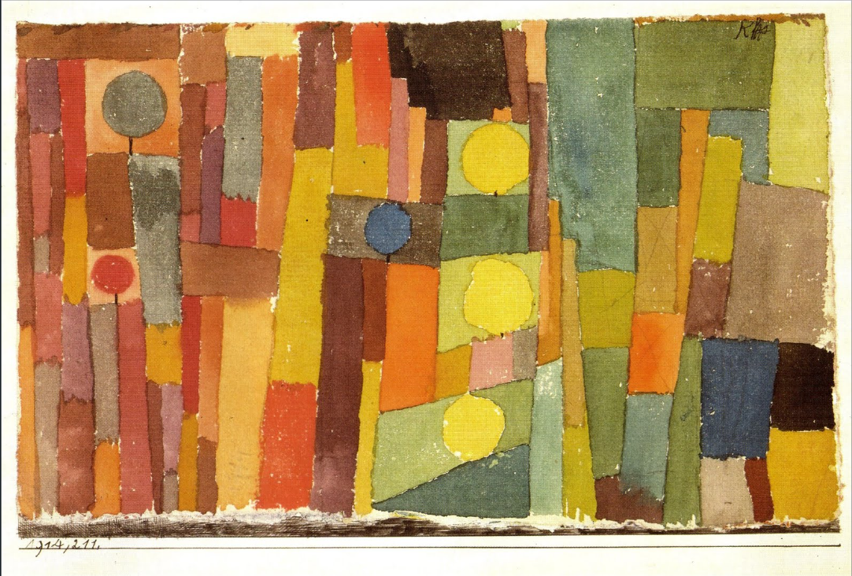
Key Bauhaus Figures
Paul Klee: Painter, focused on color theory and abstraction.
Wassily Kandinsky: Pioneer of abstract art.
László Moholy-Nagy: Photography and new media experimentation.
In the Style of Kairouan, 1914 - Paul Klee - WikiArt.org. (n.d.). www.wikiart.org. https://www.wikiart.org/en/paul-klee/in-the-style-of-kairouan-1914
Notes:
In the Style of Kairouan, 1914 - Paul Klee - WikiArt.org. (n.d.). www.wikiart.org. https://www.wikiart.org/en/paul-klee/in-the-style-of-kairouan-1914

Slide 10

Bauhaus Closure and Legacy
Closed in 1933 under Nazi pressure.
Spread of Bauhaus ideas through Europe and the U.S. (Chicago School of Design).
Influence on modernist architecture, design, and education.
Notes:
In the Style of Kairouan, 1914 - Paul Klee - WikiArt.org. (n.d.). www.wikiart.org. https://www.wikiart.org/en/paul-klee/in-the-style-of-kairouan-1914

Slide 11
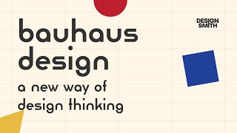
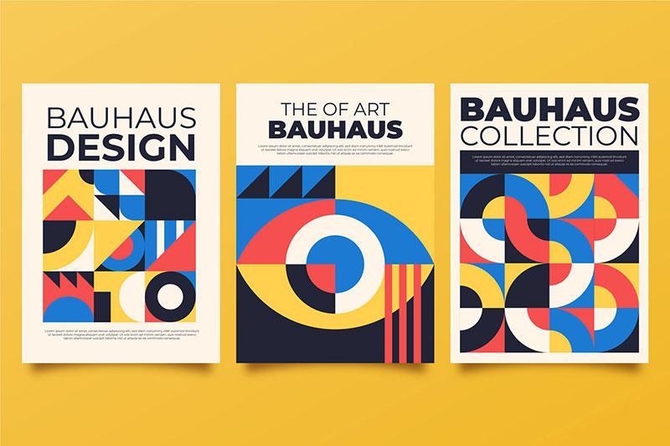
Bauhaus Tools and Methods
Geometric design tools: circles, triangles, and squares.
Use of new materials: steel, glass, and concrete.
Introduction of photography, film, and graphic design into the curriculum.
Copyright: Freepik Company S.L. - www.freepik.com
Notes:
Copyright: Freepik Company S.L. - www.freepik.com

Slide 12
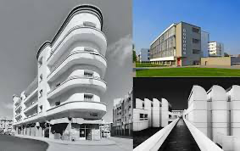
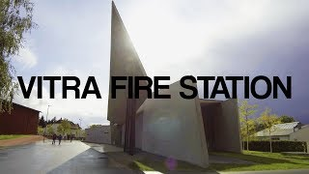

Lasting Impact of Bauhaus
Influence on modern architecture and design (e.g., Le Corbusier, minimalist design).
Continued relevance in design education worldwide.
The Bauhaus philosophy in contemporary architecture and sustainability.
Notes:
Copyright: Freepik Company S.L. - www.freepik.com

Slide 13


Website
Suggested actions to increase visitors
Mention in all project posts at the end: “Find out more: (website link)”
Repost our posts in stories of project’s accounts and add link of website as a sticker
Share newsletter with stakeholders, including website link

