Slide 1
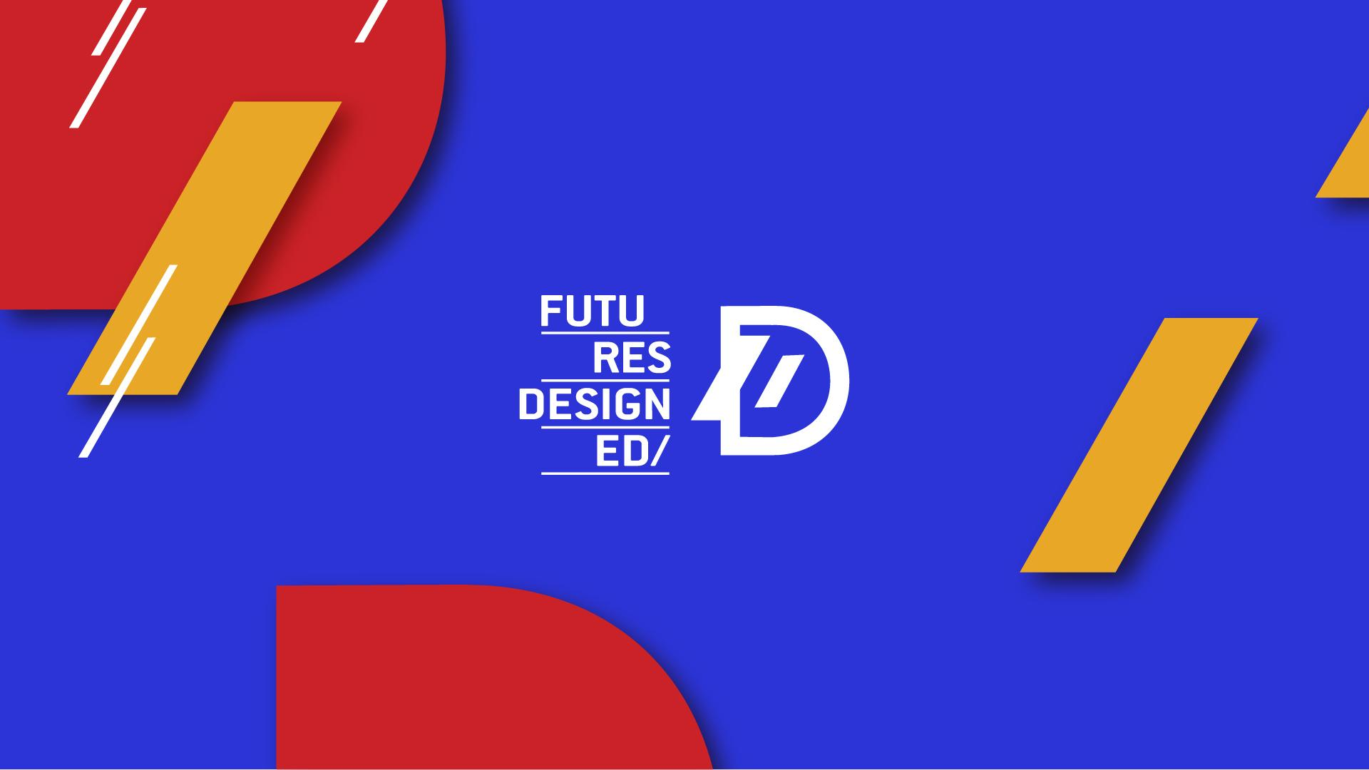

Slide 2


Introductory Course - New European Bauhaus and Principles of Sustainability in Design
Module 3: Principles of Sustainability in Design
3.1 Definition and Importance of Sustainability in Design
3.2 Key Sustainability Concepts: Reduce, Reuse, Recycle
2023-1-CY01-KA220-HED-000160668

Slide 3
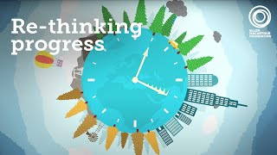

Introduction to Sustainability in Design
Increasing importance due to climate change, resource depletion, and environmental degradation.
Sustainability means meeting present needs without compromising future generations.
Considers environmental, social, and economic impacts throughout the product life cycle.

Slide 4
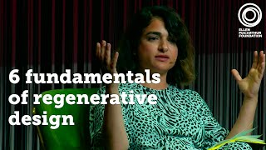
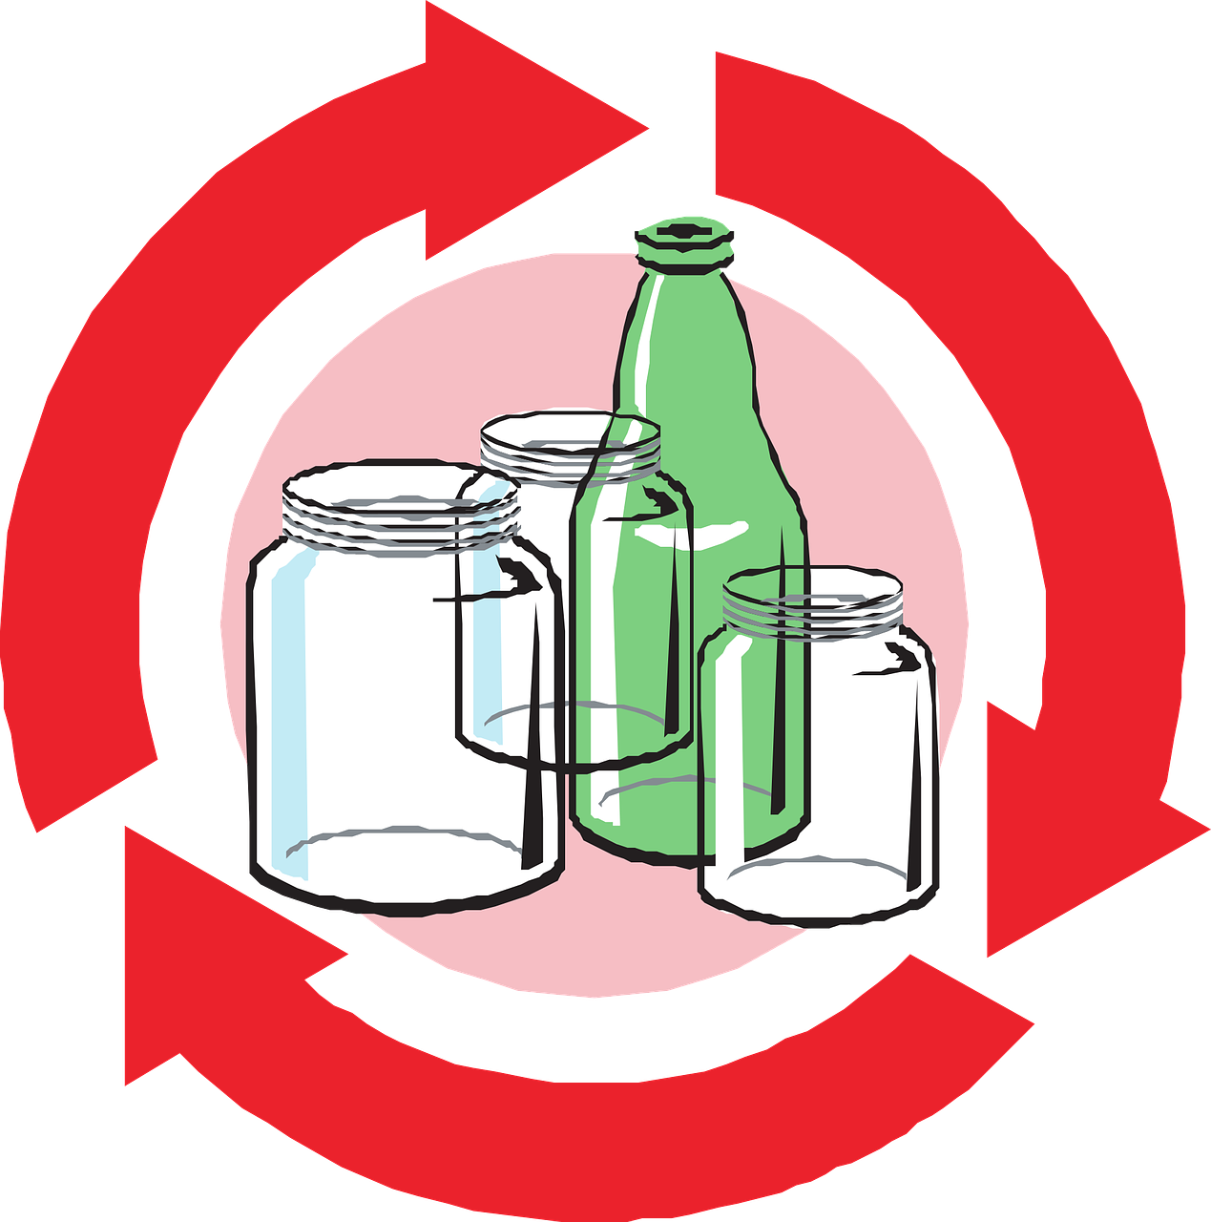
Definition of Sustainability in Design
Creating solutions that are environmentally responsible, socially equitable, and economically viable.
Designing with a long-term perspective (materials, manufacturing, disposal).

Slide 5


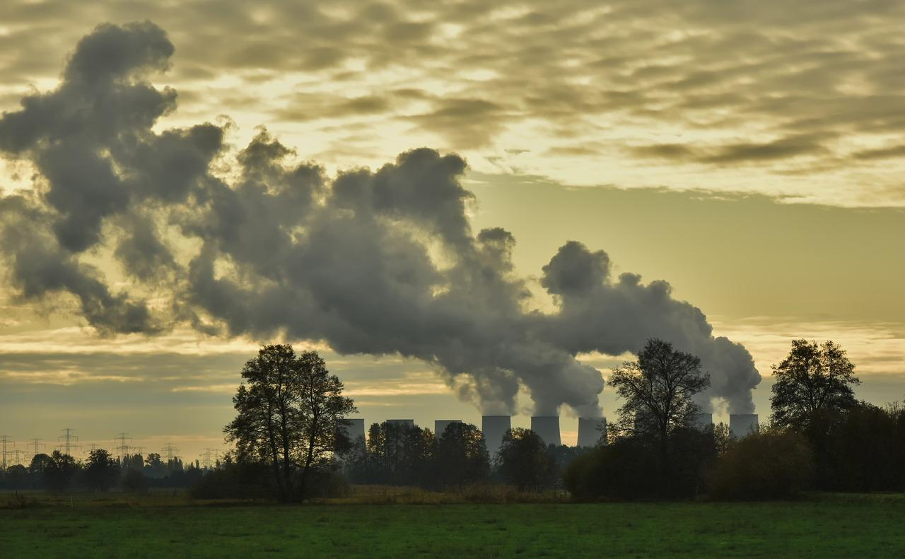
Environmental Responsibility
Design and production contribute to pollution, deforestation, climate change.
Sustainable design reduces environmental impact, conserves resources, protects ecosystems.

Slide 6
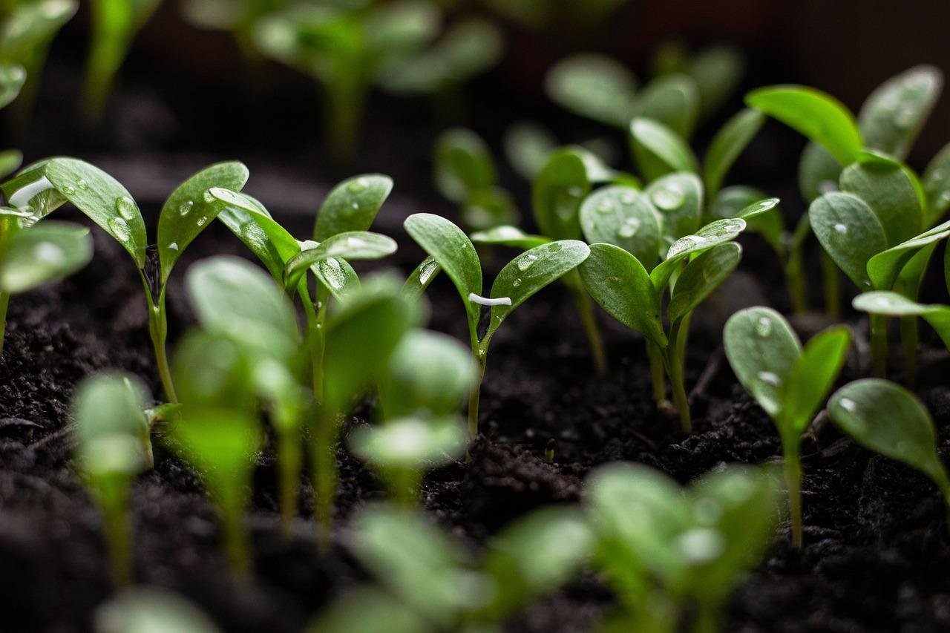
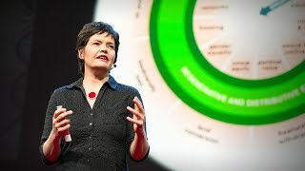
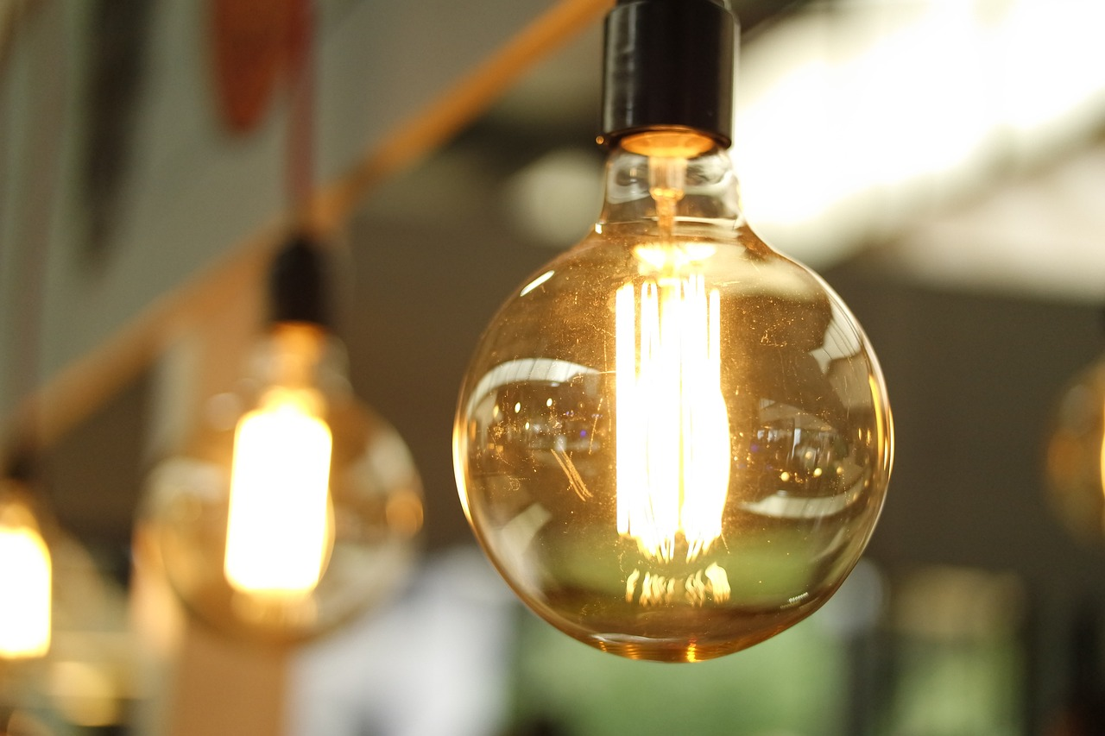
Economic Efficiency
Efficient use of materials and energy reduces costs.
Sustainable products are more durable and cost-effective in the long run.

Slide 7




Social Equity in Sustainable Design
Inclusive and accessible designs for people of all backgrounds.
Sustainable design promotes equity by ensuring products are beneficial to all people.

Slide 8


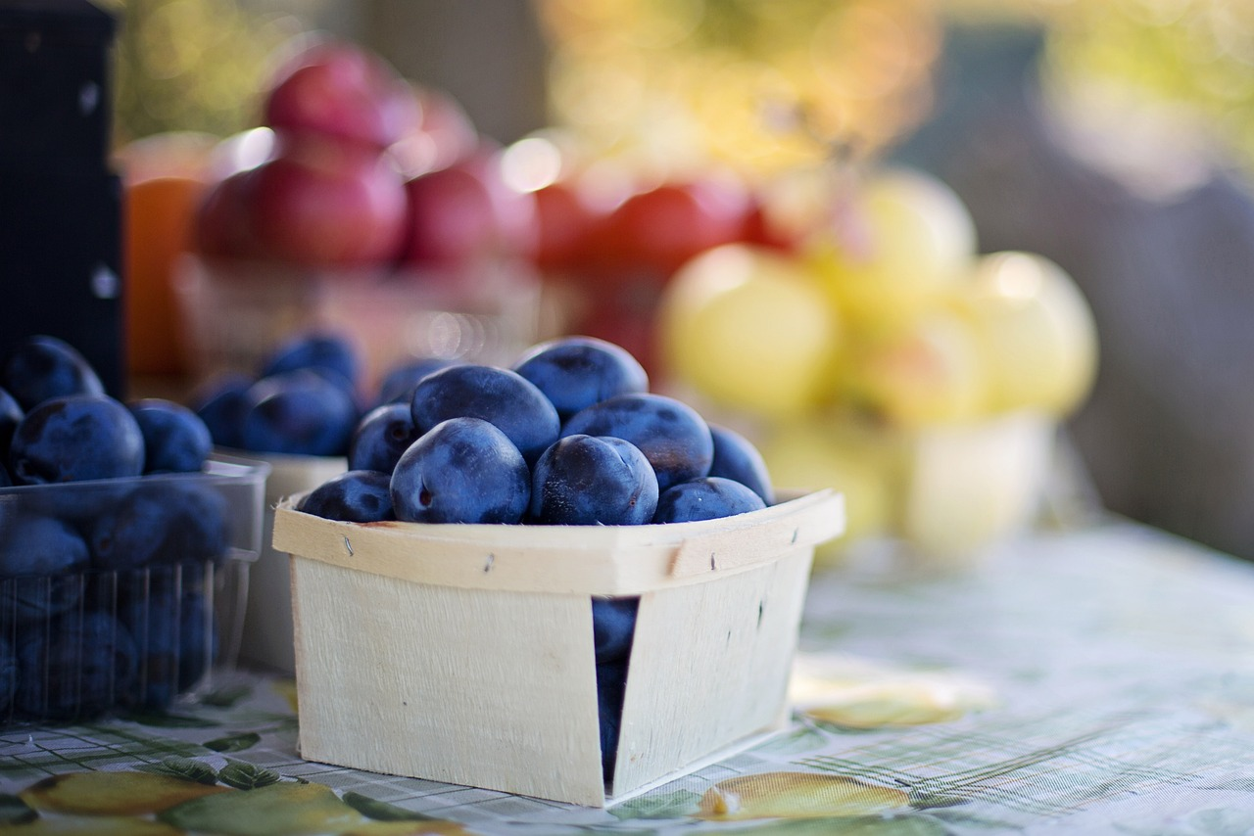
Regulatory Compliance & Market Demand
Governments are implementing stricter environmental regulations.
Consumers are demanding ethically produced, sustainable products.
Companies that adopt sustainable practices gain a competitive advantage.

Slide 9
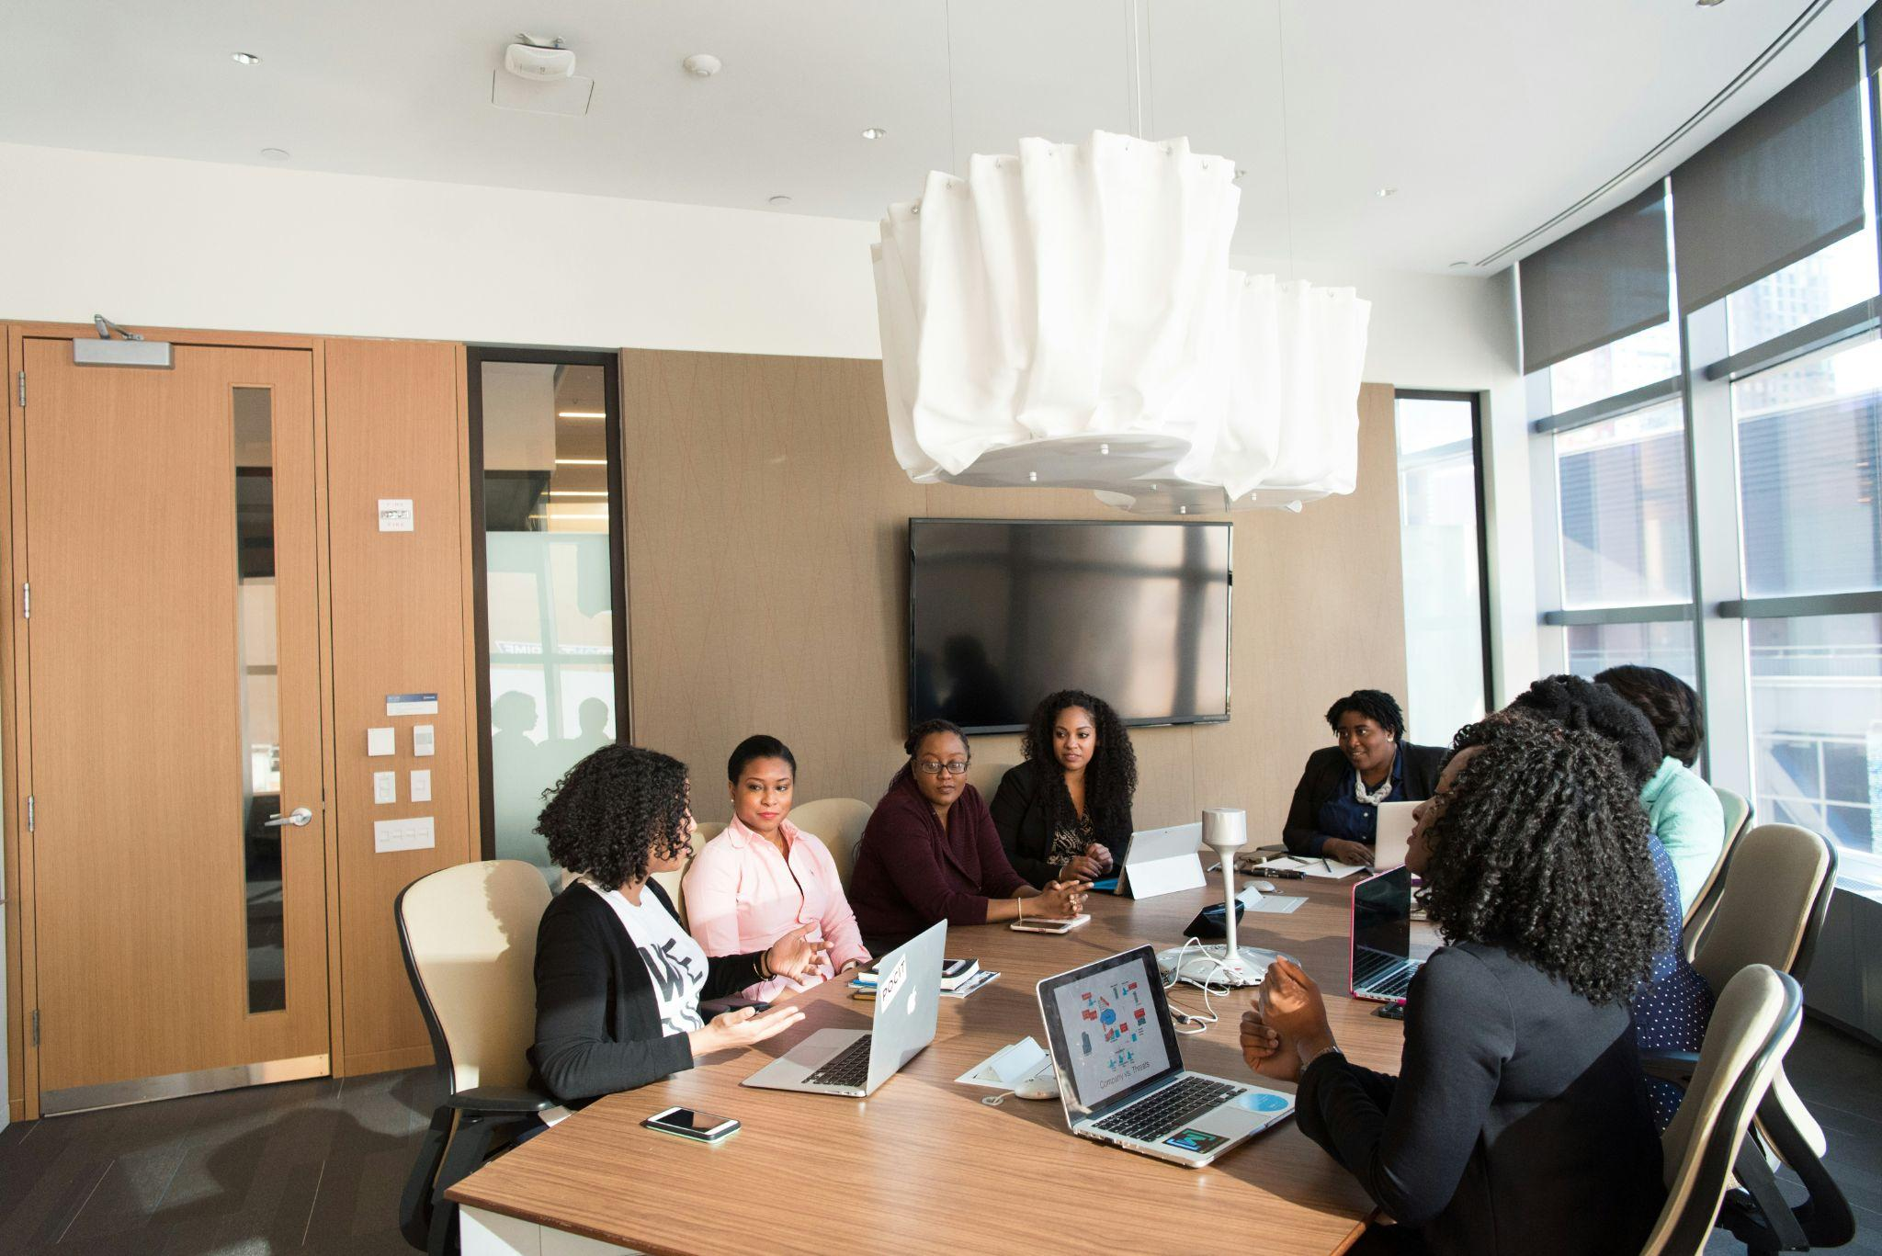
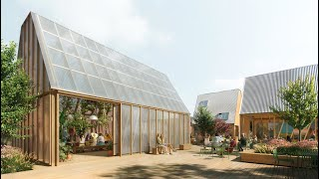
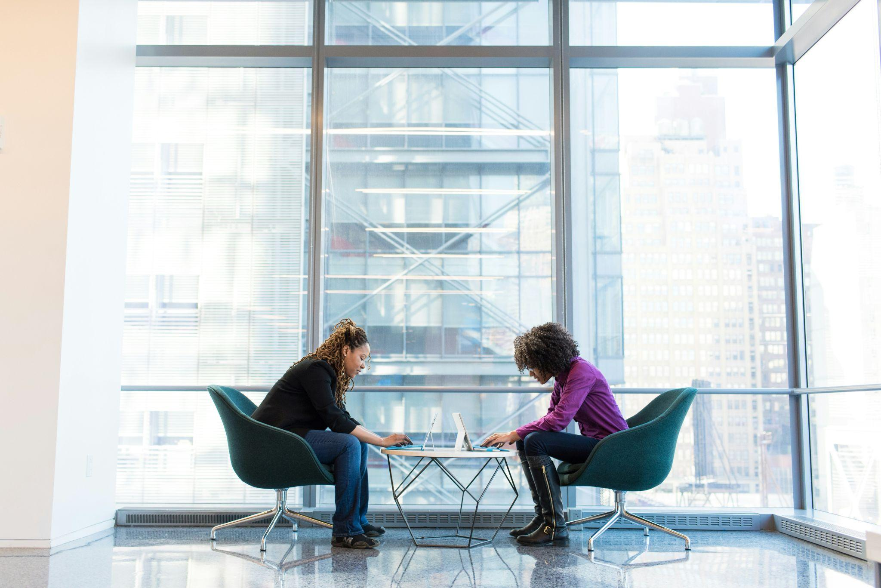
Conclusion: Why Sustainability Matters
Sustainability is key to creating responsible and impactful designs.
A holistic approach benefits the environment, society, and the economy.

Slide 10
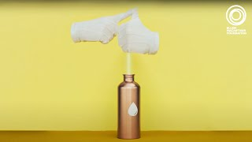
The 3 Rs of Sustainability: Reduce
Minimise material and energy use in production and lifecycle.
Material efficiency: choose durable, energy-efficient materials.
Energy efficiency: design products that consume less energy.
Waste reduction: minimise packaging, design for repair, and modularity.

Slide 11

The 3 Rs of Sustainability: Reuse
Design products that can be reused multiple times or repurposed.
Focus on durability and upcycling.
Modular design allows for parts to be upgraded or replaced.

Slide 12
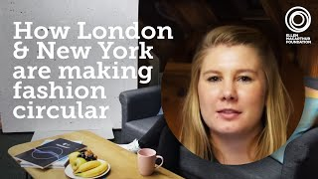
The 3 Rs of Sustainability: Recycle
Reclaim materials from old products to create new ones.
Design for disassembly and material selection for easy recycling.
Use of recycled materials in production.

Slide 13

Conclusion: Applying the 3 Rs in Design
The 3 Rs guide sustainable design to minimize environmental impact.
Reduce, Reuse, Recycle promotes circular economy and resource efficiency.
Designers can contribute to a more sustainable future by integrating these principles.
Notes:
Copyright: Freepik Company S.L. - www.freepik.com

Slide 14

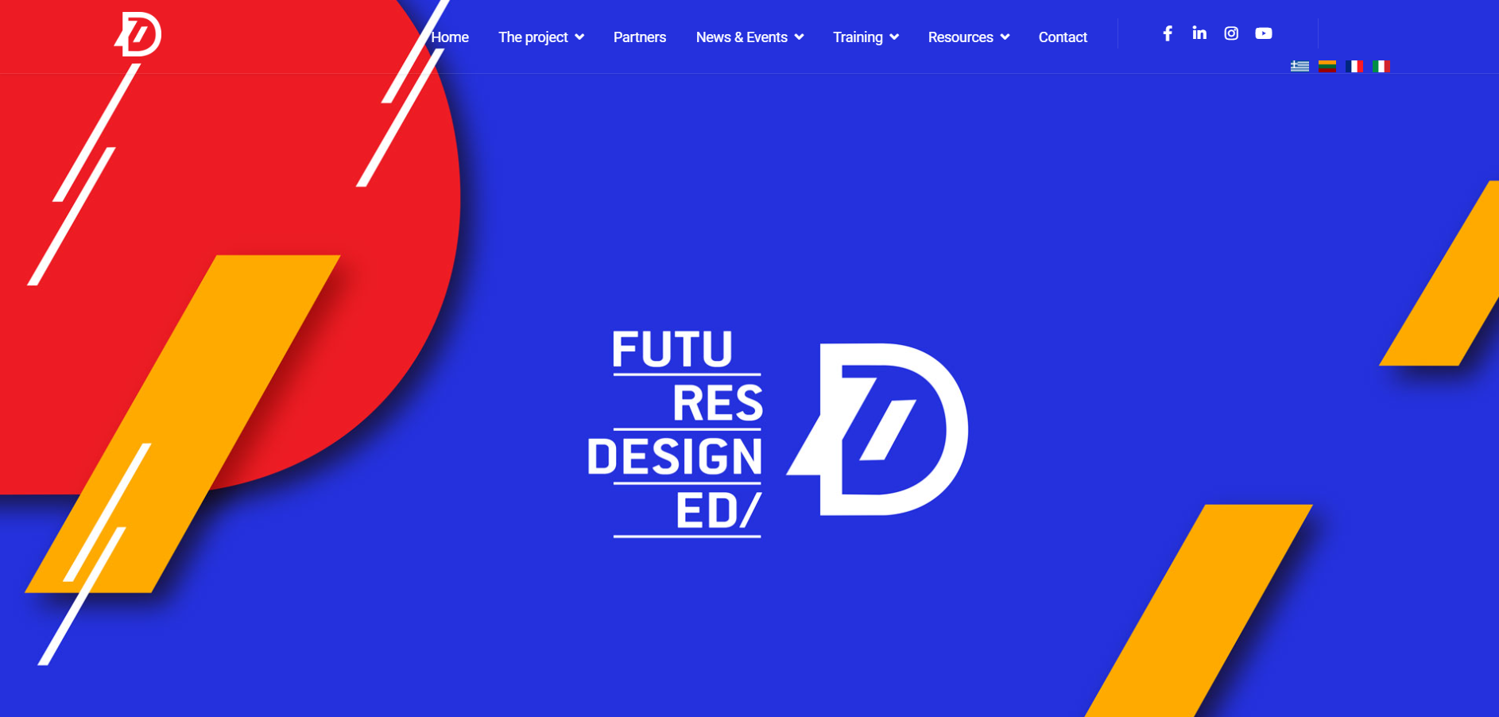
Website
Suggested actions to increase visitors
Mention in all project posts at the end: “Find out more: (website link)”
Repost our posts in stories of project’s accounts and add link of website as a sticker
Share newsletter with stakeholders, including website link

