Slide 1


Slide 2




Re-use and Re-design of Outdated Industrial Objects
Module 1: Principles of Re-Use and Re-Design
1.1. Introduction: Reuse of Outdated Industrial Objects
1.2. Understanding the Ecosystem of Urban Development
1.3. The history of conservation policy and urban adaptive reuse
1.4. The European Union's Approach to Urban
1.5. Urban Reuse in New European Bauhaus (NEB)
1.6. Approaches to Reuse in Buildings and Landscapes
1.7. Defining Adaptive Landscape and Architecture Reuse
1.8. Key Challenges and Opportunities in Industrial Reuse
2023-1-CY01-KA220-HED-000160668

Slide 3
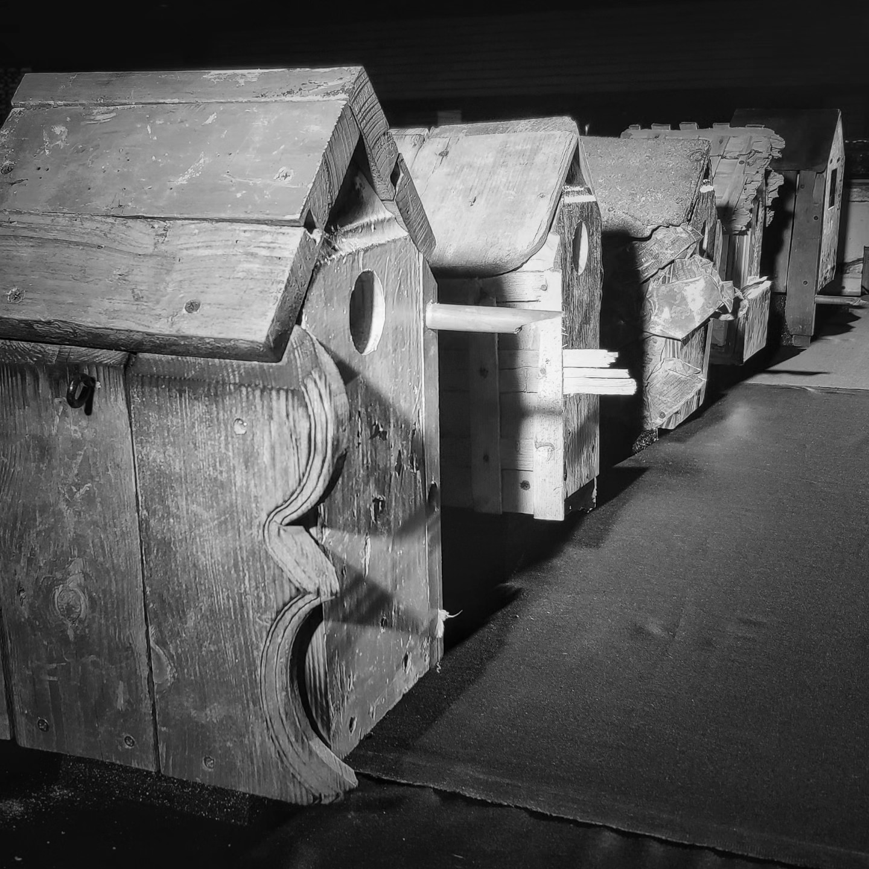
1.1. Introduction: Reuse of Outdated Industrial Objects
Adaptive reuse transforms outdated industrial objects into multifunctional spaces, conserving resources and preserving cultural heritage while addressing urban challenges such as sustainability and community engagement​.
This approach enhances urban environments by integrating ecological benefits, like improved air quality and biodiversity, with recreational and cultural opportunities, creating spaces that honor the past and support future resilience

Slide 4
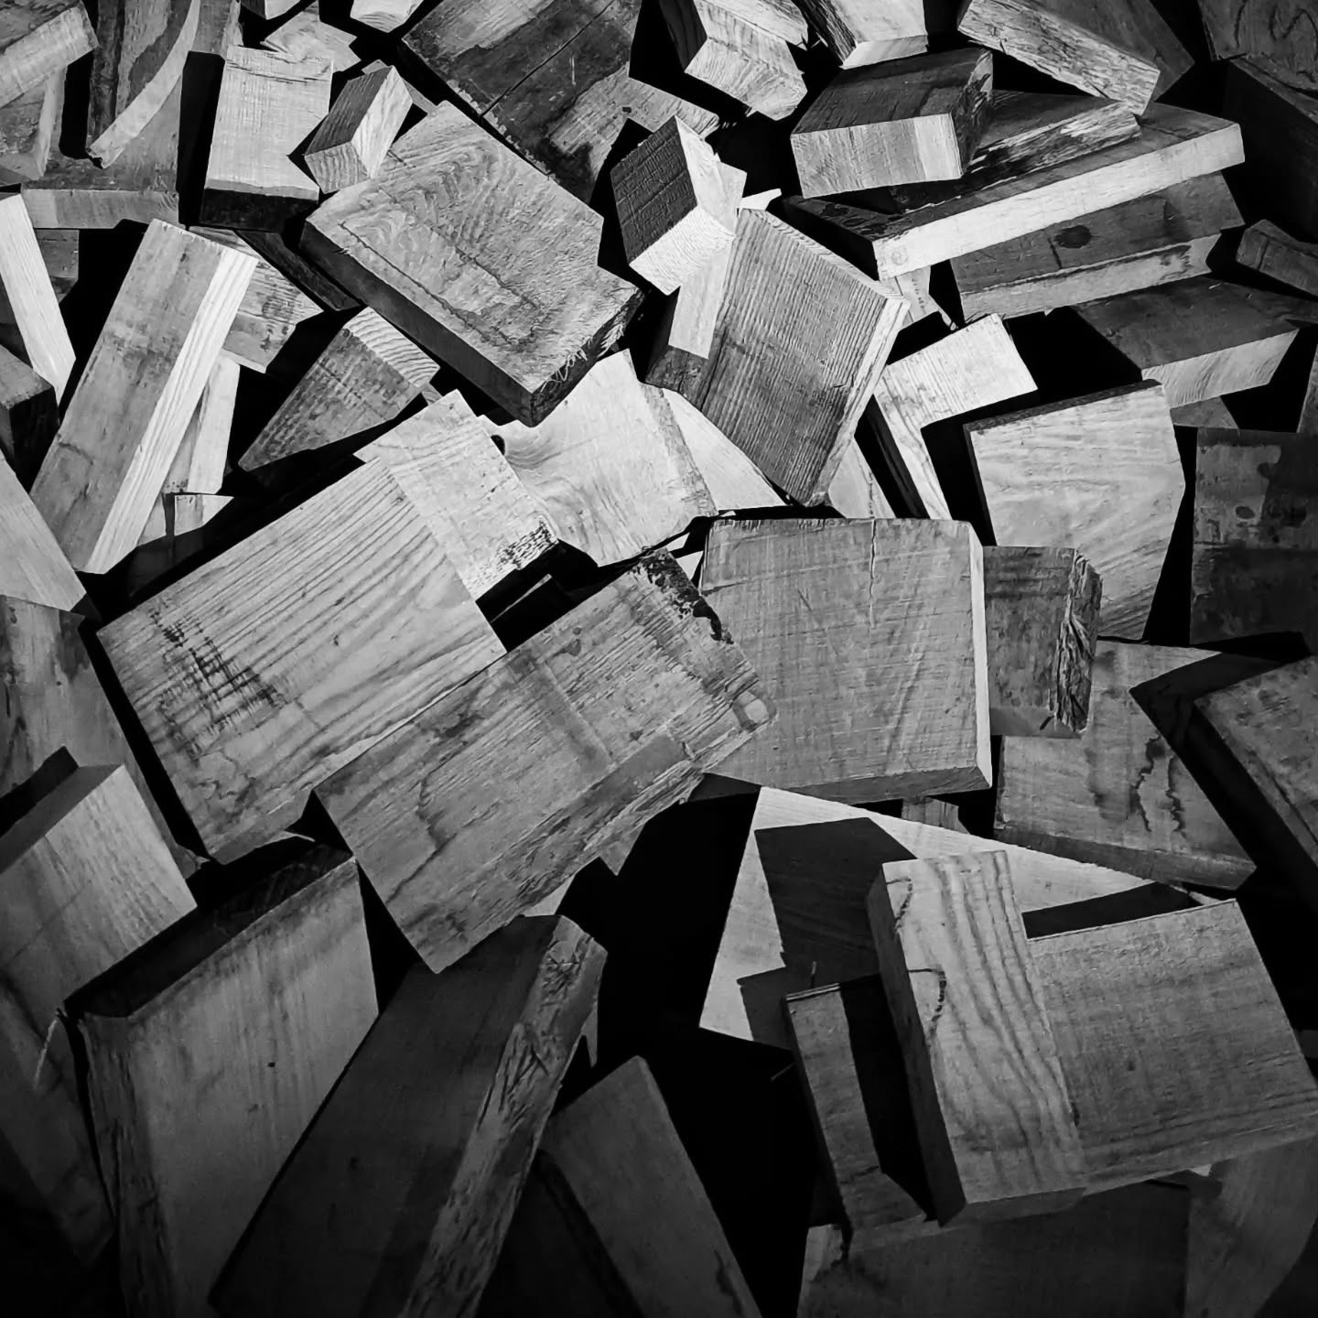
1.2. Understanding the Ecosystem of Urban Development
Adaptive reuse integrates outdated industrial structures into urban development, transforming them into functional spaces like green corridors, recreational parks, or cultural hubs, which promote sustainability and community engagement by repurposing resources and preserving historical character​.
Multifunctionality is a key principle, enabling reused industrial objects to meet ecological, cultural, and social needs simultaneously, such as turning an abandoned railway into a park that serves as a recreational pathway, a wildlife habitat, and a green buffer for urban areas.
Incorporating ecosystem services enhances urban sustainability, with features like green roofs, rain gardens, and vegetative corridors improving air quality, managing stormwater, and supporting biodiversity, demonstrating a harmonious coexistence of natural and built environments.

Slide 5
1.3. The History of Conservation Policy and Urban Adaptive Reuse
Adaptive reuse evolved from necessity to deliberate practice, with historical roots in practical conservation during ancient and medieval times, gradually becoming a purposeful design philosophy emphasizing sustainability and cultural preservation​.
The 19th and 20th centuries shaped modern conservation policy, with influential movements like John Ruskin’s emphasis on preserving material authenticity and Viollet-le-Duc’s focus on restoration, culminating in global frameworks like the Venice Charter​.
Global conservation charters established principles for adaptive reuse, advocating minimal intervention, authenticity, and the integration of historical sites into modern urban life to ensure their relevance and preservation​.
Contemporary adaptive reuse aligns with sustainability and inclusivity, transforming neglected industrial and cultural landmarks into functional spaces that support ecological, social, and economic goals while honoring historical significance

Slide 6
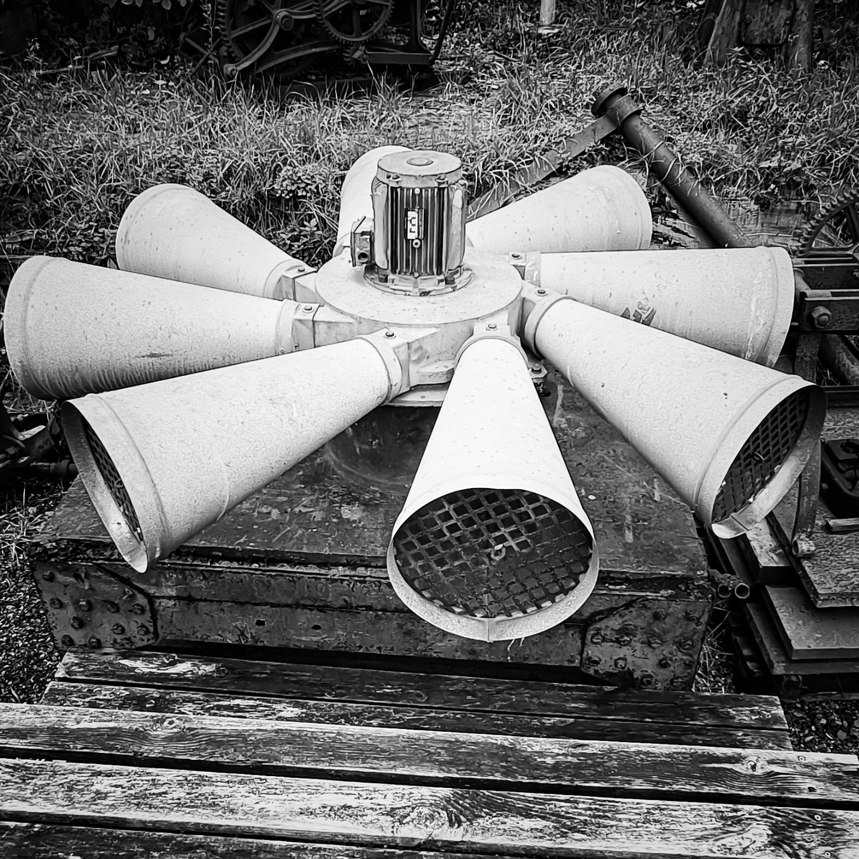
1.4. The European Union's Approach to Urban
The European Union integrates circular economy principles into urban reuse, prioritizing sustainable development through material recycling, urban regeneration, and compact city strategies that minimize environmental impacts and urban sprawl​.
Policies such as the New European Bauhaus emphasize inclusivity, sustainability, and aesthetic innovation, fostering collaboration among stakeholders to repurpose urban spaces into multifunctional and culturally rich environments​

Slide 7
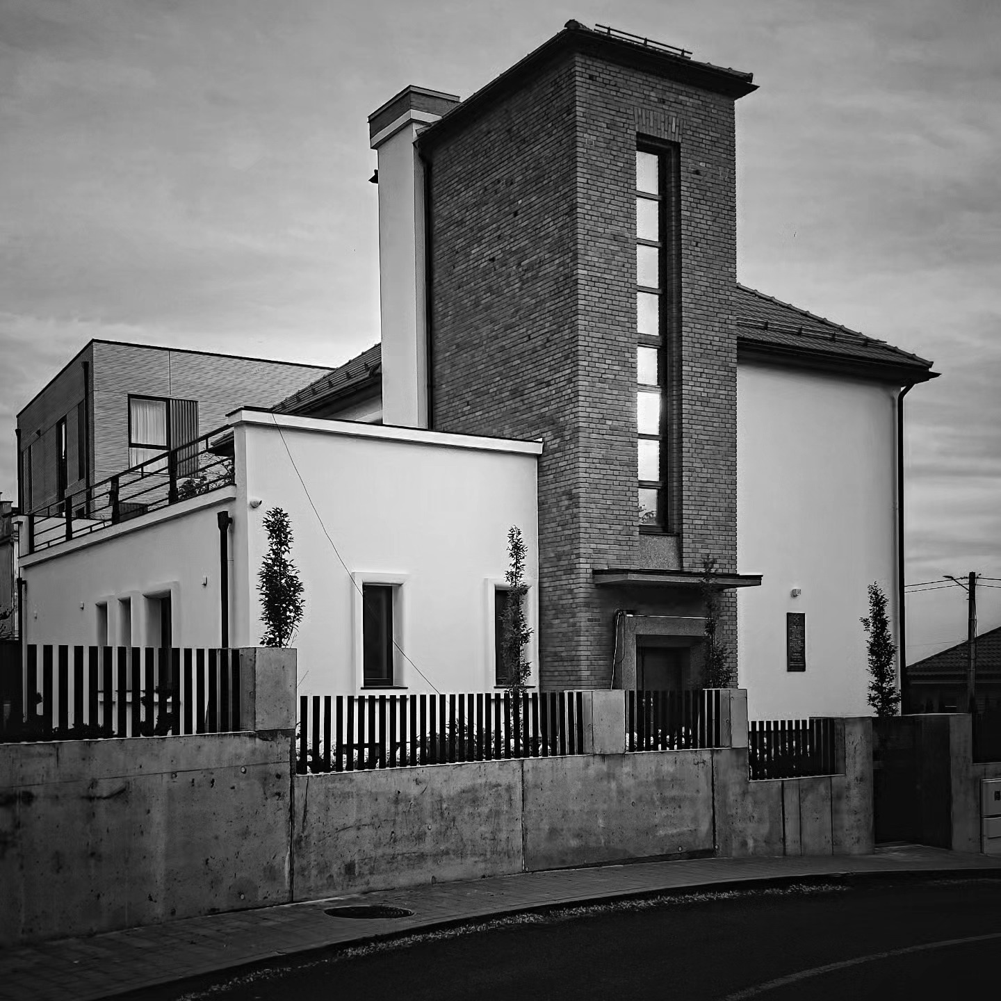
1.5. Urban Reuse in New European Bauhaus (NEB)
The New European Bauhaus (NEB) integrates sustainability, inclusivity, and aesthetic innovation in urban reuse, transforming outdated structures into culturally significant, multifunctional spaces that align with ecological and social goals​.
NEB emphasizes community involvement and cultural preservation, ensuring adaptive reuse projects address diverse needs while honoring historical heritage, fostering resilience and creativity in urban design

Slide 8
1.6. Approaches to Reuse in Buildings and Landscapes
Adaptive reuse offers diverse strategies, such as retrofitting for energy efficiency, regeneration of industrial districts, and reclamation of degraded landscapes, tailoring solutions to specific environmental, social, and functional needs​.
Multifunctionality is a cornerstone of reuse approaches, enabling spaces to serve ecological, cultural, and social purposes simultaneously, such as converting railways into greenways or factories into mixed-use urban hubs​.
Creative and sustainable reuse leverages materials and existing structures, integrating practices like upcycling and modular design to reduce environmental impact while enhancing the aesthetic and functional value of urban landscapes

Slide 9
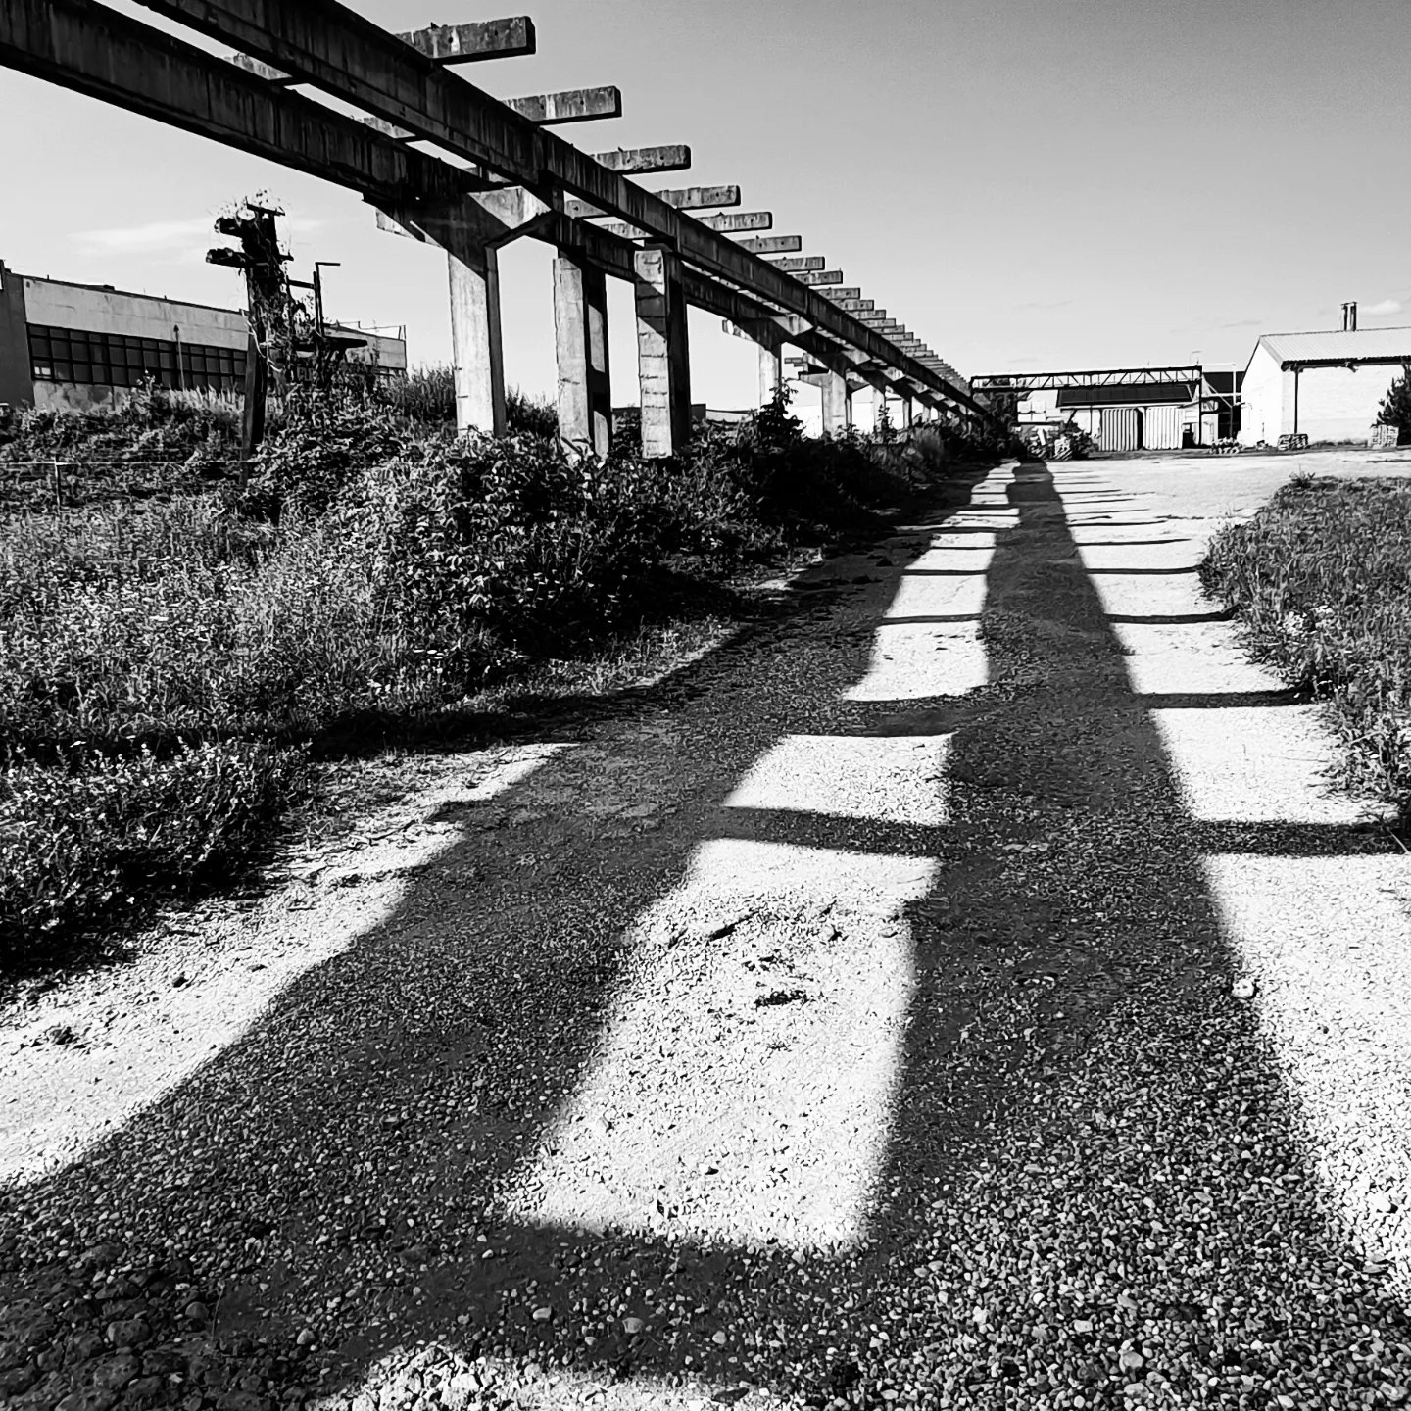
1.7. Defining Adaptive Landscape and Architecture Reuse
Adaptive reuse combines adaptation and reuse principles to
transform existing structures into functional spaces while
retaining historical and cultural elements​.
It bridges modernization with heritage preservation, ensuring
historical buildings and landscapes remain relevant and
sustainable in contemporary contexts​.
Flexibility and multifunctionality are central, enabling spaces to
evolve with societal and environmental needs over time​.
Creativity plays a pivotal role, reimagining materials and
structures to foster innovation and community engagement​.
Adaptive reuse minimizes environmental impact by conserving
resources and prioritizing the integration of natural and human
elements into revitalized spaces

Slide 10
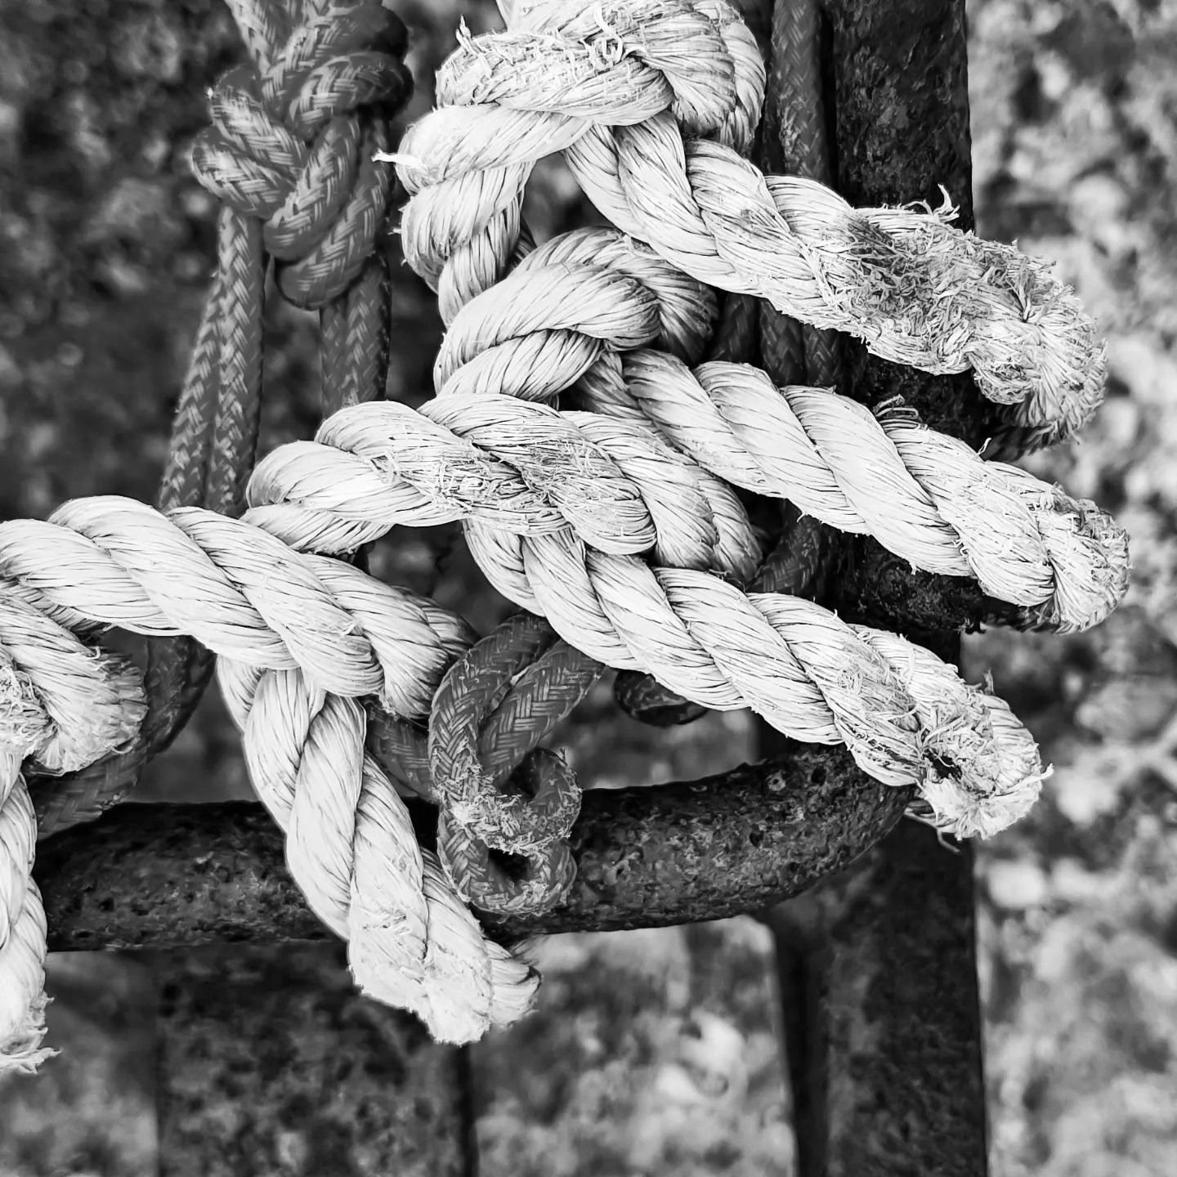
1.8. Key Challenges and Opportunities in Industrial Reuse
Industrial reuse reduces construction waste and resource consumption, supporting the transition to a circular economy.
Remediating environmental contamination in industrial sites creates opportunities for ecological restoration and urban revitalization.
Adaptive reuse fosters multifunctional spaces, integrating cultural, social, and environmental benefits in urban landscapes.
Challenges include addressing contamination, ensuring structural adaptability, and overcoming regulatory and financial barriers.
Collaboration among stakeholders and innovative technologies like BIM can streamline reuse projects and enhance sustainability outcomes.

Slide 11
1. Activities | Readings
Mary L. Cadenasso, Steward T. A. Pickett. Urban Principles for Ecological Landscape Design and Maintenance: Scientific Fundamentals.
Liliane Wong ”Adaptive REUSE: Extending the Lives of Buildings”
Athens Charter for the Restoration of Historic Monuments. In The First International Congress of Architects and Technicians of Historic Monuments
International charter for the conservation and restoration of monuments and sites (the Venice charter). In IInd International Congress of Architects and Technicians of Historic Monuments
European Union. New European Bauhauz. Policy ecosystem.
European Union. New European Bauhauz. About.
The New European Bauhaus. Making the Renovation Wave a Cultural Project STATEMENT.

Slide 12
1. Activities | Visuals
Intro - What Does Adaptive Reuse Mean? - https://www.youtube.com/watch?v=okkheYt5jK8
Adaptive Reuse of Built Heritage: Concepts and Cases of an Emerging Discipline - https://www.youtube.com/watch?v=pb6EwUUiEwE&t=147s
Reuse and Preservation in Contemporary Architecture - https://www.youtube.com/watch?v=ADE37ncCMjA
Adaptive Reuse. The Future Of Our Industrial Legacies - https://www.youtube.com/watch?v=8s7qeL2WNhs
The Emerging Trend of Adaptive Reuse in 2021 - https://www.youtube.com/watch?v=uYni4kUB15E
The principles of reusing existing buildings - https://www.youtube.com/watch?v=rzV6ITBm6SM
Adaptive Reuse: Challenges, Opportunities and Benefits - https://www.youtube.com/watch?v=bfkf3hji534
Approaches to Adaptive Reuse in Architecture - https://www.youtube.com/watch?v=3Uymv-hch9E
New European Bauhaus: Adaptive reuse of cultural heritage - https://www.youtube.com/watch?v=GR04zAFyLaw
Adaptive heritage reuse: Policy contexts across Europe - https://www.youtube.com/watch?v=4jWewJeUCps
Webinar: Historic houses in the green transition - https://www.youtube.com/watch?v=8Q2ermbw1GI
Overcoming the Challenges of Economically Reusing/Restoring Historic Buildings - https://www.youtube.com/watch?v=X8jrR2LUQ10

