Slide 1


Slide 2




Re-use and Re-design of Outdated Industrial Objects
Module 2: Theory of Adaptive Reuse in Urban and Landscape Design
2.1. Core Principles of Adaptive Reuse in Urban and Landscape Design
2.2. Multifunctionality, Inclusivity and Historical Preservation
2.3. Green and Blue Infrastructure in Reuse Projects
2.4. The Benefits of a Holistic Approach
2023-1-CY01-KA220-HED-000160668

Slide 3
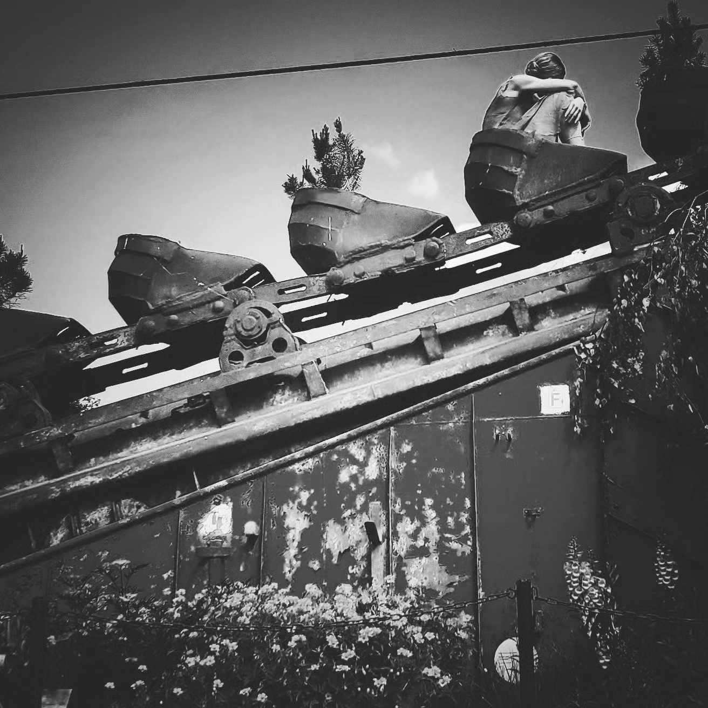
2.1. Core Principles of Adaptive Reuse in Urban and Landscape Design
Adaptive reuse prioritizes sustainability, conserving
resources by repurposing materials and spaces while
reducing environmental impact​.
Cultural preservation is central, integrating historical and
community identity into modern design to create meaningful
and functional landscapes​.
Flexibility and multifunctionality ensure long-term usability,
enabling reused spaces to adapt to evolving societal and
environmental needs

Slide 4
2.2. Multifunctionality, Inclusivity and Historical Preservation
Multifunctionality, inclusivity, and historical preservation are key principles in adaptive reuse, ensuring projects are sustainable, equitable, and culturally rich.
Multifunctionality enhances urban spaces by integrating diverse uses within a single building or site. This approach revitalizes old structures while creating vibrant spaces that serve multiple community needs, generating both economic and social value​.
Inclusivity focuses on ensuring adaptive reuse projects benefit all residents. This includes creating accessible public spaces, affordable housing, and preventing gentrification. Community engagement ensures that these spaces reflect local cultural values and serve a broad spectrum of society​
Historical preservation balances the integration of modern needs with the conservation of cultural and architectural heritage. By maintaining key historical features, adaptive reuse projects allow communities to celebrate their past while adapting to present-day demands​.
To mention: economic and environmental sustainability, ingenuity and flexible design, cultural diversity.

Slide 5
2.3. Green and Blue Infrastructure in Reuse Projects
Green and blue infrastructure (GBI), such as green roofs and rain gardens, integrates natural systems into adaptive reuse projects, improving environmental sustainability by managing stormwater, enhancing air quality, and reducing urban heat islands.
GBI promotes biodiversity by transforming reused sites into ecological spaces, fostering habitats for urban wildlife and supporting plant and animal life in cities.
The combination of GBI and adaptive reuse creates multifunctional urban spaces** that offer both ecological and social benefits, turning redeveloped areas into vibrant community hubs that also serve environmental goals.
GBI contributes to urban resilience, addressing climate challenges such as flooding and water management, while maintaining the cultural and historical value of reused buildings and landscapes.

Slide 6
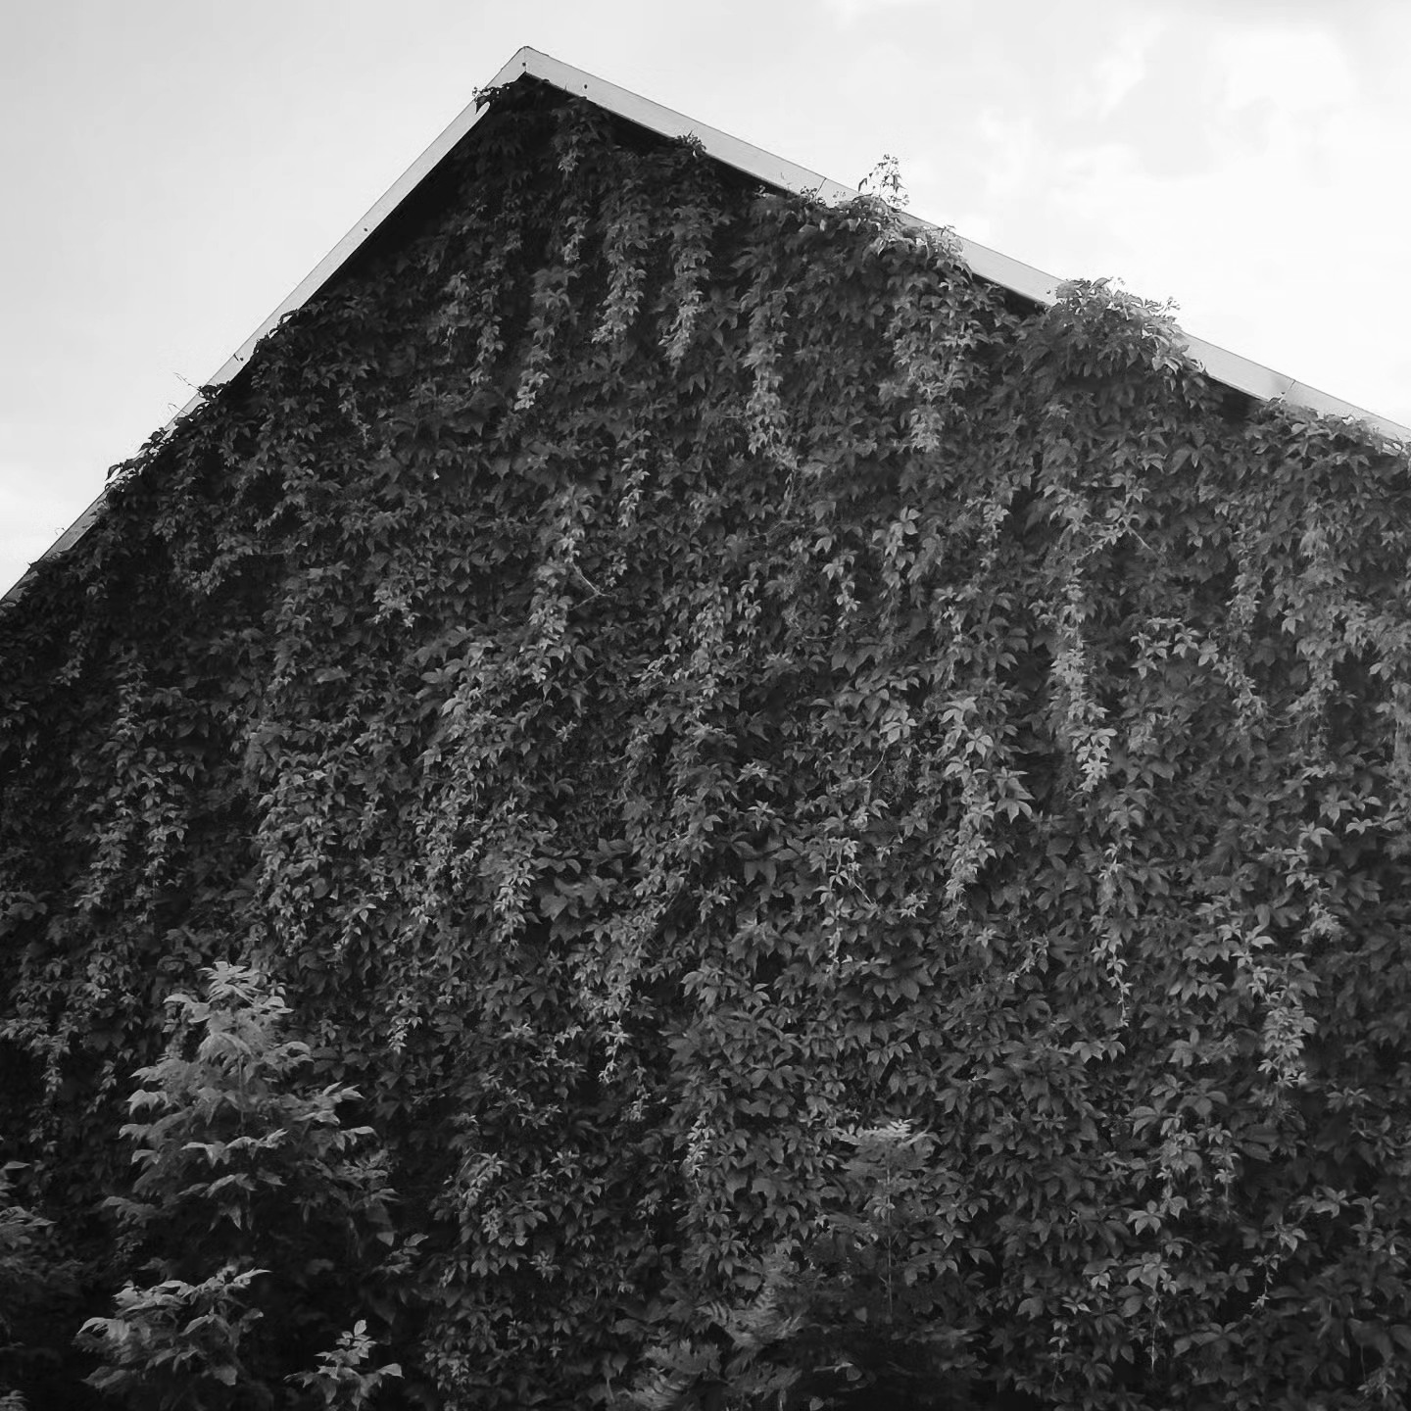
2.4. The Benefits of a Holistic Approach
Ecological land reuse offers significant environmental, economic, and social benefits, including improved biodiversity, reduced remediation costs, and enhanced community well-being, while transforming degraded areas into valuable urban or natural spaces.
A holistic approach to land reuse maximizes sustainability by integrating natural systems and human activities**, creating spaces that foster economic growth, environmental restoration, and community engagement simultaneously.

Slide 7
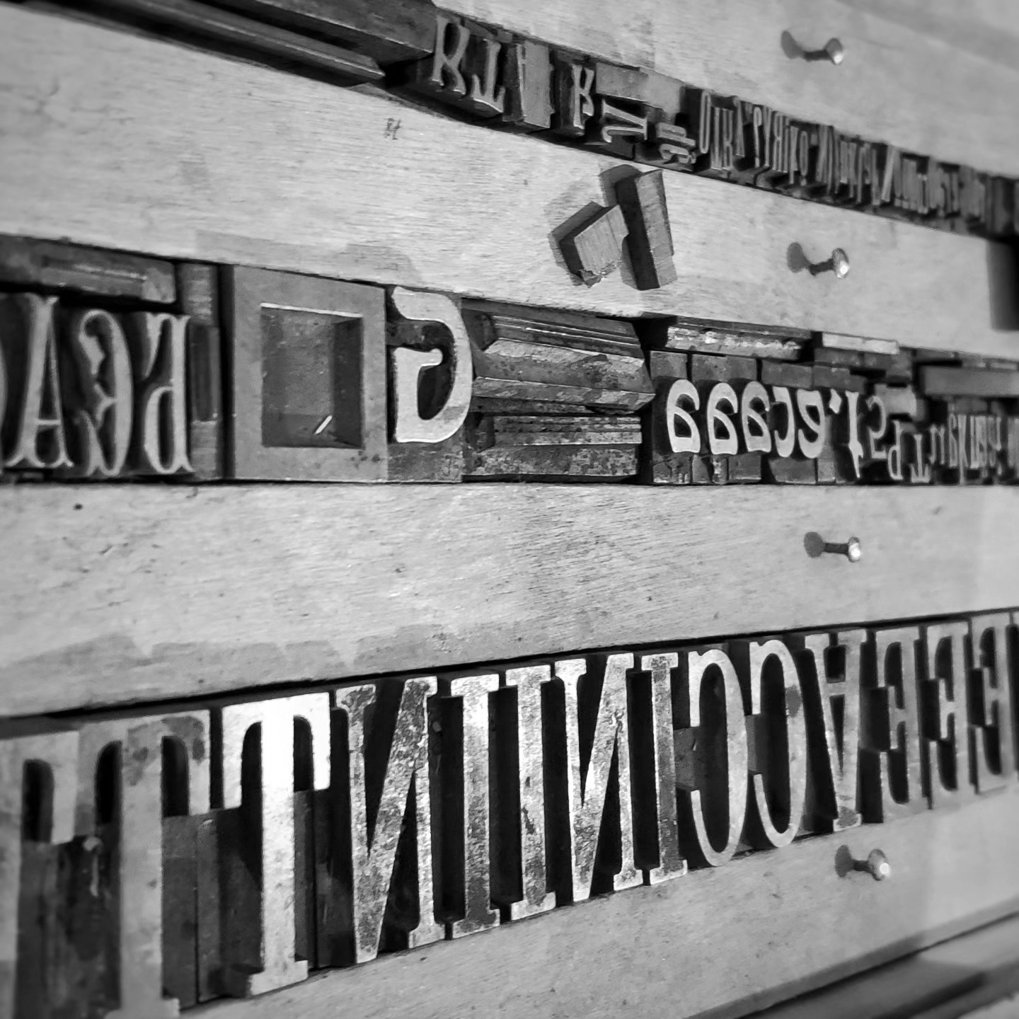
2. Activities | Readings
The American Institute of Architects. Buildings that last:
design for adaptability, deconstruction, and reuse.
Astrid Severin, Magda Michaliková. Green and blue
infrastructure. Policy Brief from the Policy Learning
Platform for a greener Europe.

Slide 8
2. Activities | Visuals
What is the Importance of Historical Preservation in Modern Society - https://www.youtube.com/watch?v=ISb_jImuoiw
Blue Green Solutions: a Systems Approach to Sustainable and Cost-Effective Urban Development - https://www.youtube.com/watch?v=7bgp3E0gUAQ
Green/Blue Infrastructure for Sustainable, Attractive Cities - https://www.youtube.com/watch?v=FKyc1QIpuQM
Planning Multi-functional Blue Green Systems in Cities of the Future - https://www.youtube.com/watch?v=ATQHzEgmSsk

