Slide 1


Slide 2



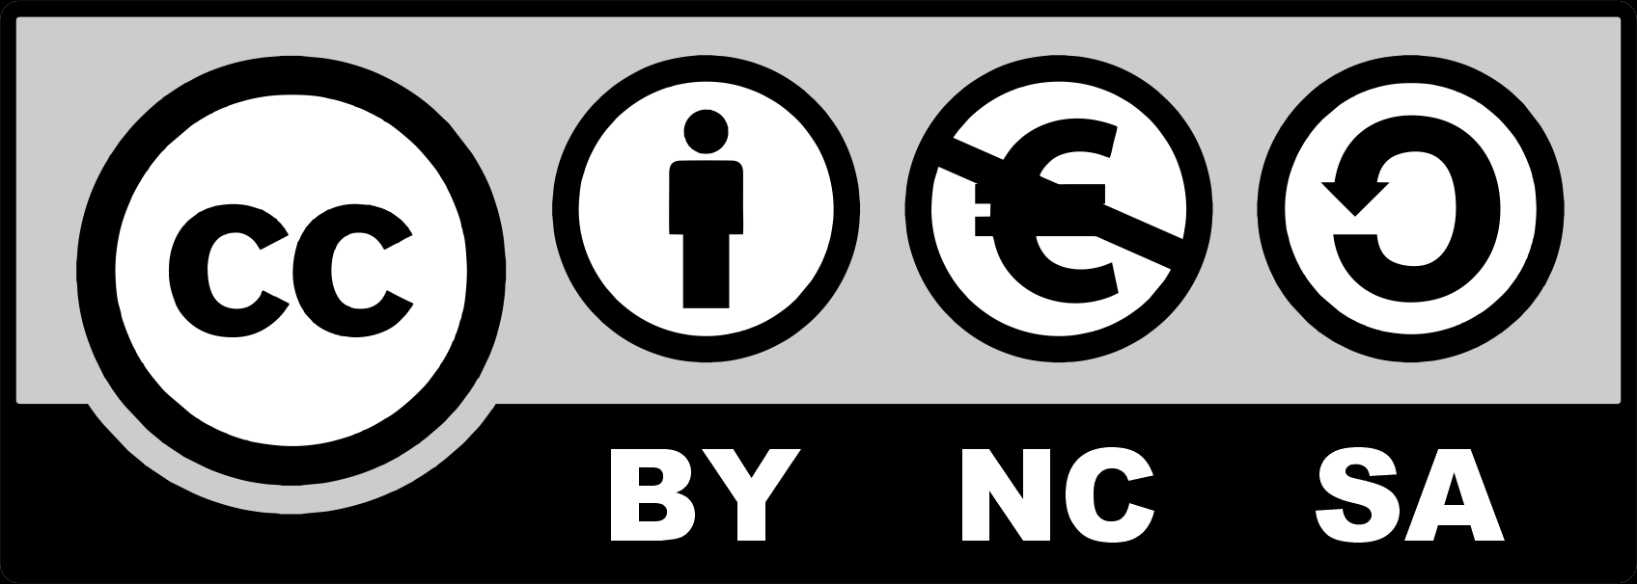
Re-use and Re-design of Outdated Industrial Objects
Module 3: Techniques for Repurposing Industrial Objects
3.1. Cornerstone of Modern Urban Planning
3.2. Different Methods of Preserving Buildings
3.3. Strategies for Reuse
3.4. Tactics for Reuse
3.5. Intervention Types in Reuse
3.6. Decision-Making Models
3.7. Focus on Design Criteria System Method
3.8. Methodologies for Post-Industrial Landscape
2023-1-CY01-KA220-HED-000160668

Slide 3
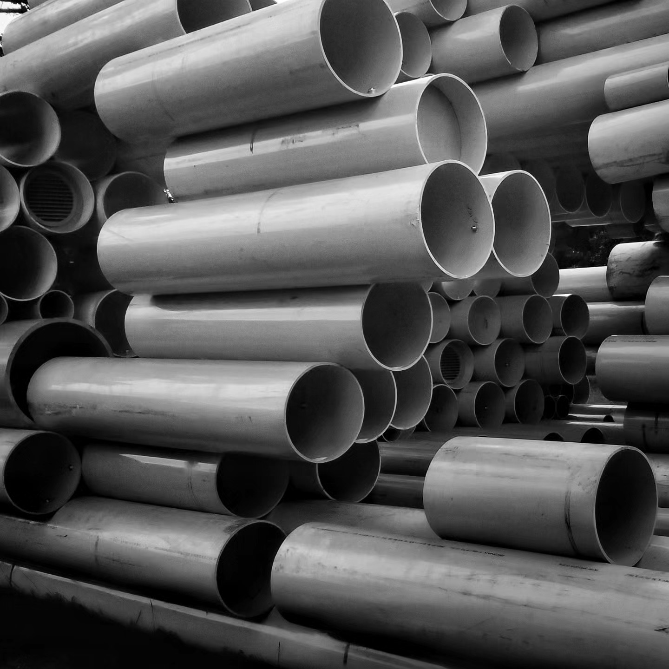
3.1. Cornerstone of Modern Urban Planning
Integration of History and Modern Needs: The reuse of abandoned industrial areas offers a transformative approach to urban planning, blending historical preservation with sustainable and functional modern applications.
Opportunities in Urban Sustainability: Revitalizing industrial
spaces through adaptive reuse addresses ecological concerns
and enhances urban connectivity, creating vibrant,
multi-purpose environments.
Collaborative Redevelopment Vision: Effective reuse of
industrial zones depends on strategic partnerships, innovative
solutions, and a commitment to aligning redevelopment with
urban sustainability and community goals.
Notes:
Creator: Meyer, Thomas, 2017
|
Credit: Bildnachweis siehe Beschreibung
Copyright: Thomas Meyer/OSTKREUZ

Slide 4
3.2. Different Methods of Preserving Buildings
Tailored Conservation Approaches: Methods like preservation, restoration, renovation, and remodeling address specific historical, cultural, or functional needs, ensuring buildings retain their value while adapting to modern requirements​.
Balancing Historical and Modern Needs: Each method—whether maintaining authenticity through preservation or integrating contemporary functionality through renovation—reflects diverse goals aligned with the building's context and intended use​.
Adaptive Integration for Sustainability: Remodeling and adaptive reuse strategies enable the transformation of old buildings into relevant urban assets, balancing historical preservation with the demands of a changing urban landscape
Notes:
In the Style of Kairouan, 1914 - Paul Klee - WikiArt.org. (n.d.). www.wikiart.org. https://www.wikiart.org/en/paul-klee/in-the-style-of-kairouan-1914

Slide 5
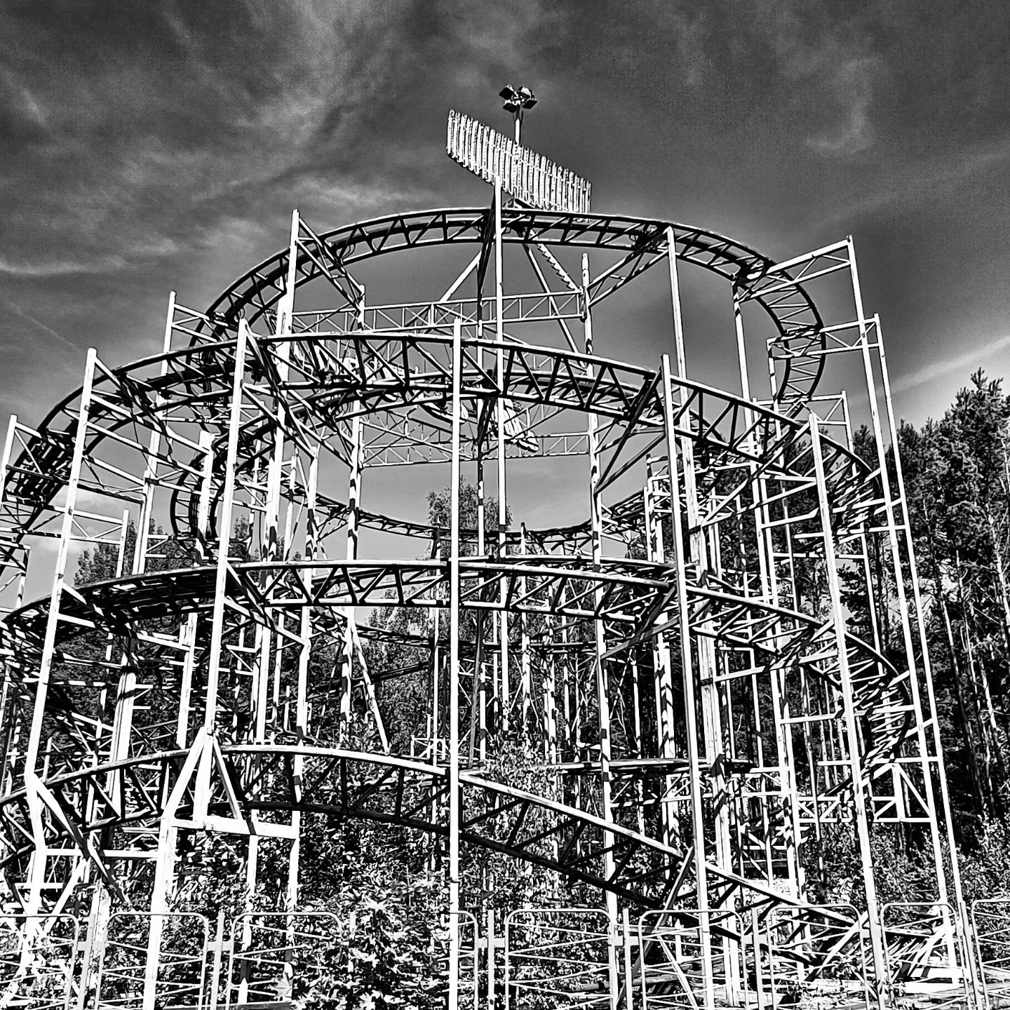
3.3. Strategies for Reuse
Intervention strategies focus on modifying existing structures to meet new functional needs while retaining their original character.
Insertion involves adding new elements, like modular or structural upgrades, to enhance usability without compromising historical integrity.
Installation emphasizes reversible, temporary features to ensure flexibility and sustainability in building reuse.
Notes:
In the Style of Kairouan, 1914 - Paul Klee - WikiArt.org. (n.d.). www.wikiart.org. https://www.wikiart.org/en/paul-klee/in-the-style-of-kairouan-1914

Slide 6
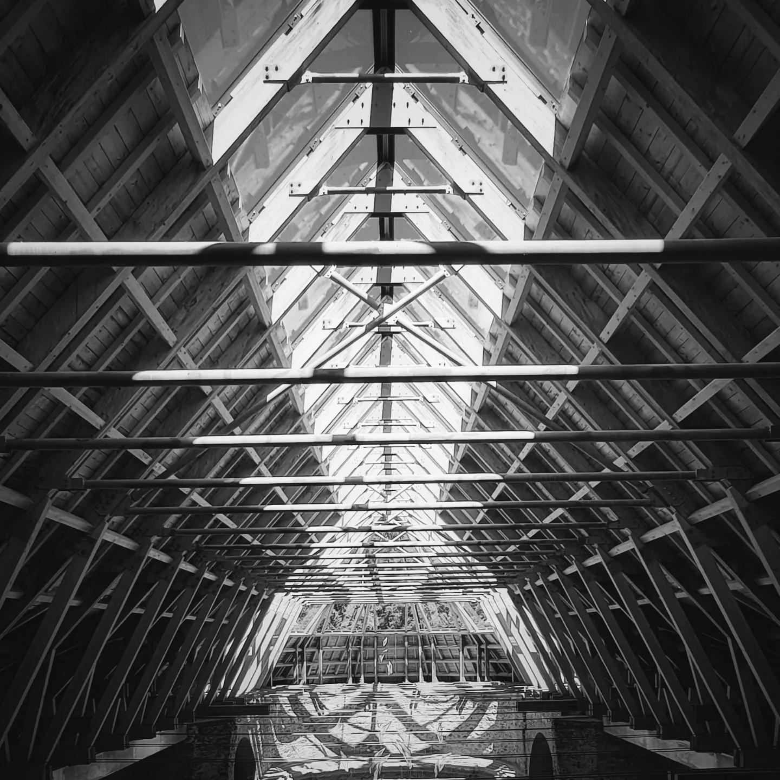
3.4. Tactics for Reuse
Movement tactics emphasize reconfiguring spaces with adaptable features like movable walls or improved circulation systems, ensuring flexibility and multi-functionality.
Opening tactics enhance connections between interior and exterior spaces by introducing larger windows, skylights, and courtyards, improving natural light and ventilation.
Lighting tactics focus on using architectural lighting and reflective materials to highlight design elements, conserve energy, and enhance the building's ambiance.
Notes:
In the Style of Kairouan, 1914 - Paul Klee - WikiArt.org. (n.d.). www.wikiart.org. https://www.wikiart.org/en/paul-klee/in-the-style-of-kairouan-1914

Slide 7
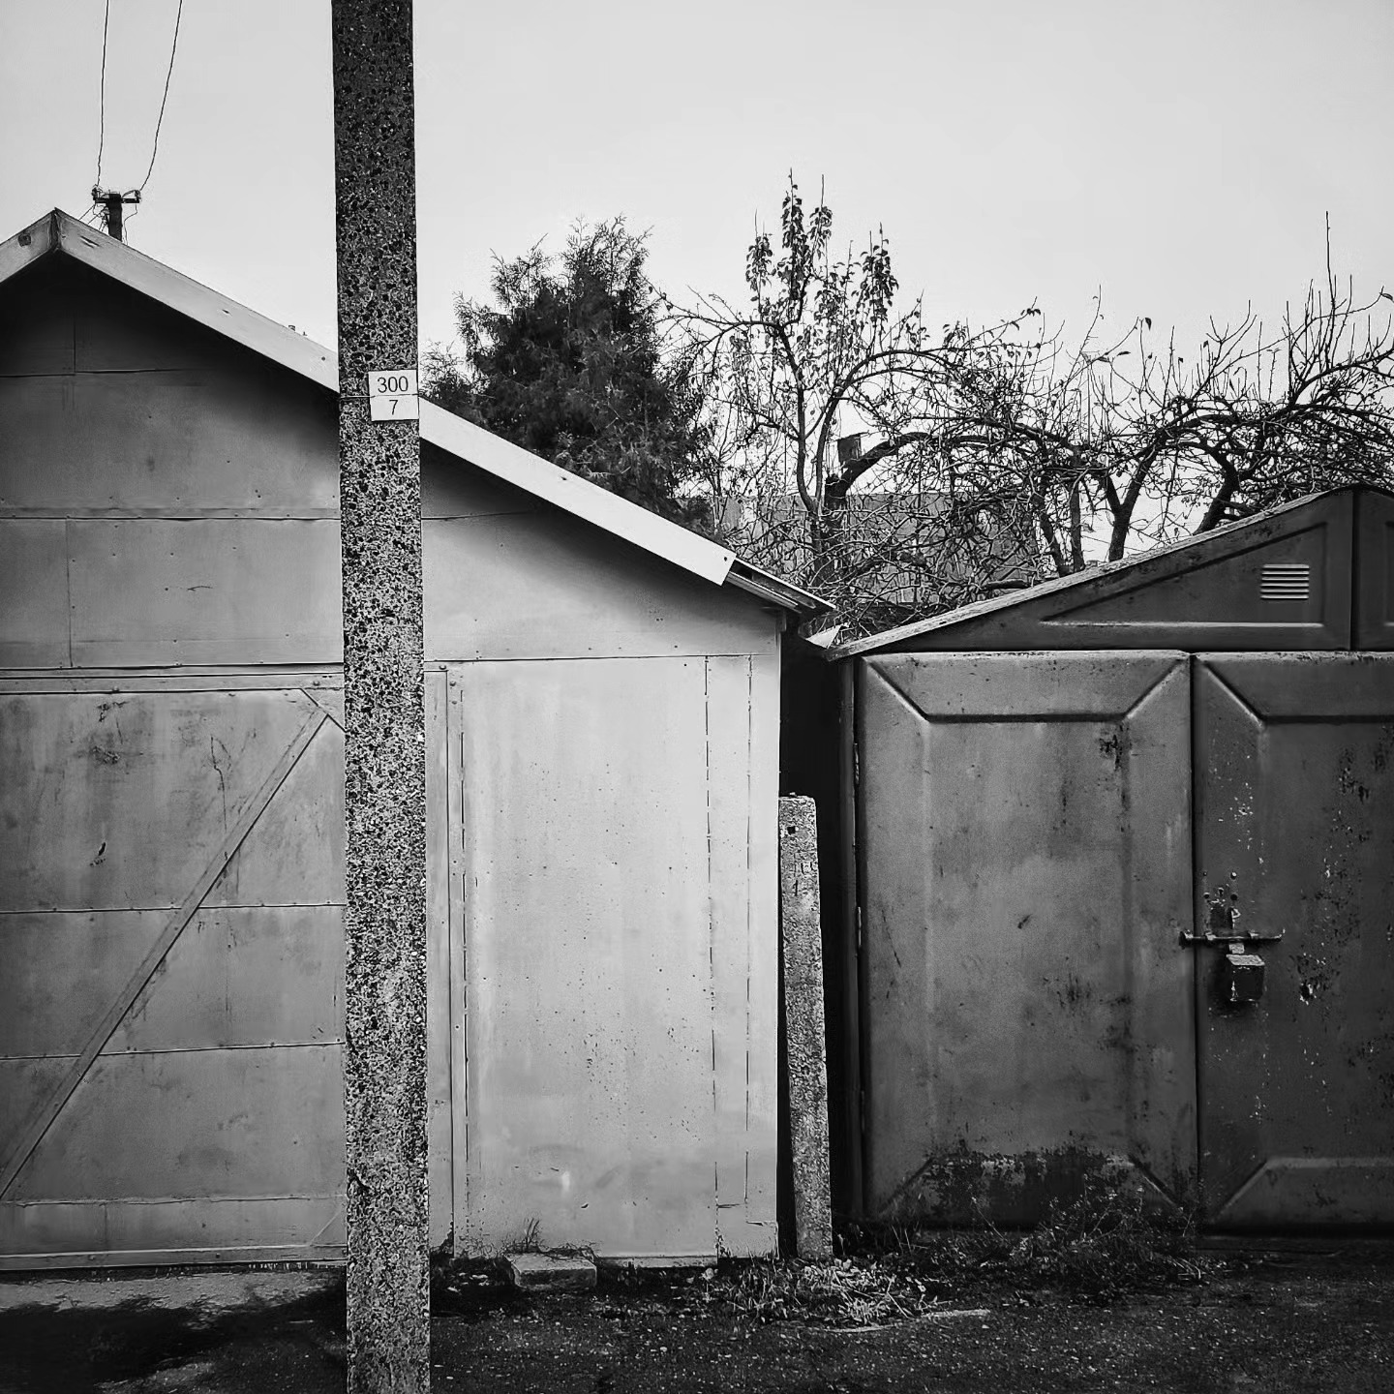
3.5. Intervention Types in Reuse
Structural interventions reinforce or modify a building’s framework to ensure safety, longevity, and adaptability for new uses.
Spatial interventions reconfigure interior layouts, enhancing functionality and flexibility while maintaining architectural integrity.
Aesthetic and functional interventions improve visual appeal and modernize systems, blending heritage conservation with contemporary standards.
Notes:
In the Style of Kairouan, 1914 - Paul Klee - WikiArt.org. (n.d.). www.wikiart.org. https://www.wikiart.org/en/paul-klee/in-the-style-of-kairouan-1914

Slide 8
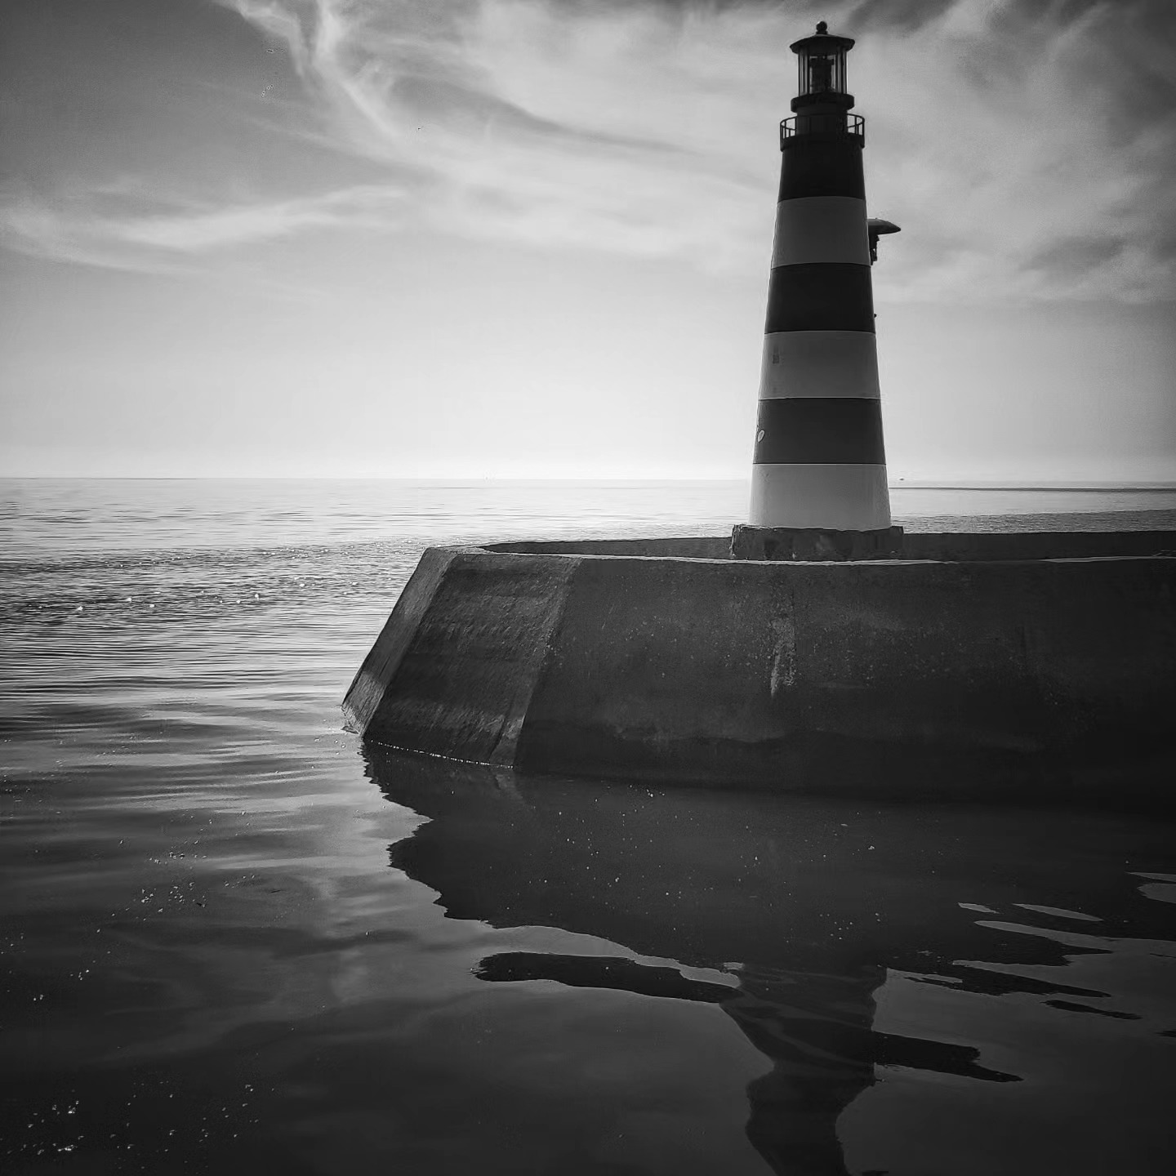
3.6. Decision-Making Models
Decision-making in adaptive reuse incorporates structured frameworks like ARP, AdaptSTAR, and the Design Criteria System (DCS), which assess a range of economic, physical, and social factors to optimize the transformation of industrial spaces.
The Design Criteria System (DCS) provides a comprehensive radiocentric model for adaptive reuse, organizing seven criteria—economic, functional, physical, technological, social, legal, and political—to guide sustainable and community-inclusive redevelopment.
Notes:
In the Style of Kairouan, 1914 - Paul Klee - WikiArt.org. (n.d.). www.wikiart.org. https://www.wikiart.org/en/paul-klee/in-the-style-of-kairouan-1914

Slide 9
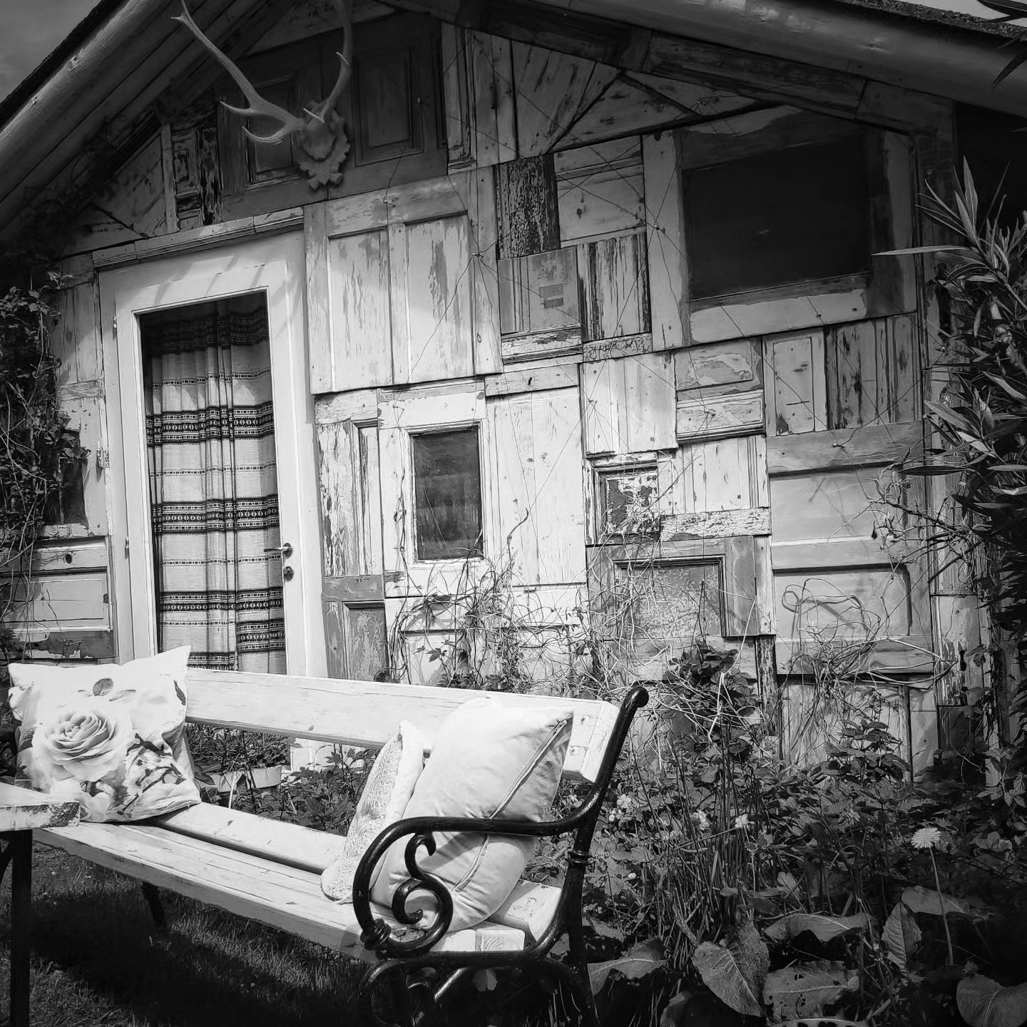
3.7. Focus on Design Criteria System Method
The Design Criteria System (DCS) methodology addresses the reuse of abandoned industrial sites through sustainability, stakeholder collaboration, and overcoming challenges like regulatory barriers and technical constraints.
DCS employs a systematic three-step process—data collection,
scenario analysis, and decision-making using Multi-Criteria
Decision-Making tools—to evaluate and optimize the reuse
potential of industrial sites.
Learning from global case studies, DCS identifies patterns and
best practices, ensuring adaptive reuse aligns with economic,
cultural, and urban regeneration goals.
Notes:
In the Style of Kairouan, 1914 - Paul Klee - WikiArt.org. (n.d.). www.wikiart.org. https://www.wikiart.org/en/paul-klee/in-the-style-of-kairouan-1914

Slide 10
3.8. Methodologies for Post-Industrial Landscape
The methodologies for post-industrial landscapes include Inverted Translational Research (ITR) and Case Study Research (CSR), which bridge practical applications and theoretical frameworks to design multifunctional and sustainable spaces.
Redevelopment principles for post-industrial sites emphasize compatibility, sustainability, heritage preservation, and public participation to transform these areas into assets aligned with community needs.
Successful reclamation projects like Duisburg Nord and the Eden Project illustrate how industrial landscapes can be revitalized through ecological restoration and socio-economic regeneration.
Notes:
In the Style of Kairouan, 1914 - Paul Klee - WikiArt.org. (n.d.). www.wikiart.org. https://www.wikiart.org/en/paul-klee/in-the-style-of-kairouan-1914

Slide 11
3. Activities | Readings
Xander Lacson. Adaptive Reuse and the ARP Model: Background and Method Analysis.
Case study.
Adaptive Reuse as a Design Approach “Industrial Structures” [1], [2]

Slide 12
3. Activities | Visuals
Required visuals
Preservation 101: Tools and Tips for Preserving Historic Buildings - https://www.youtube.com/watch?v=TZz7vKSkJvg
Discover Restorative Construction with Reusable Materials - https://www.youtube.com/watch?v=a2x6mwKbcXw
Strategies for Climate Action: Reuse, Energy Retrofitting, and Deconstruction - https://www.youtube.com/watch?v=onKbvpf8YrI
Strategic Circular Decision-Making for Real Estate Assets: A Reincarnate Innovation - https://www.youtube.com/watch?v=5k89Cx60BFg
A post-industrial site turned ecological flagship - https://www.youtube.com/watch?v=OrOTMvXWBJU
Recommended visuals
Architectural Conservation And Historic Preservation - https://www.youtube.com/watch?v=BbNNjgzG5Jo&list=PLAJ3fBmKHRY-cq673Zyk0rU8kRF26jC0G
Conservation strategies and reuse of concrete heritage - https://www.youtube.com/watch?v=aFjJFEm_veg
Sustainable cultivation in post-industrial places - https://www.youtube.com/watch?v=62AwIFojh3A

