Slide 1


Slide 2



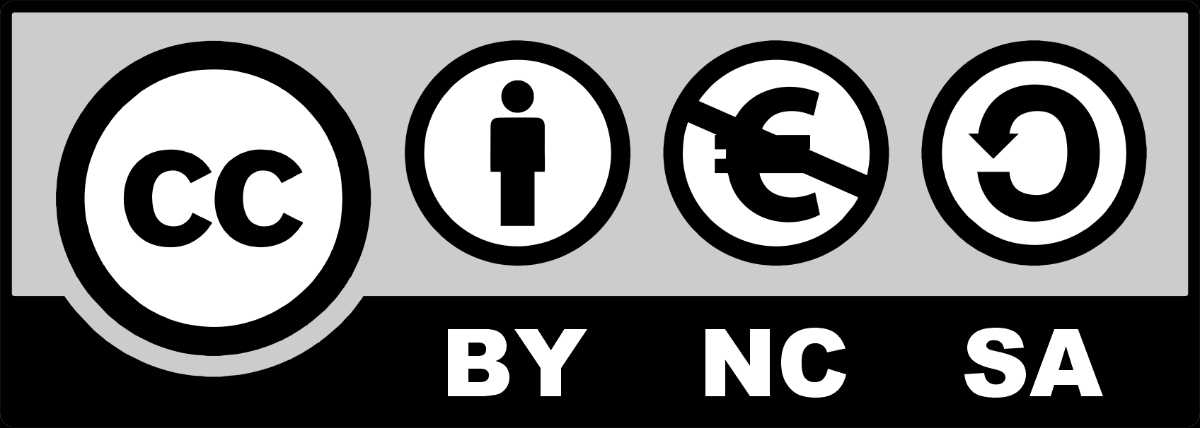
Re-use and Re-design of Outdated Industrial Objects
Module 4: Re-use and Re-design Outdated Industrial Objects
4.1. Creative and Unique Experiences from Reusing Old Vehicles
4.2. Small Objects Against Big Challenges. Reuse of Ships.
4.2. Small objects against big challenges. Reuse of Buses and Trains.
4.3. Enabling Factors and Challenges
2023-1-CY01-KA220-HED-000160668

Slide 3
4.1. Creative and Unique Experiences from Reusing Old Vehicles
Transforming decommissioned vehicles like cruise ships, trains, and buses into homes, cultural hubs, and entertainment spaces highlights innovative and sustainable reuse approaches.
Repurposed vehicles serve community needs by becoming mobile clinics, shelters, and eco-tourism lodges, emphasizing adaptability and social impact.
In tourism, old vehicles converted into hotels, food trucks, or escape rooms provide immersive, themed experiences that combine nostalgia with modern utility.
Creative urban solutions, such as floating ships addressing housing shortages or train carriages as business hubs, demonstrate the potential of vehicle reuse to tackle modern challenges.
Notes:
In the Style of Kairouan, 1914 - Paul Klee - WikiArt.org. (n.d.). www.wikiart.org. https://www.wikiart.org/en/paul-klee/in-the-style-of-kairouan-1914

Slide 4
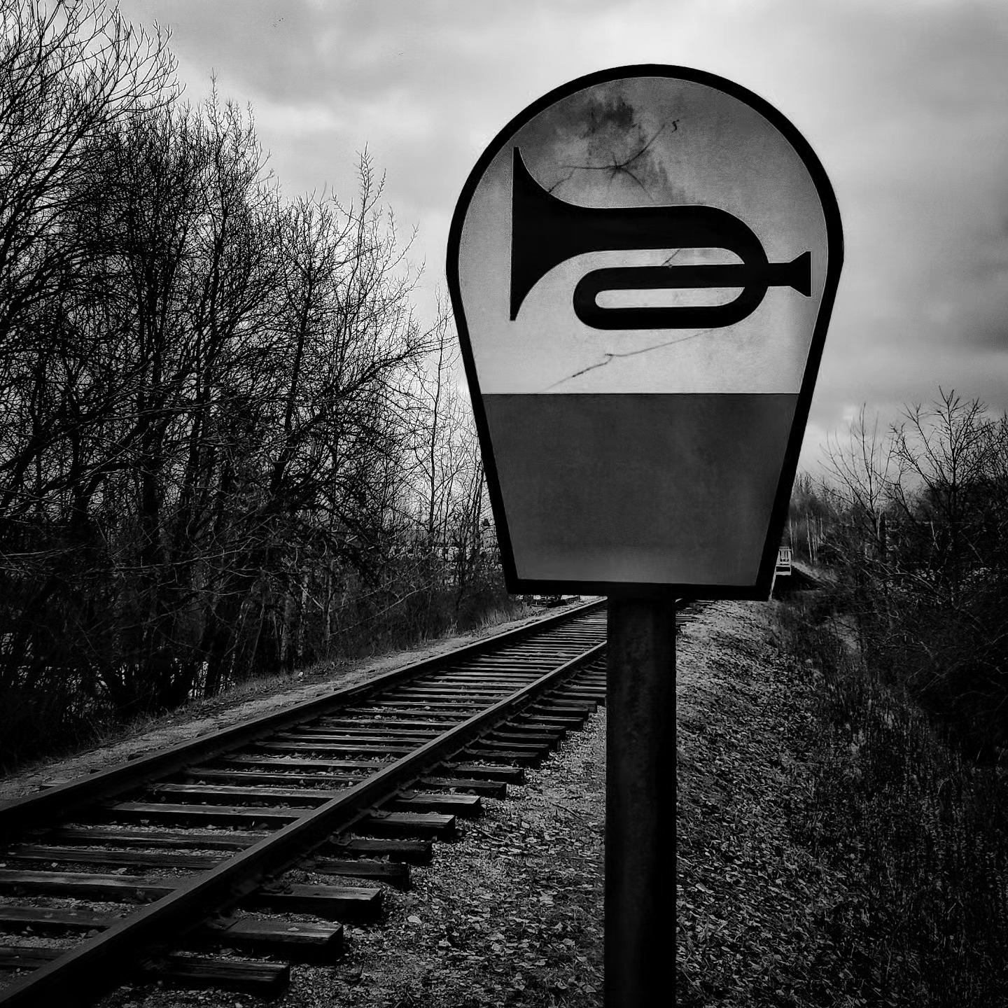
4.2. Small Objects Against Big Challenges. Reuse of Ships.
Repurposing decommissioned ships as housing and community spaces offers a sustainable solution to urban housing shortages and climate challenges, utilizing their inherent buoyancy to create resilient, affordable, and environmentally friendly living options​
4.3. Small objects against big challenges. Reuse of Buses and Trains.
The reuse of buses and trains presents creative solutions to waste and sustainability challenges by transforming retired vehicles into homes, businesses, and community hubs, promoting both environmental and social benefits.
Notes:
Copyright: Freepik Company S.L. - www.freepik.com

Slide 5
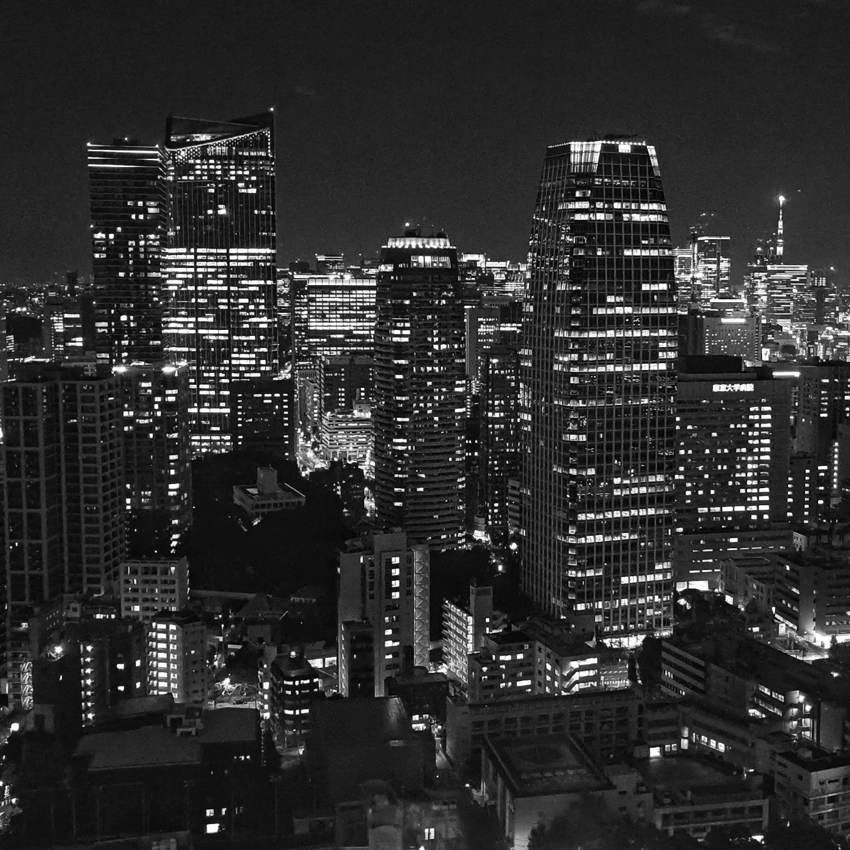
4.4. Enabling Factors and Challenges
Achieving a sustainable and circular built environment requires the integration of adaptable reuse strategies, supported by policy reforms, collaborative partnerships, advanced tools, and public awareness, to overcome barriers and transition from linear to circular construction models.
Notes:
In the Style of Kairouan, 1914 - Paul Klee - WikiArt.org. (n.d.). www.wikiart.org. https://www.wikiart.org/en/paul-klee/in-the-style-of-kairouan-1914

Slide 6
4. Activities | Readings
Marian Gogola, Dana Sitanyiova, UNIZA. Good practice research documentation.
4. Activities | Visuals
10 Amazing Adaptive Reuse Projects (w/ Before and After Pictures) - https://www.youtube.com/watch?v=C6SEGi6Qxos
Before and After: Buildings Reinvented - https://www.youtube.com/watch?v=HGtMta8vpbg
Notes:
In the Style of Kairouan, 1914 - Paul Klee - WikiArt.org. (n.d.). www.wikiart.org. https://www.wikiart.org/en/paul-klee/in-the-style-of-kairouan-1914

