Slide 1





Module 4
Circular Fashion
Designing for Longevity and Reuse

Slide 2

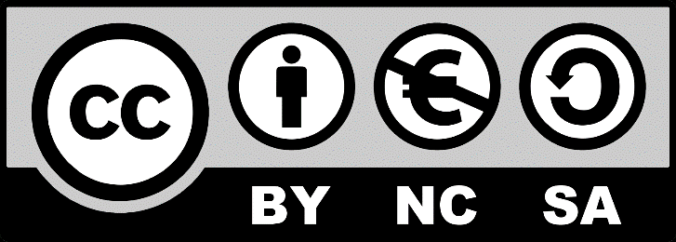

Sustainable Fashion Design
Module 4: Circular Fashion Designing for Longevity and Reuse
4.1 Circular Fashion
4.2 Fundamentals of Circular Economy.
4.3 Closed-loop systems.
4.4 Designing for Durable and Adaptable Clothing.
2023-1-CY01-KA220-HED-000160668

Slide 3
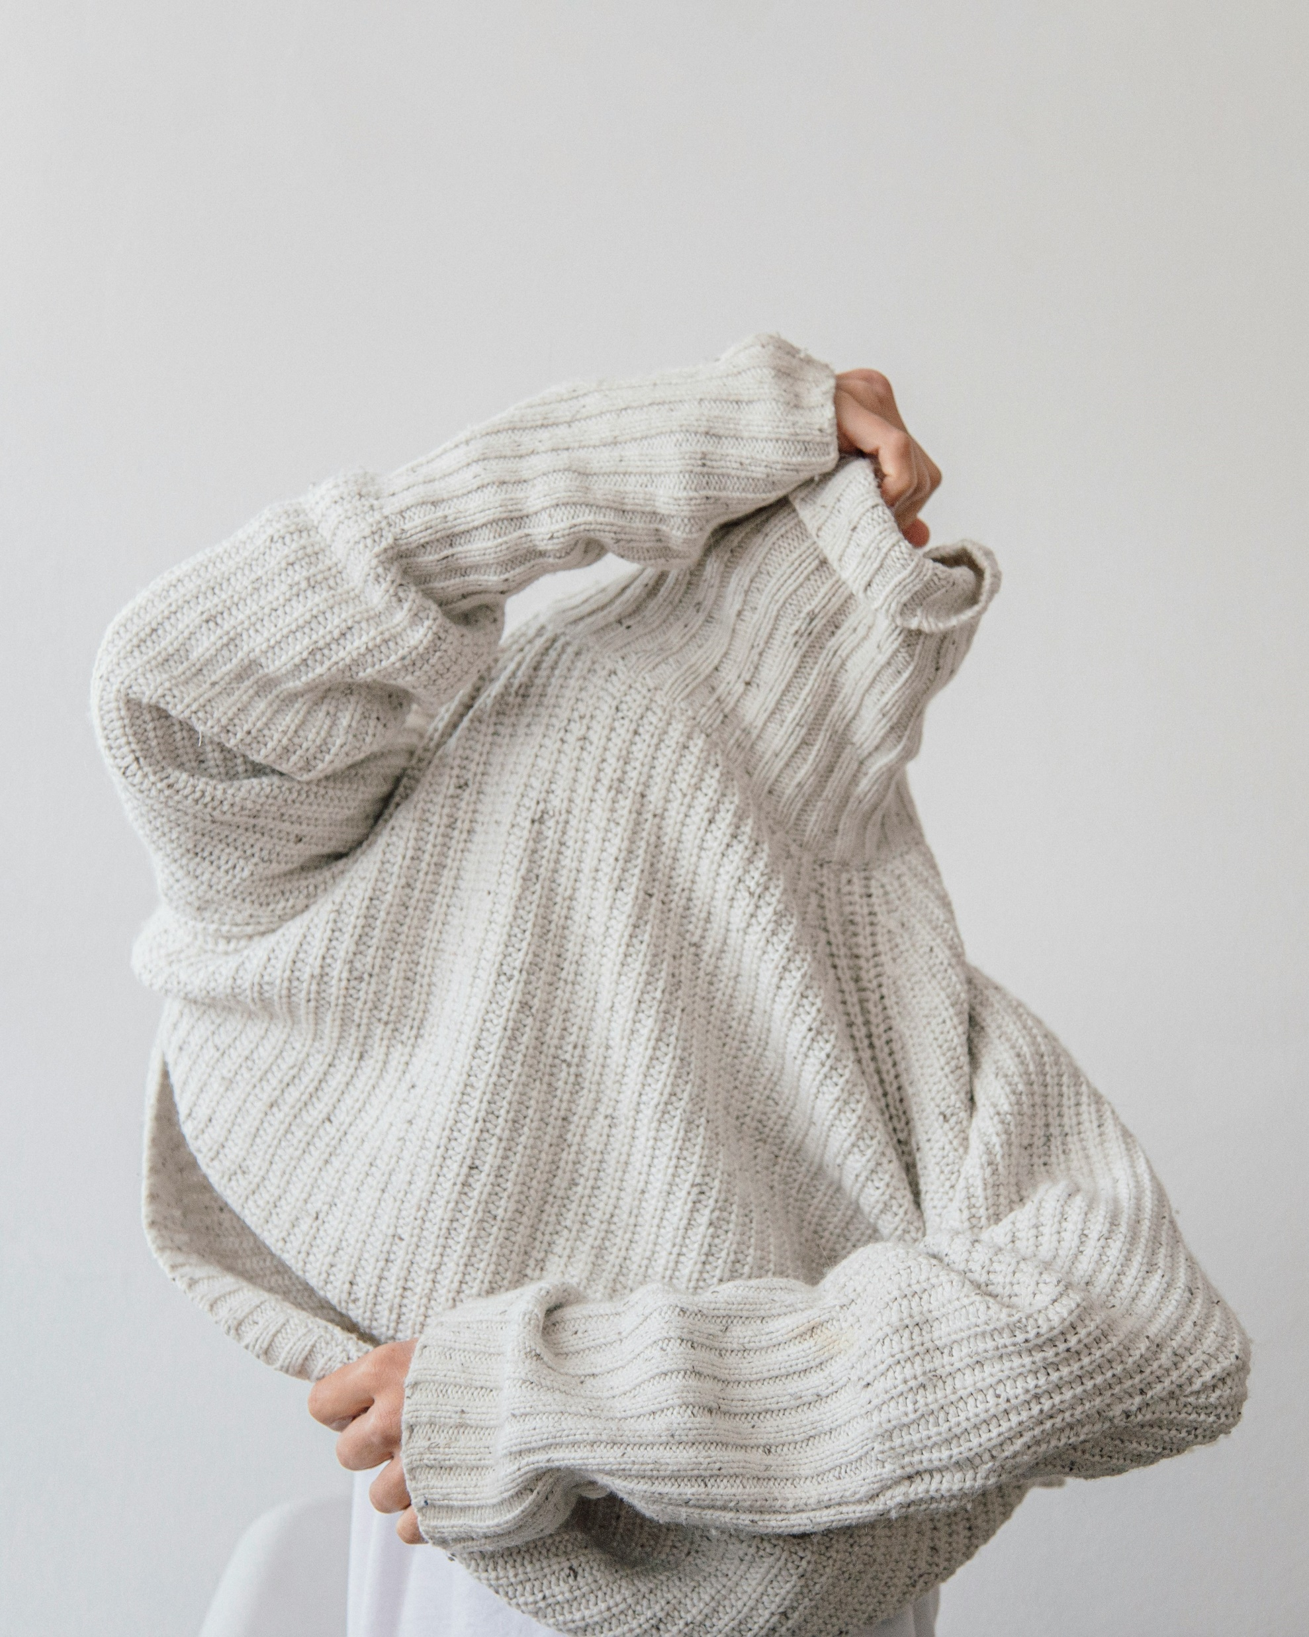
Module 4 Overview
This module focuses on Circular fashion and how the fashion industry is trying to create a closed-loop system where clothing, accessories, and textiles are designed, produced, consumed, and then reintroduced into the cycle without generating waste or pollution.
It covers the topic of sustainability, minimizing environmental impact, and maximizing the lifecycle of garments, by creating durable, timeless pieces that are versatile and can be worn for many years.
Photo by Mukuko Studio on Unsplash

Slide 4
4.1 Circular Fashion
The current fashion model operates linearly emphasizing mass production and consumption of clothing and footwear. An industry where the clothing we wear, the materials that have been used, the packaging, the shopping bags and all remnants we no longer wear will be discarded.
All these synthetic materials will become waste in landfills in our natural environment.
This linear model for years has created major damage to our environment.

Slide 5
The Linear Supply Chain
1 2 3 4 5 6 7
Inspiration
Raw
Materials
Retail
Consumer
Design
Manufacturing
Distribution
Pre-consumer waste
25% of resources gets
spilled from factories.
Post-consumer waste
73% of clothing ends up in landfills.
Circular Fashion: Making the Fashion Industry Sustainable

Slide 6
‘Circular fashion’ can be defined as clothes, shoes or accessories that are designed sourced, produced, and provided with the intention to be used circulated responsibly and effectively in society for as long as possible in their most valuable form, and hereafter returned safely to the biosphere when no longer of human use.
Dr. Anna Brismar, 2017 Green Strategy

Slide 7
The Circular Fashion Model
The circular Fashion Model is in fact a ‘circle of responsibility’. It is about accountability, traceability and the ownership of the entire life cycle of a product.
It looks at the product life cycle – from its fibers right through the manufacturing stages, the workers, the transportation of goods, packaging as well as how the customer will repair or resell the product.
The common goal of a circular model is to design, produce and consume clean safe and ethical apparel.

Slide 8
1. CREATE
1. CREATE
CIRCULAR FASHION
MODEL
4. USE / CARE
2. MAKE
3. MARKET
Blum, P. (2021)

Slide 9
The Circular Fashion Model Explained
CREATE: To design garments which are durable, can be disassembled, can be recycled and are biodegradable.
MAKE: To make products using new technologies and innovations which will limit waste, reduce water consumption, include recycled fibers and eliminate the use of toxic materials
.
MARKET: To use renewable energy, clean transport and environmentally friendly packaging. To include store fittings, lighting designs and merchandizing models which have zero impact on our environment.
USE/ CARE /REPAIR: To provide consumers with garment warranties, repair-kits in order to adhere to quality, environmental and longevity standards. To change the mindset of consumers where they are responsible for smart consumption habits.
RENEW: To introduce initiatives to eliminate textile waste by introducing second and third generation garments mixed with first generation waste to go back around the system.
Blum, P. (2021)

Slide 10
4.2 Fundamentals of Circular Economy
The circular economy in fashion represents a shift from the traditional linear model to a more sustainable, regenerative system that minimizes waste, optimizes resource use, and keeps materials in circulation as mentioned previously.

Slide 11
The core fundamentals of a circular economy in fashion are:
1. DEISGNING FOR LONGEVITY | Garments should be designed to last longer, with high-quality materials that withstand repeated wear and laundering
 | When designing, the focus should be on creating classic, timeless designs rather than trend-driven, short-lived fashion.
 | Clothes must be designed in way that allows the consumer to adjust, repair, or update parts easily in order to extend their lifespan.

Slide 12
2. Material Circularity | Materials should be sustainably sourced, renewable, and preferably biodegradable. Most appropriate choices are organic cotton and wool or hemp.
 | The use of fabrics that are either recycled or can be fully recycled at the end of their life helps close the loop. This reduces reliance on virgin resources.
 | Should use safe chemicals and non-toxic dyes to ensure the recyclability of materials and reduces harmful impacts on the environment.

Slide 13
3. Closed-Loop Systems | To extend a products life, brands should include strategies like repairing, reselling, refurbishing, and upcycling. Brands can offer repair services or second-hand sales to extend the life of garments.
 | At the end of a garment's life, materials should be easily recyclable into new textiles, avoiding waste and reducing the need for new raw materials.
 | When recycling is not feasible, biodegradable materials can decompose naturally, reducing landfill waste.

Slide 14
4. Business Model Innovation | Instead of owning clothes, consumers can lease or rent garments, ensuring that products are used by multiple people and maximizing their utility.
 | Take-Back Programs may be introduce, were brands incentivize customers to return used clothing for recycling or repurposing, often offering discounts or rewards.
 | Subscription-based models will allow consumers to rent or exchange clothes on a regular basis, reducing consumption while still keeping wardrobes fresh.

Slide 15
5. The Efficient Use of Resources | Efficient production processes reduce fabric waste in manufacturing.
 | Reducing water and energy usage, both in manufacturing and across the supply chain, minimizes the environmental footprint.
 | Producing garments based on actual demand instead of overproducing, helps to prevent surplus stock and waste.

Slide 16
6. Consumer Education & Engagement | Brands can promote sustainable behavior by encouraging consumers to care for their garments properly and to recycle or donate old clothes.
 | Brands must be transparent by providing clear communication about materials, processes, and sustainability efforts in order to help consumers make informed, ethical choices.

Slide 17
7. Collaboration Across the Supply Chain | Collaboration among brands, manufacturers, recyclers, and innovators is essential to build systems for recycling, upcycling, and resource recovery.
 | It must be seen as a shared responsibility from designers to consumers, all players in the supply chain must contribute to the goal of minimizing waste and maximizing value.

Slide 18
8. Regenerative Practices | For natural fibers like cotton or wool, adopting regenerative farming practices improves soil health, sequesters carbon, and enhances biodiversity.
 | A regenerating ecosystems, ensures that production processes restore, rather than degrade the environment. This can be seen as the key to long-term sustainability.

Slide 19
9. Data & Digital Tools | Digital tools help track a product's lifecycle, verifying material sources, and ensuring transparency in recycling and waste management.
 | Data driven design and AI can help in predicting demand forecasting, and automation in production can optimize material use and minimize excess.

Slide 20
9. Circularity Metrics & Accountability | Companies must track key indicators like material use, recyclability, carbon footprint, and water consumption, and set clear targets for circularity.
 | Brands are responsible not only for the sale of their garments but also for their end-of-life management, promoting a full lifecycle approach.

Slide 21
The fundamentals of a circular economy in fashion are grounded in creating systems where resources are continually reused, waste is minimized, and products are designed for longevity, recyclability, and regenerative benefits. It requires innovation, collaboration, and shifting both consumer mindsets and business practices toward a more sustainable future.
Required reading: Stella McCartney on Wanting to Make Fashion More Sustainable
Further reading: Redesigning the Future of Fashion

Slide 22
The EU Strategy for Sustainable and Circular Textiles
The EU Strategy for Sustainable and Circular Textiles, does recognize the importance of textile sector, but at the same time it also recognizes the urgent action that is required as the impact on the environment continues to grow.
The EU Strategy proposes actions that must be implemented in order to change how we produce and consume textiles.
‘EU consumption of textiles has, on average, the fourth highest impact on the environment and climate change, after food, housing and mobility. It is also the third highest area of consumption for water and land use, and fifth highest for the use of primary raw materials and greenhouse gas emissions.’ (European Commission)

Slide 23
THE EU OBJECTIVES
The Commission's 2030 vision for textiles is that:
All textile products placed on the EU market are durable, repairable and recyclable, and are mainly made of recycled fibres, free of hazardous substances, produced in respect of social rights and the environment.
”fast fashion is out of fashion” and consumers benefit longer from high quality affordable textiles.
Profitable re-use and repair services are widely available.
The textiles sector is competitive, resilient and innovative with producers taking responsibility for their products along the value chain with sufficient capacities for recycling and minimal incineration and landfilling .’ European Commission (2024)

Slide 24
ACTIONS SET BY THE EU COMMISSION
Set design requirements for textiles to make them last longer, easier to repair and recycle, as well as requirements on minimum recycled content
Reverse overproduction and overconsumption, and discourage the destruction of unsold or returned textiles
Address the unintentional release of microplastics from synthetic textiles
Tackle greenwashing to empower consumers and raise awareness about sustainable fashion
Restrict the export of textile waste and promote sustainable textiles globally
Incentivise circular business models, including reuse and repair sectors
For full version of actions required reading: EU Strategy for Sustainable and Circular Textiles.

Slide 25
4.3 The Closed Looped System
The aim of a Closed-loop systems is to reduce the waste and the environmental impact that the fashion industry has created.
By creating a circular flow of resources, the design and production works to keep clothes in circulation for as long as possible.
In doing so, this minimizes the need for new raw materials, and maximizes product reuse, recycling, and recovery.
In manufacturing or consumption, this often includes: Product reuse, Material recycling and
Energy recovery.
The goal is to "close the loop" by reintroducing waste into the system, thus maintaining the value of materials and minimizing environmental degradation.

Slide 26
Product Life Cycle
A product’s life cycle refers to all stages of a products life. This includes the raw material, right through to its introduction to the marketplace as well as its exit. All stages of the product’s life cycle can affect the environment. This includes climate change, water toxicity from dyes and fabric finishes and natural resource depletion.

Slide 27
Life Cycle Assessment (LCA)
Lifecycle Assessment is used to assess the environmental impacts of a product or system throughout its entire lifecycle.
This covers stages such as:
Raw material extraction
Production
Packaging
  Transportation
Use and maintenance
End-of-life disposal or recycling
LCA evaluates metrics like carbon footprint, energy use, water consumption, and waste generation, offering a holistic view of a product's environmental footprint.
When a LCA is conducted a brand has the opportunity to understand their product better.

Slide 28
Benefits of Life Cycle Assessment
The purpose of conducting a LCA is to provide critical information on how to improve a fashion brand’s sustainability challenges.
The benefits of conducting an LCA are:
- To identify environmental impacts
- Product design and process improvements
- Customer and stakeholders engagement

Slide 29
Why Use a Closed-loop System Lifecycle Analysis?
This provides an essential framework for understanding and optimizing the environmental benefits of circular processes. By integrating reuse, recycling, and material recovery, closed-loop systems can significantly reduce the overall environmental impact, which LCA helps to quantify.

Slide 30
CASE STUDY: Patagonia Inc.
Patagonia Inc. is a family owned American owned corporation that produces sustainable outdoor apparel.
The brand Patagonia is known as one of the most environmentally responsible enterprises.
Their garments are made from responsible sourced materials and are guaranteed for life.

Slide 31
The company’s mission is:
1. To make the best quality products
2. Cause no unnecessary harm to the environment
3. Use their business to protect nature
4. Not bound by convention
Required Video: Patagonia: The Sustainability Champions ReCrafted | These Are Clothes Made From Other Clothes

Slide 32
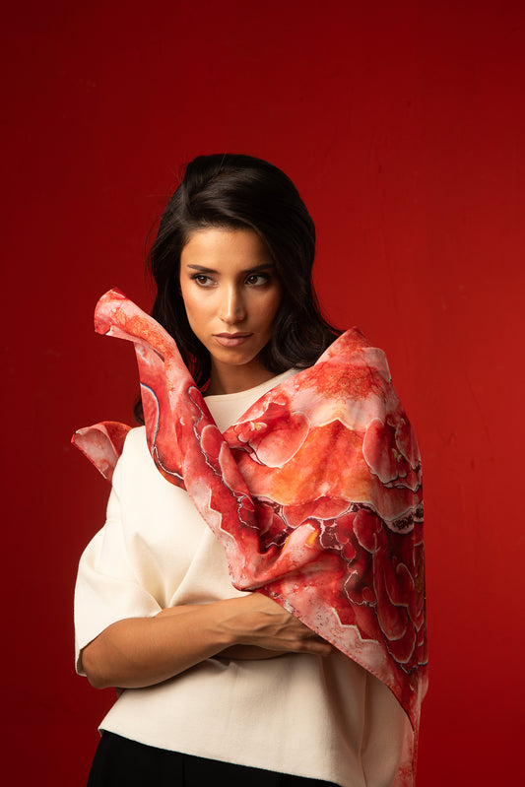
Michalis Pantelidis- Turning Trash to Fashion
Michalis Pantelidis is a Cypriot Textiles Designer based in Italy. He graduated from the University of the West of England in Bristol in 2022. He has been nominated by his university for the “Fashion Innovation Award” and “The Considered Fashion Award” at the Graduate Fashion Week in the UK.
In 2021, he launched his own brand which combines his love for textiles, photography, and art. His first project was called “The Land of Decomposition” and he explored alternative ways of understanding the idea of value by turning trash into colorful and joyful scarves

Slide 33
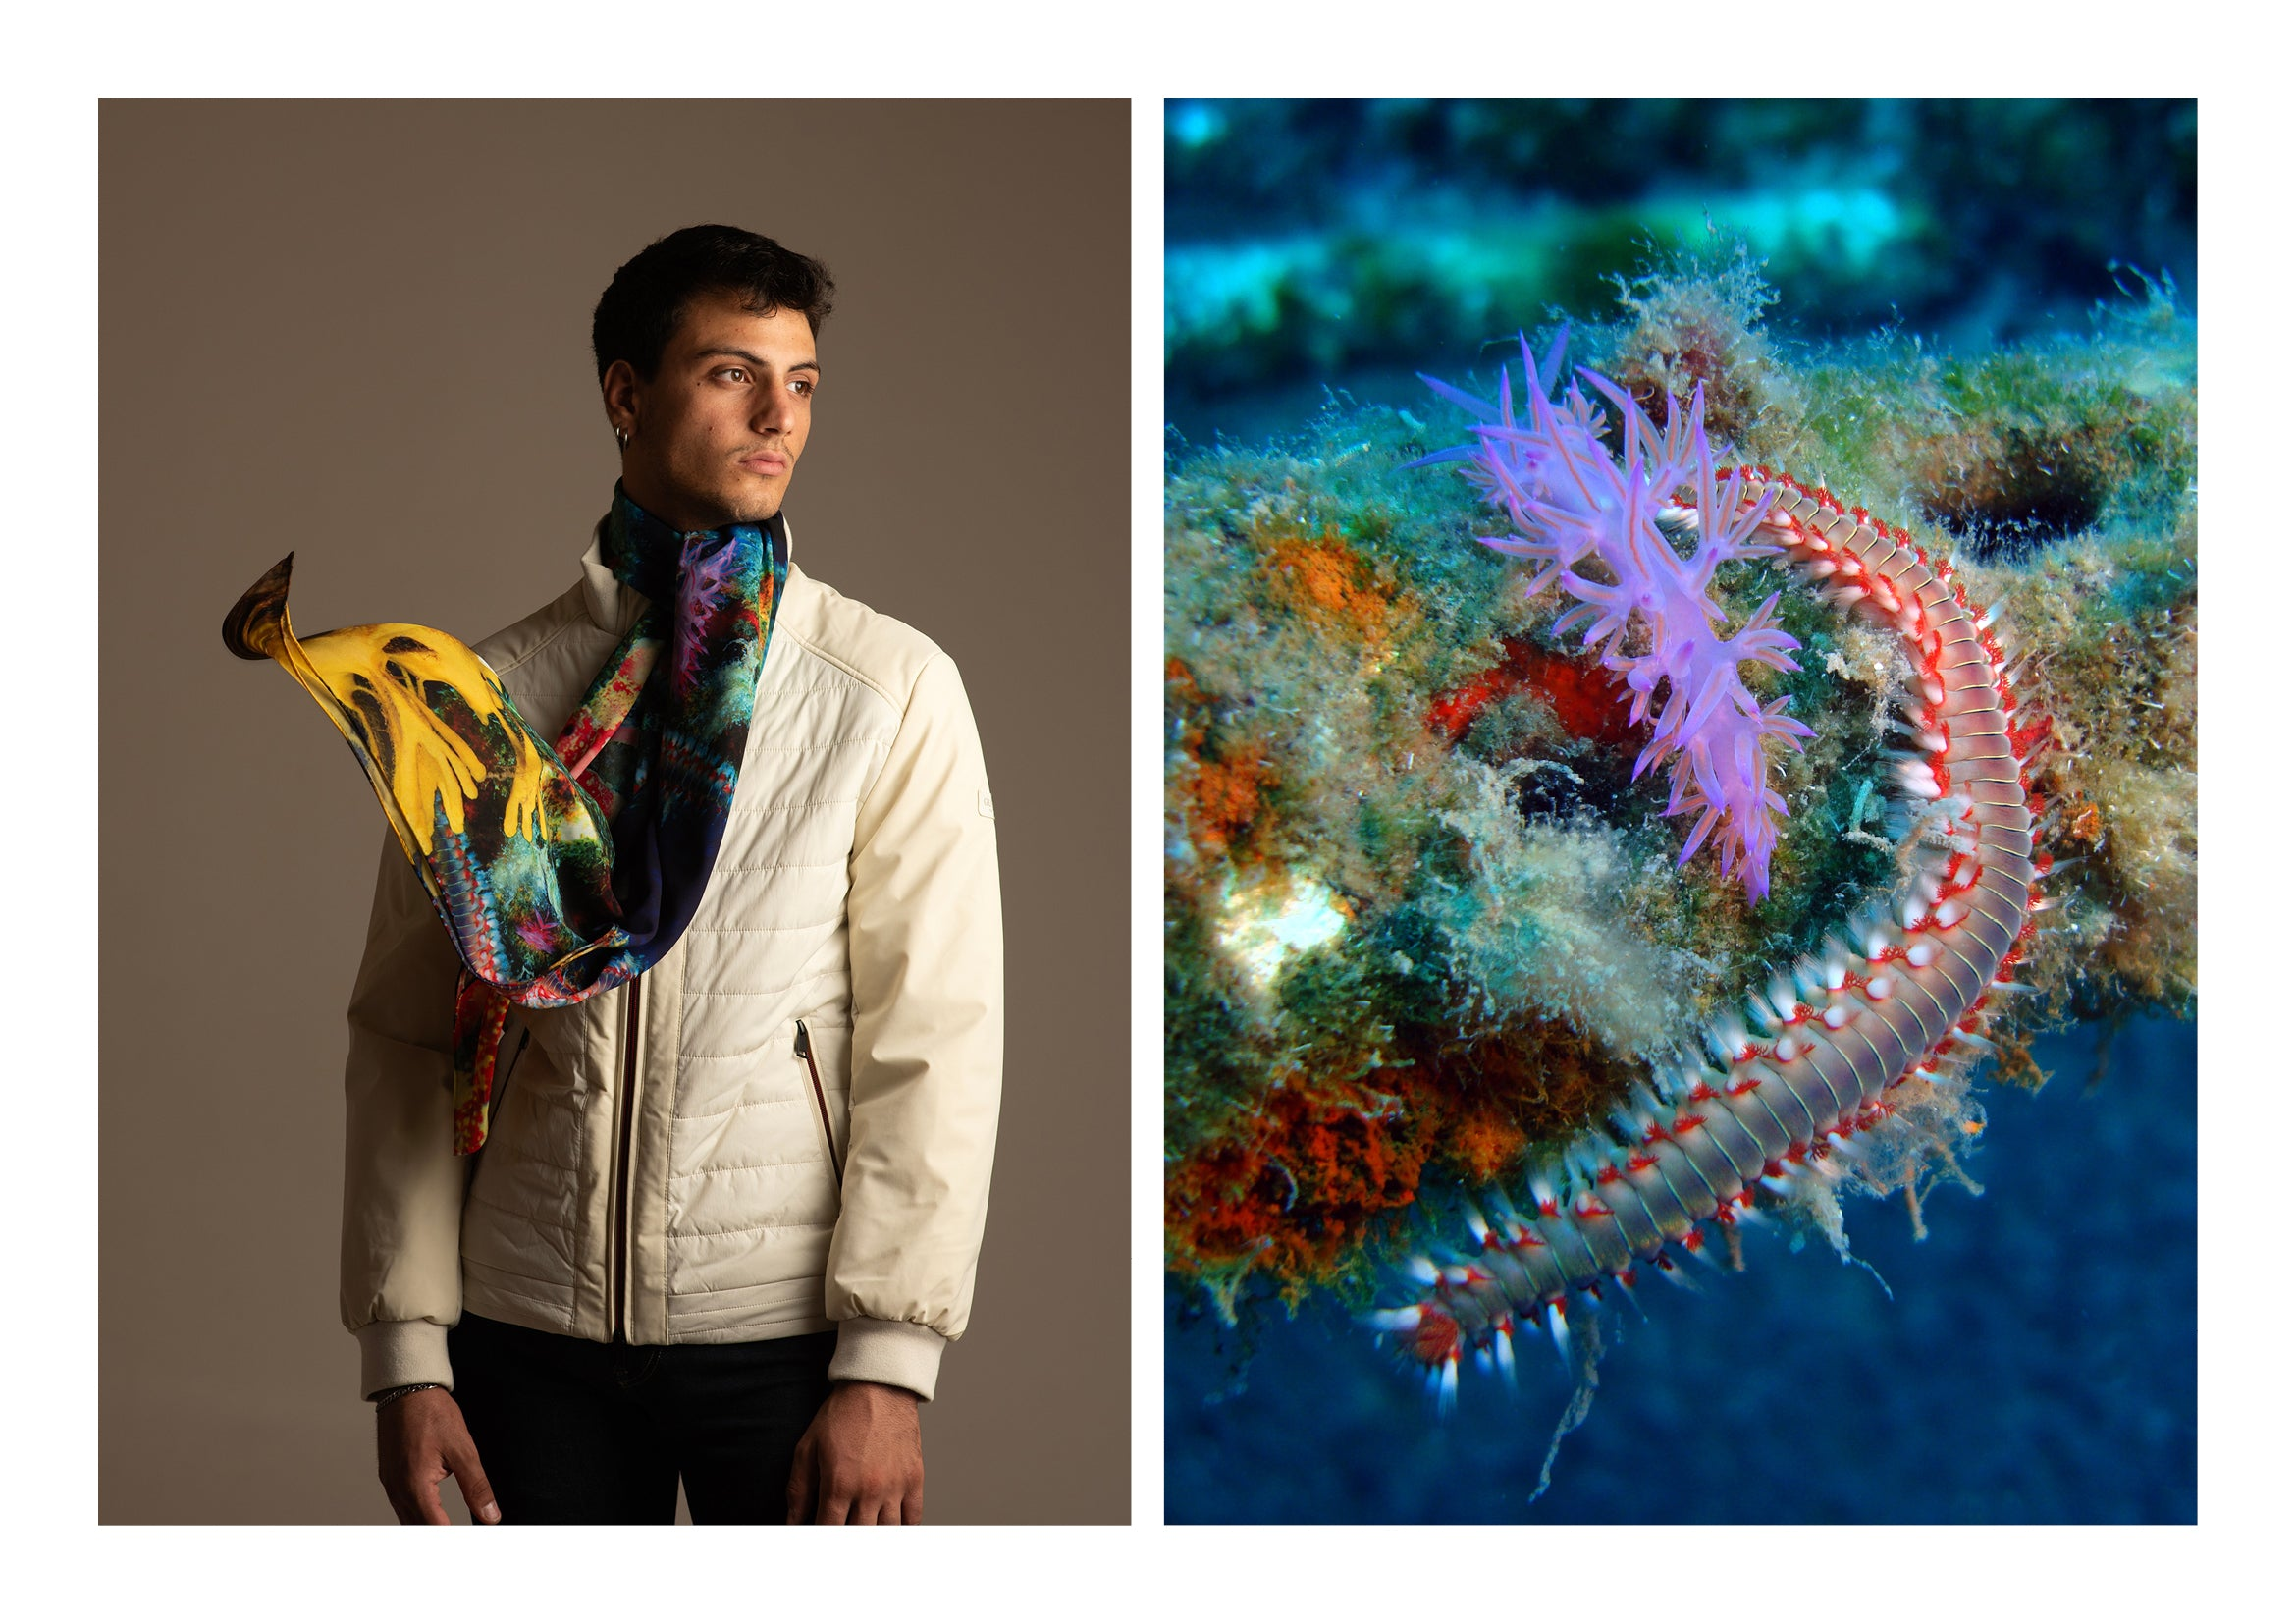
All of his scarves and dresses are made of 100% recycled plastic bottles emphasizing eco-conscious fashion.
website. www.michalispantelidis.com

Slide 34
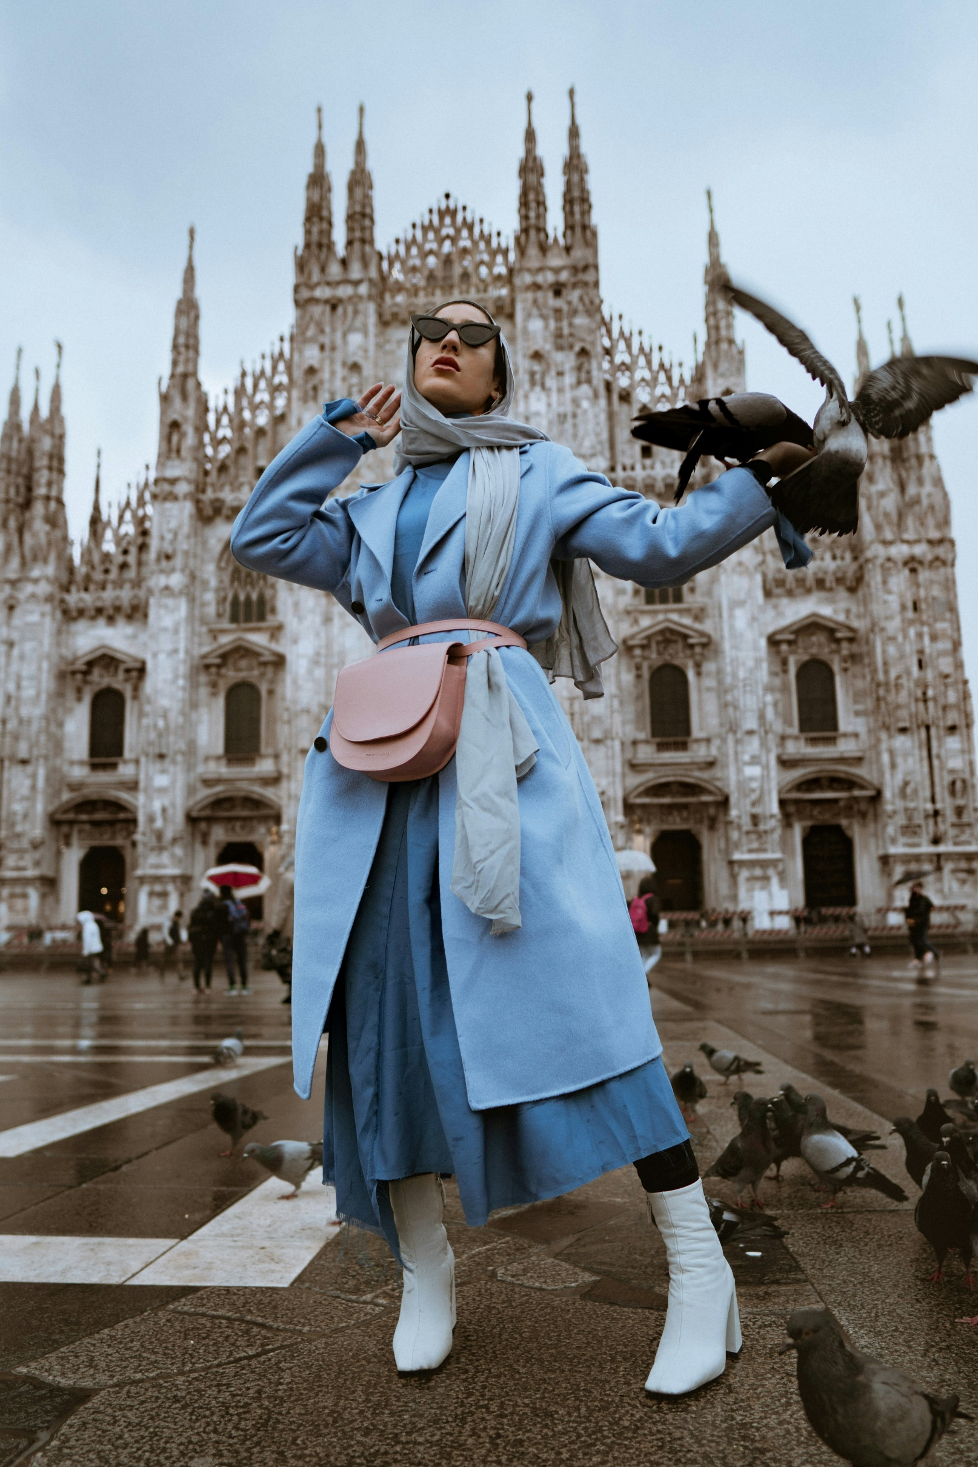
4.4 Designing Durable and Adaptable Clothing
Designing durable and adaptable clothing is essential in order to reduce waist and to extend the life cycle of a garment, as well as maximizing resources efficiently.
Durable and adaptable clothing is about designing garments which can evolve with the user.
Photo by Alexi Romano on Unsplash

Slide 35
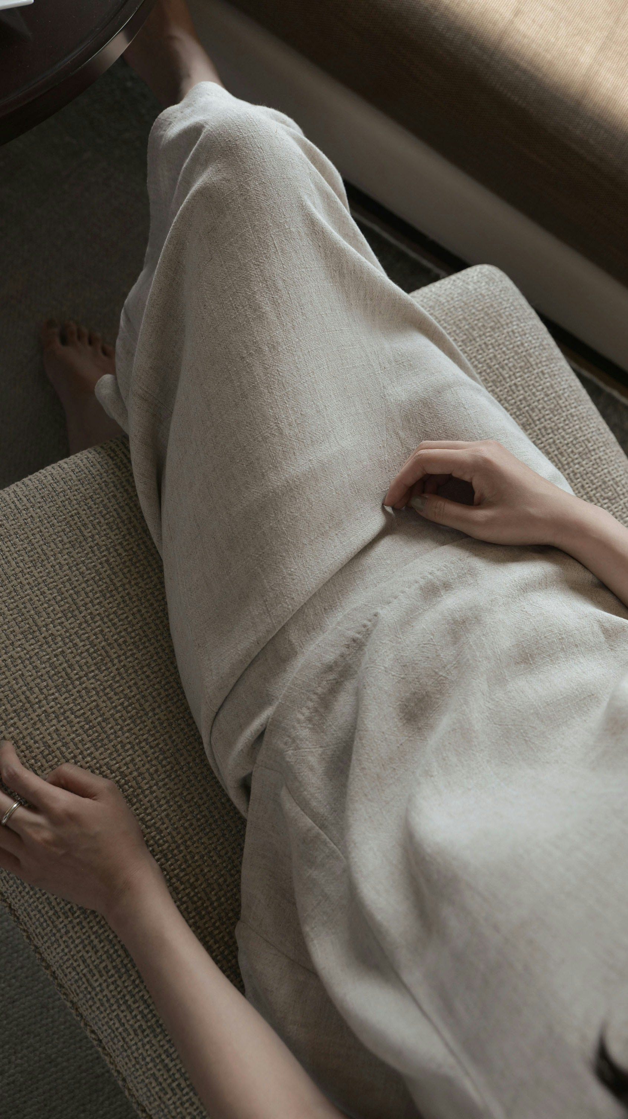
Selecting the Correct Materials
Use durable fabrics that can withstand frequent wear and washing.
Select recyclable or biodegradable fabrics that facilitate end-of-life processing.
Use eco-friendly dyes and finishes that allow the recyclability of fabrics.
Photo by WARION Taipei on Unsplash

Slide 36
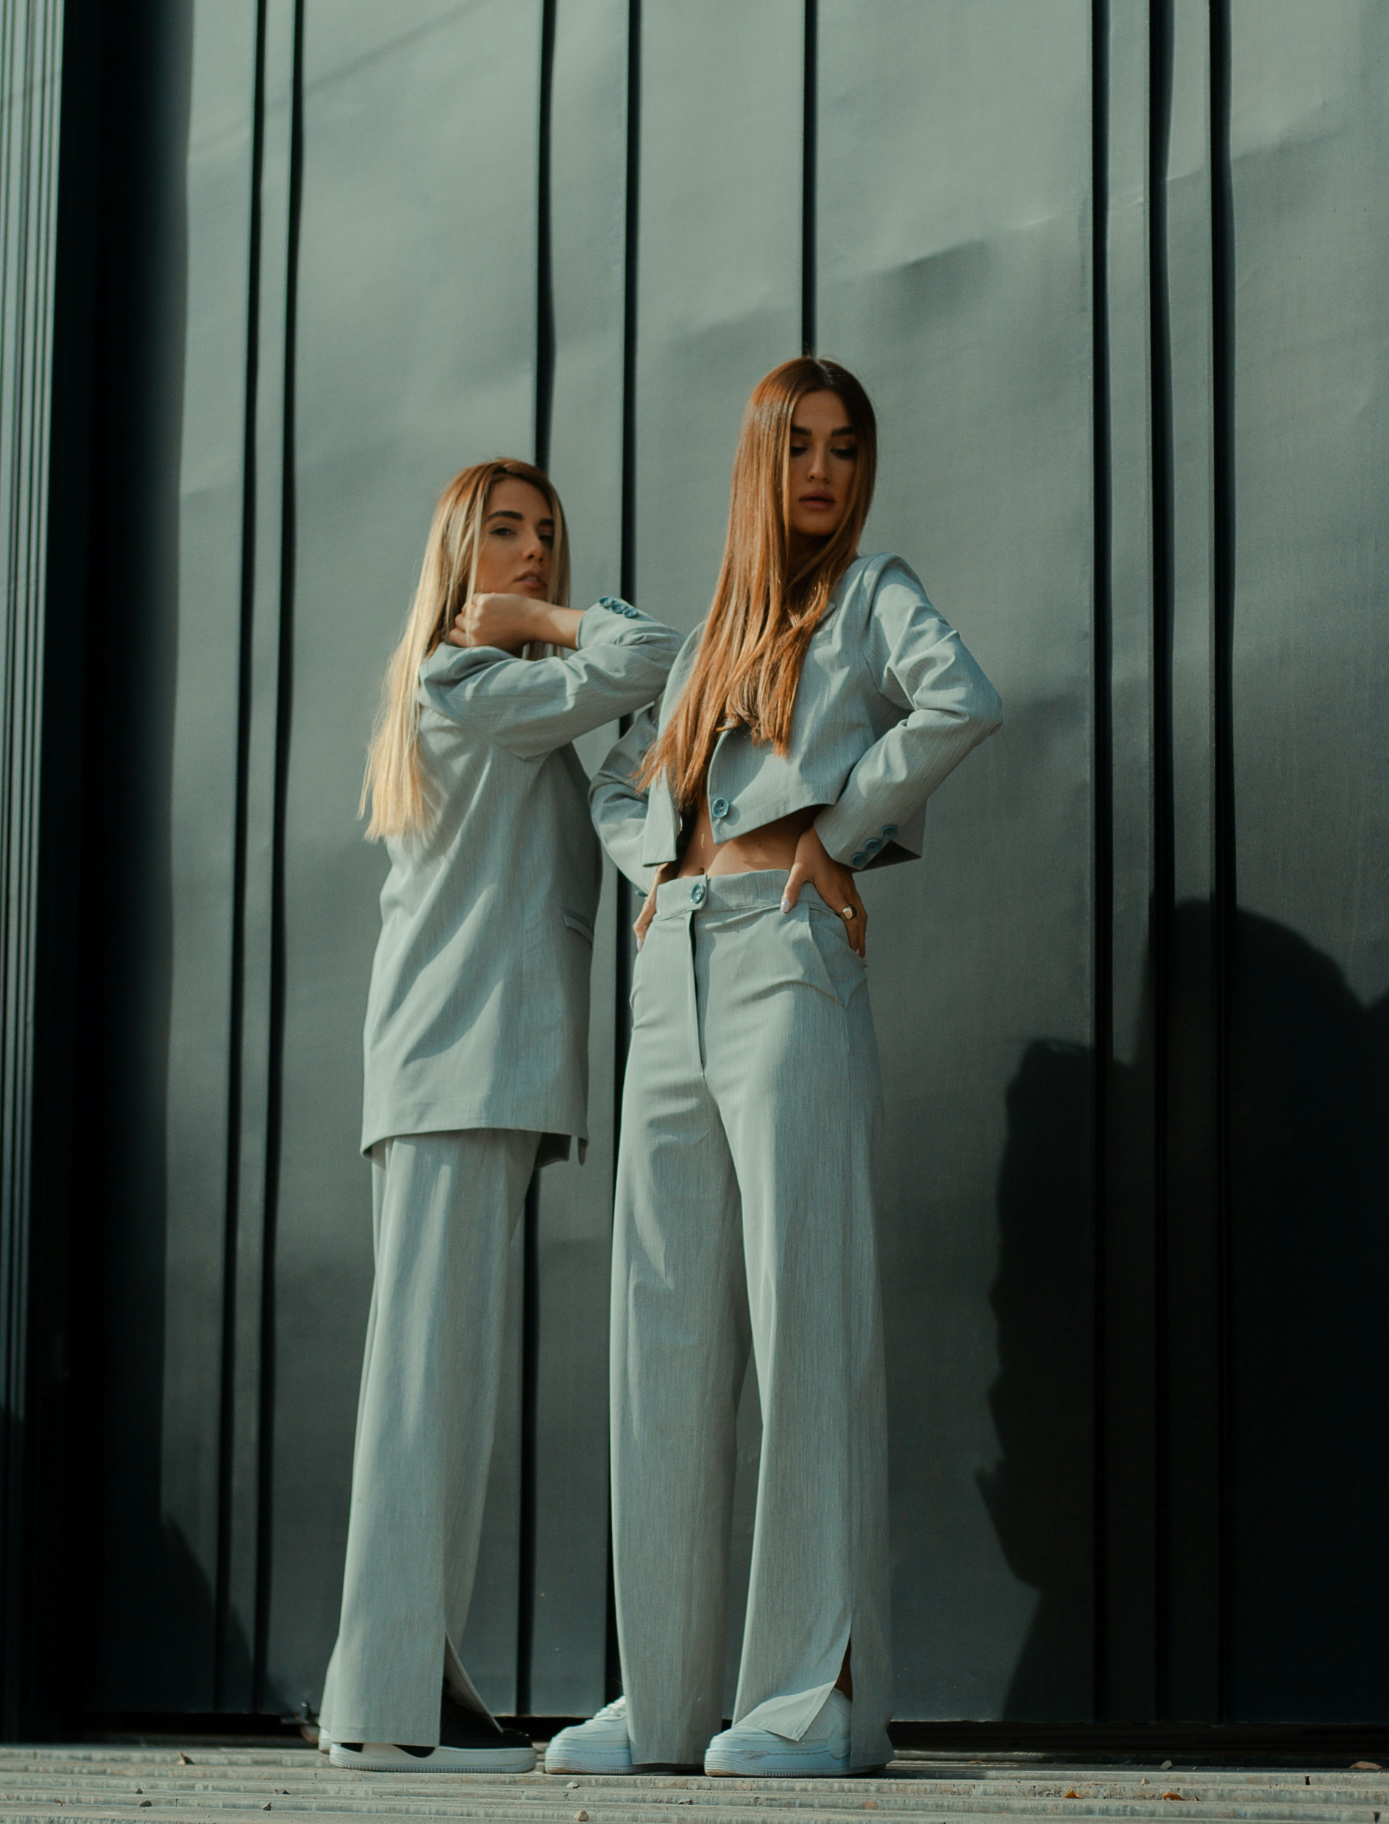
Timeless Design
Design clothing with basic silhouettes and neutral colors that don’t go out of style quickly.
Design simple, modular garments that can be worn in multiple ways, this offers versatility and reduces the need for additional garments.
Photo by MohamadReza Khashay on Unsplash

Slide 37
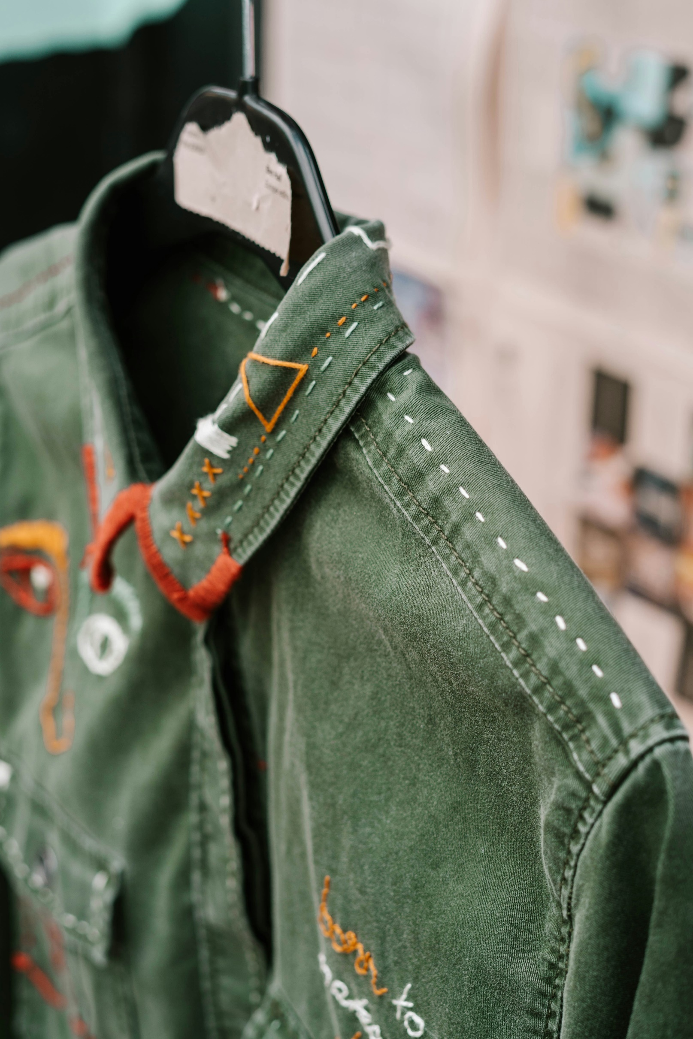
Longevity in Design
Longevity in design means prolonging the lifespan of a garment. This can be achieved by:
Reinforced seams and stress points.
Use resilient closures that can be easy to replace.
Design clothing that can be easily washed and repaired.
Photo by Toa Heftiba on Unsplash

Slide 38
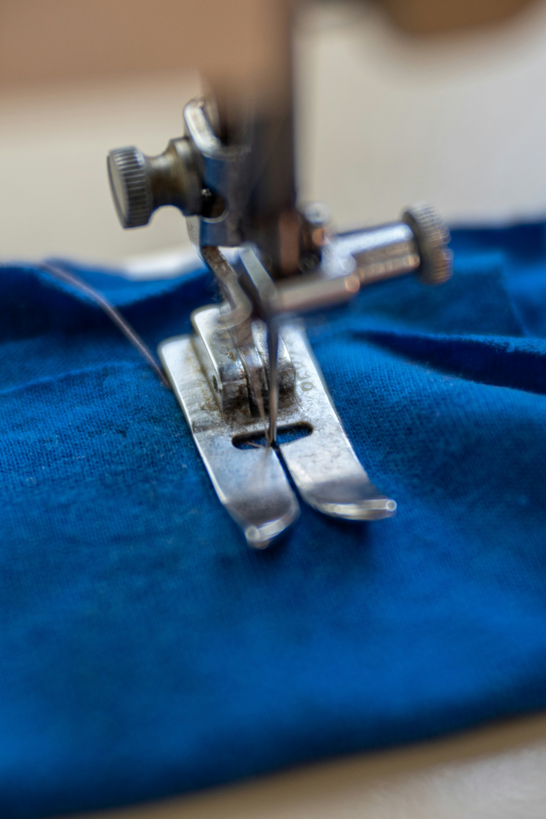
Repairability in Design
Design garments that are easy to repair. Brands to offer repair kits for consumers.
Designers to encourage users to repair their garments rather than discard them. Making visible mending, part of the design.
Brands can offer repair services as part of the product lifecycle, encouraging consumers to extend the life of their garments rather than replace them.
Photo by Bozhin Karaivanov on Unsplash

Slide 39
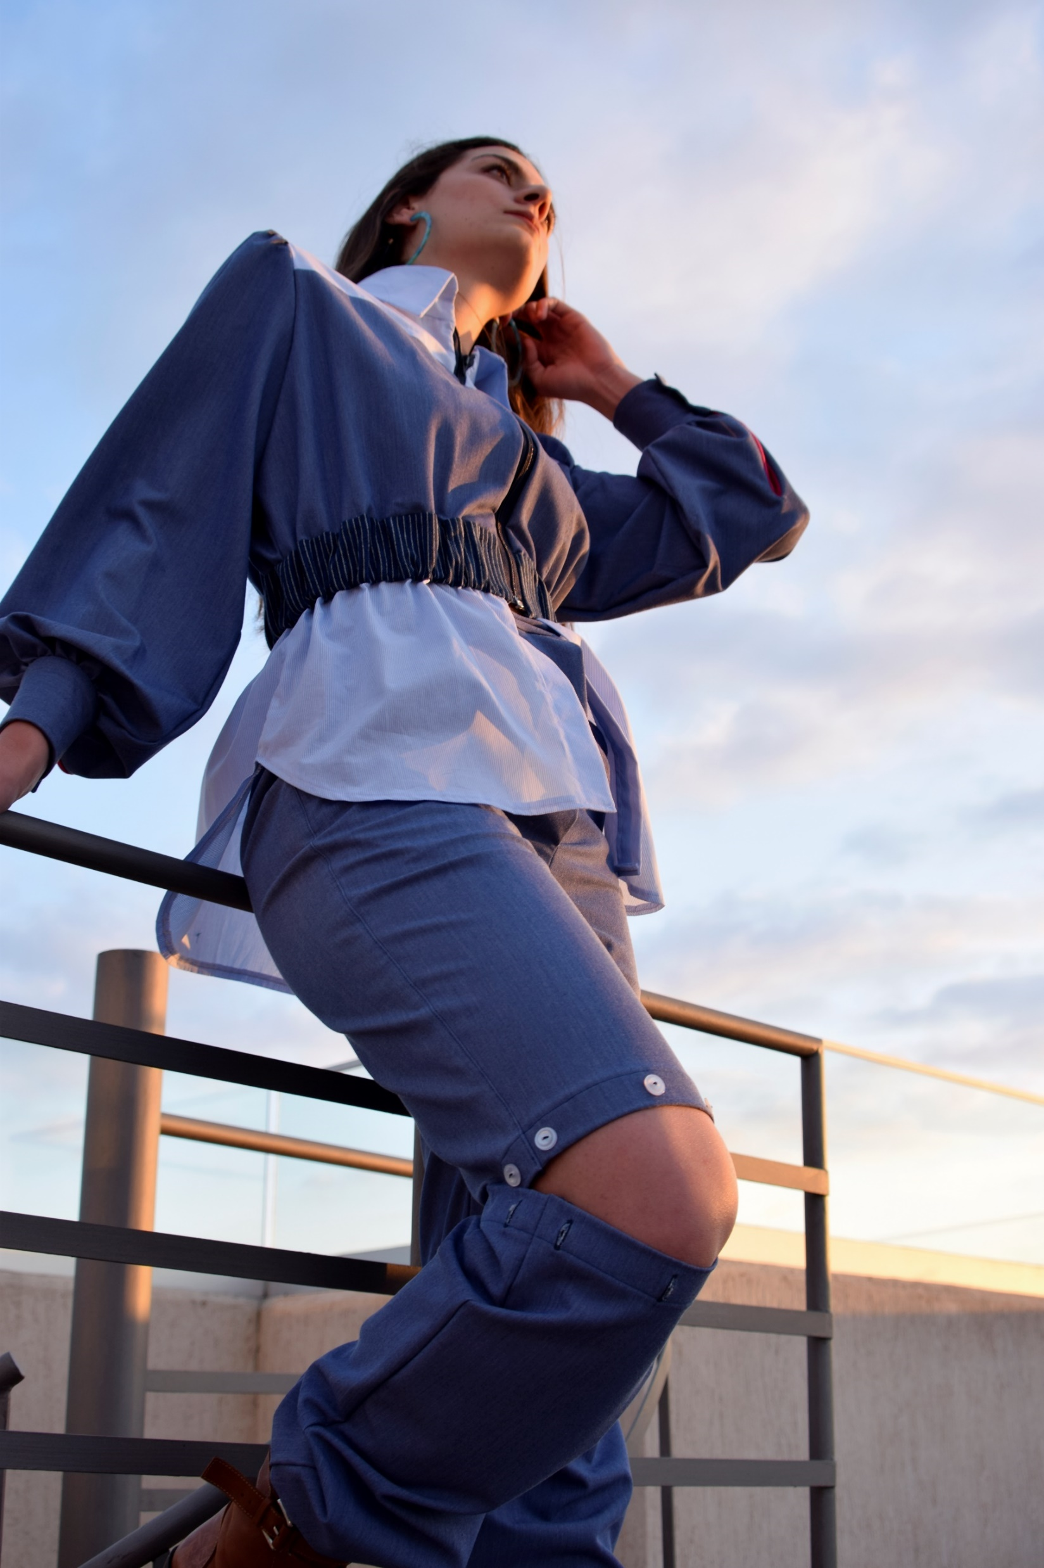
Adaptable and Modular Garments
Design garments which allows adjustable sizing with the use elastic panels, adjustable waistbands, or extendable hemlines.
Design Garments with interchangeable components to allow customization, repair, or restyling of garments.
Design and create garments which are multi-functional and serve more than one purpose.
Clothing by: Angela Michail

Slide 40
Designing for Disassembly and Upcycling
Design garments that can be easily disassembled into their components such as zippers and buttons. This will make it possible for the garment to be recycled or upcycled.
Use fabrics and patterns that are simple allowing the garment to be upcycled with minimal alterations.

Slide 41
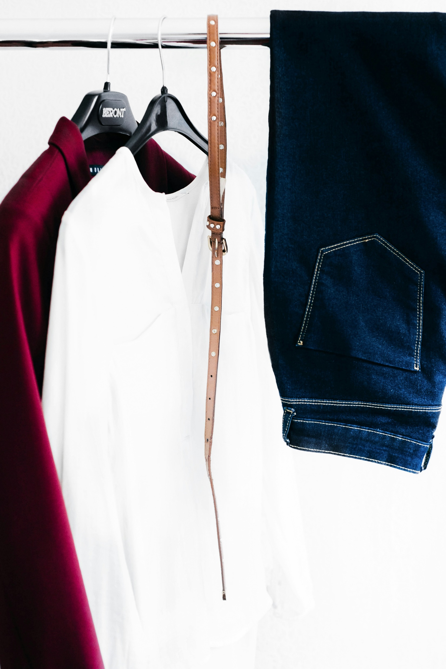
Circular Business Model Integration
Brands to design Take-back schemes, where garments will be returned to the manufacturer at the end of its life, ensuring that materials can be recycled or reused correctly.
Brands to design clothes specifically for rental programs. Garments need to be durable, easy to clean, and versatile enough to appeal to many consumers.
Photo by Alexandra Gorn on Unsplash

Slide 42
Educating Consumers
Educate consumers on how to repair and care for their clothing properly, to extend the lifespan of the their garment.
Offer consumers guides or tutorials on how to personalize or repurpose their clothing, extending the life of the garments while tapping into their creativity and desire for individuality.
Required Reading:
What is Circular Fashion?
CIRCULAR DESIGN KIT Design strategies for material cyclability and longevity.

Slide 43




References
Bajekal, N. (2023) TIME: Stella McCartney on Wanting to Make Fashion More Sustainable. Available at: www.time.com/6302562/stella-mccartney-sustainability-interview-lvmh/
Blum, P. (2021) Circular Fashion: Making the Fashion Industry Sustainable. UK: Laurence King Publishing
Business Insider (2023) How Millions of Jeans Get Recycled Into New Pairs. Worldwide Waste.
Available at: www.youtube.com/watch?v=hV_-yJ6NiP8&si=ayg27XqS4rB-JG8y
Circular.Fashion (2019) CIRCULAR DESIGN KIT Design strategies for material cyclability and longevity. Available at: www.circular.fashion/downloads/2021_circular.fashion_circular_design_kit.pdf
D.W Planet (2024) Can we really recycle our old Clothes. Available at: www.youtube.com/watch?v=YvBS6qagQdE&si=VnNju3QgrXaCBkeM
Ellen Macarthur Foundation (2024) Redesigning the Future of Fashion. Available at: www.ellenmacarthurfoundation.org/topics/fashion/overview

Slide 44
European Commission (2024) EU Strategy for Sustainable and Circular Textiles. Available at: Textiles strategy - European Commission
Hertantyos, S. (2024) 14 Textile recycling companies Pushing for Circularity in Fashion. Available at: www.consciousfashion.co/guides/textile-recycling-companies
Patagonia (2024) Patagonia's Mission Statement. Available at: www.patagonia.com.hk/pages/our-mission
Patagonia (2020) ReCrafted | These Are Clothes Made From Other Clothes. Available at: www.youtube.com/watch?v=aBpSziExmA8
Samatvam Academy (2016) Patagonia: The Sustainability Champions. Available at: www.youtube.com/watch?v=bB8ZWOKoygY
Sustainable Fashion Forum. (2024) What is Circular Fashion? Available at: www.thesustainablefashionforum.com/pages/what-is-circular-fashion

